Slide 1
AI Apps for STEM and Professional Studies
Presenters:
Dr. Jason Yao
Dr. Chuck Lesko
Dr. Bob O'Halloran
Dr. Lucky Xue
Moderated by:
Dr. John Southworth

Slide 2
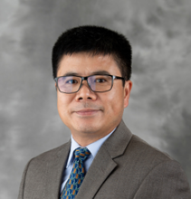
Preparing Engineering Students for the AI Age Workplace
With an Elective Course
Dr. Jason Yao

Slide 3
Disruptive or Revolutionary?
Is GenAI

Slide 4
What Is Disruptive Innovation?
The process in which a smaller company, usually with fewer resources, can challenge an established business (often called an “incumbent”) by entering at the bottom of the market and continuing to move up-market. Steps:
Incumbent businesses develop their products or services to appeal to their most demanding and/or profitable customers, ignoring the needs of those down-market.
Entrants target this ignored market segment and gain traction by meeting their needs at a reduced cost compared to what is offered by the incumbent.
Incumbents don’t respond to the new entrant, continuing to focus on their more profitable segments.
Entrants eventually move upmarket by offering solutions that appeal to the incumbent’s “mainstream” customers.
Once the new entrant has begun to attract the incumbent business’s mainstream customers en masse, disruption has occurred.

Slide 5
GenAI is Revolutionary

Slide 6
To predict the future, we must look at the past. -- Marcus Aurelius
Future
Now
Past

Slide 7
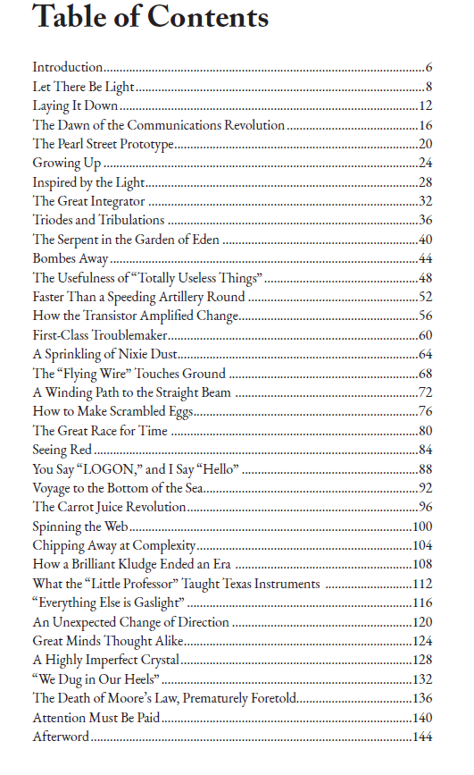
Past #1
If you’re curious about the innovations that underpin our technology-dominated world, check out Inspiring Technology: 34 Breakthroughs. This marvelous book consists of delightful, detail-packed stories about key “breakthroughs” in electrical engineering, from Maxwell‘s Equations in the 19th century to ChatGPT in the 21st. I wish I’d had a book like this when I started my career as a science journalist.
—JOHN HORGAN Director, Center for Science Writings, Stevens Institute of Technology Author of The End of Science, The Undiscovered Mind, and Rational Mysticism

Slide 8
Past #2

Slide 9
Now The ChatGPT Course Project
Investigate the capabilities of ChatGPT and gain insights into its advantages and potential implications:
Use ChatGPT to generate VBA macros to process and visualize data
Discuss ChatGPT's potential applications and possible concerns in engineering

Slide 10
ChatGPT Applications
Create and run VBA macros in Excel
Process data using AI tools (ChatGPT)
Visualize data using AI tools (ChatGPT)

Slide 11
Example #1 Data-cleaning
ENGR1016 Final Exam (1170975) | Experiential Learning Exploration (1142100) | Attendance/Participation Current Score | Attendance/Participation Unposted Current Score | Attendance/Participation Final Score | Attendance/Participation Unposted Final Score | Homework Current Score | Homework Unposted Current Score | Homework Final Score | Homework Unposted Final Score | Project Reports Current Score | Project Reports Unposted Current Score | Project Reports Final Score | Project Reports Unposted Final Score | Midterm Exam Current Score | Midterm Exam Unposted Current Score | Midterm Exam Final Score | Midterm Exam Unposted Final Score | Final Exam Current Score | Final Exam Unposted Current Score
40.33 |  | 84.51 | 84.51 | 84.51 | 84.51 | 75 | 75 | 75 | 75 | 71.11 | 71.11 | 71.11 | 71.11 | 50 | 50 | 50 | 50 | 40.33 | 40.33
79 |  | 95.58 | 95.58 | 95.58 | 95.58 | 74.38 | 74.38 | 74.38 | 74.38 | 85 | 85 | 85 | 85 | 72.55 | 72.55 | 72.55 | 72.55 | 79 | 79
66 |  | 86.73 | 86.73 | 86.73 | 86.73 | 52.5 | 52.5 | 52.5 | 52.5 | 77.78 | 77.78 | 77.78 | 77.78 | 82.35 | 82.35 | 82.35 | 82.35 | 66 | 66
83 | 3 | 88.5 | 88.5 | 88.5 | 88.5 | 79.38 | 79.38 | 79.38 | 79.38 | 81.94 | 81.94 | 81.94 | 81.94 | 72.55 | 72.55 | 72.55 | 72.55 | 83 | 83
73 |  | 62.39 | 62.39 | 62.39 | 62.39 | 50.63 | 50.63 | 50.63 | 50.63 | 71.11 | 71.11 | 71.11 | 71.11 | 65.69 | 65.69 | 65.69 | 65.69 | 73 | 73
81 |  | 93.81 | 93.81 | 93.81 | 93.81 | 88.75 | 88.75 | 88.75 | 88.75 | 76.11 | 76.11 | 76.11 | 76.11 | 92.16 | 92.16 | 92.16 | 92.16 | 81 | 81
96 |  | 71.68 | 71.68 | 71.68 | 71.68 | 83.75 | 83.75 | 83.75 | 83.75 | 87.5 | 87.5 | 87.5 | 87.5 | 86.27 | 86.27 | 86.27 | 86.27 | 96 | 96
77 |  | 77.43 | 77.43 | 77.43 | 77.43 | 43.13 | 43.13 | 43.13 | 43.13 | 81.67 | 81.67 | 81.67 | 81.67 | 69.61 | 69.61 | 69.61 | 69.61 | 77 | 77
76 |  | 98.23 | 98.23 | 98.23 | 98.23 | 59.38 | 59.38 | 59.38 | 59.38 | 70.28 | 70.28 | 70.28 | 70.28 | 81.37 | 81.37 | 81.37 | 81.37 | 76 | 76
78 |  | 98.67 | 98.67 | 98.67 | 98.67 | 86.88 | 86.88 | 86.88 | 86.88 | 81.94 | 81.94 | 81.94 | 81.94 | 72.55 | 72.55 | 72.55 | 72.55 | 78 | 78
44 |  | 90.71 | 90.71 | 90.71 | 90.71 | 81.33 | 81.33 | 81.33 | 81.33 | 75.56 | 75.56 | 75.56 | 75.56 | 69.61 | 69.61 | 69.61 | 69.61 | 44 | 44
75 |  | 83.19 | 83.19 | 83.19 | 83.19 | 93.75 | 93.75 | 93.75 | 93.75 | 83.61 | 83.61 | 83.61 | 83.61 | 85.29 | 85.29 | 85.29 | 85.29 | 75 | 75
71 |  | 86.28 | 86.28 | 86.28 | 86.28 | 74.38 | 74.38 | 74.38 | 74.38 | 79.17 | 79.17 | 79.17 | 79.17 | 61.76 | 61.76 | 61.76 | 61.76 | 71 | 71
87 |  | 83.63 | 83.63 | 83.63 | 83.63 | 64.38 | 64.38 | 64.38 | 64.38 | 82.5 | 82.5 | 82.5 | 82.5 | 73.53 | 73.53 | 73.53 | 73.53 | 87 | 87
68 |  | 97.79 | 97.79 | 97.79 | 97.79 | 88.75 | 88.75 | 88.75 | 88.75 | 81.11 | 81.11 | 81.11 | 81.11 | 62.75 | 62.75 | 62.75 | 62.75 | 68 | 68
79 | 4 | 96.02 | 96.02 | 96.02 | 96.02 | 89.38 | 89.38 | 89.38 | 89.38 | 83.06 | 83.06 | 83.06 | 83.06 | 85.29 | 85.29 | 85.29 | 85.29 | 79 | 79
72 | 5 | 96.02 | 96.02 | 96.02 | 96.02 | 86.25 | 86.25 | 86.25 | 86.25 | 78.33 | 78.33 | 78.33 | 78.33 | 74.51 | 74.51 | 74.51 | 74.51 | 72 | 72
69 |  | 85.84 | 85.84 | 85.84 | 85.84 | 75 | 75 | 75 | 75 | 76.39 | 76.39 | 76.39 | 76.39 | 60.78 | 60.78 | 60.78 | 60.78 | 69 | 69
73 |  | 100 | 100 | 100 | 100 | 84.38 | 84.38 | 84.38 | 84.38 | 77.78 | 77.78 | 77.78 | 77.78 | 77.45 | 77.45 | 77.45 | 77.45 | 73 | 73
71 | 1 | 85.4 | 85.4 | 85.4 | 85.4 | 55.63 | 55.63 | 55.63 | 55.63 | 82.22 | 82.22 | 82.22 | 82.22 | 70.59 | 70.59 | 70.59 | 70.59 | 71 | 71
89 |  | 91.15 | 91.15 | 91.15 | 91.15 | 62.5 | 62.5 | 62.5 | 62.5 | 82.5 | 82.5 | 82.5 | 82.5 | 69.61 | 69.61 | 69.61 | 69.61 | 89 | 89
86 |  | 96.46 | 96.46 | 96.46 | 96.46 | 93.13 | 93.13 | 93.13 | 93.13 | 80.83 | 80.83 | 80.83 | 80.83 | 84.31 | 84.31 | 84.31 | 84.31 | 86 | 86
98 |  | 94.25 | 94.25 | 94.25 | 94.25 | 85 | 85 | 85 | 85 | 83.33 | 83.33 | 83.33 | 83.33 | 83.33 | 83.33 | 83.33 | 83.33 | 98 | 98

Slide 12
Example #2: Faculty SCH Generation
Banner Crn | Subj | Crse Num | Sect | Crdt Hr | Enrollmt | Bldg Code | Room | M | T | W | T | F | Inst Last Name | Instructional Method | Synchronous or Asynchronous?
34542 | MATH | 2200 | 601 | 3 | 45 |  |  |  |  |  |  |  | Amedha | Web | Asynchronous
34544 | MATH | 2210 | 601 | 3 | 23 |  |  |  |  |  |  |  | TBD-Petterner | Web | Asynchronous
34546 | MATH | 2210 | 602 | 3 | 14 |  |  |  |  |  |  |  | TBD-Petterner | Web | Asynchronous
34557 | MATH | 2400 | 601 | 3 | 41 |  |  |  |  |  |  |  | TBD-Barrine | Web | Asynchronous
34559 | MATH | 2400 | 602 | 3 | 22 |  |  |  |  |  |  |  | TBD-Barrine | Web | Asynchronous
34578 | MATH | 2600 | 003 | 2 | 39 | RAWL | 00309 | M |  | W |  |  | TBD-Kinsinger | HF2F | Returned to Campus
34583 | MATH | 2650 | 602 | 3 | 26 |  |  |  | T |  | R |  | Mushi | Web | Asynchronous
34579 | MATH | 2650 | 601 | 3 | 5 |  |  | M |  | W |  |  | Mushi | Web | Asynchronous
34585 | MATH | 2700 | 601 | 3 | 49 |  |  |  |  |  |  |  | Noans | Web | Asynchronous
34590 | MATH | 2700 | 602 | 3 | 4 |  |  |  |  |  |  |  | Noans | Web | Asynchronous
34595 | MATH | 2701 | 003 | 3 | 20 | SCITEC | 00149 |  |  |  |  | F | Noans | HF2F | Returned to Campus
34592 | MATH | 2701 | 001 | 3 | 20 | SCITEC | 00149 |  | T |  |  |  | Noans | HF2F | Returned to Campus
34594 | MATH | 2701 | 002 | 3 | 19 | SCITEC | 00149 |  |  |  | R |  | Noans | HF2F | Returned to Campus
34597 | MATH | 2701 | 004 | 3 | 8 | SCITEC | 00149 |  |  |  |  | F | Noans | HF2F | Returned to Campus
34622 | MATH | 2950 | 601 | 3 | 36 |  |  |  |  |  |  |  | Namian | Web | Asynchronous
34625 | MATH | 2950 | 602 | 3 | 11 |  |  |  |  |  |  |  | Namian | Web | Asynchronous
34738 | MATH | 3150 | 601 | 3 | 37 |  |  | M |  | W |  | F | Proudove | Web | Synchronous
34739 | MATH | 3150 | 602 | 3 | 9 |  |  | M |  | W |  | F | Proudove | Web | Synchronous
34744 | MATH | 3500 | 602 | 3 | 40 |  |  |  | T |  | R |  | Amedha | Web | Asynchronous
34740 | MATH | 3500 | 601 | 3 | 3 |  |  | M |  | W |  |  | Amedha | Web | Asynchronous
34745 | MATH | 3710 | 601 | 3 | 57 |  |  | M |  | W |  |  | Wrangler | Web | Synchronous
34747 | MATH | 3710 | 602 | 3 | 23 |  |  | M |  | W |  |  | Wrangler | Web | Asynchronous
34755 | MATH | 4000 | 601 | 2 | 45 |  |  |  | T |  | R |  | Proudove | Web | Synchronous
34757 | MATH | 4000 | 602 | 2 | 12 |  |  |  | T |  | R |  | Proudove | Web | Synchronous
34762 | MATH | 4010 | 602 | 3 | 22 |  |  | M |  | W |  | F | Wilmington | Web | Synchronous
34760 | MATH | 4010 | 601 | 3 | 21 |  |  | M |  | W |  | F | Wilmington | Web | Synchronous
34763 | MATH | 4100 | 601 | 3 | 23 |  |  |  |  |  |  |  | TBD-Brandenburg | Web | Asynchronous
34767 | MATH | 4100 | 602 | 3 | 2 |  |  |  |  |  |  |  | TBD-Brandenburg | Web | Asynchronous
34772 | MATH | 4200 | 602 | 3 | 42 |  |  |  | T |  | R |  | Wilmington | Web | Synchronous
34770 | MATH | 4200 | 601 | 3 | 7 |  |  | M |  | W |  |  | Wilmington | Web | Synchronous
34776 | MATH | 4300 | 602 | 3 | 37 |  |  |  |  | W |  |  | TBD-Prince | Web | Asynchronous
34775 | MATH | 4300 | 601 | 3 | 9 |  |  | M |  |  |  |  | TBD-Prince | Web | Asynchronous
34779 | MATH | 4320 | 601 | 3 | 24 |  |  |  |  |  |  |  | Raberson | Web | Asynchronous
34781 | MATH | 4320 | 603 | 3 | 25 |  |  |  |  |  |  |  | Raberson | Web | Asynchronous
34780 | MATH | 4320 | 602 | 3 | 25 |  |  |  |  |  |  |  | Raberson | Web | Asynchronous
34783 | MATH | 4340 | 602 | 3 | 37 |  |  |  |  |  |  |  | TBD-Barber | Web | Asynchronous
34782 | MATH | 4340 | 601 | 3 | 3 |  |  |  |  |  |  |  | TBD-Barber | Web | Asynchronous
34797 | MATH | 4400 | 003 | 3 | 17 |  |  |  | T |  | R |  | TBD-Kinsinger | HF2F | Returned to Campus
34801 | MATH | 4500 | 601 | 1 | 18 |  |  |  | T |  |  |  | Wrangler | Web | Asynchronous

Slide 13
What is a Macro?
A sequence of instructions that automate tasks.
Written in VBA and can be triggered by specific actions.
Save time and reduce errors in repetitive tasks.
Why Use Macros?
Efficiency: Automate repetitive tasks.
Accuracy: Reduce human errors.
Consistency: Ensure tasks are performed the same way every time.
Productivity: Free up time for more complex tasks.

Slide 14
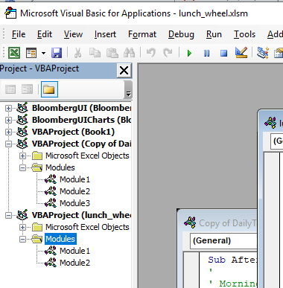
Accessing the VBA Editor
Open Excel.
Press Alt + F11 to open the VBA Editor.
Alternatively, go to the "Developer" tab and click on "Visual Basic".

Slide 15
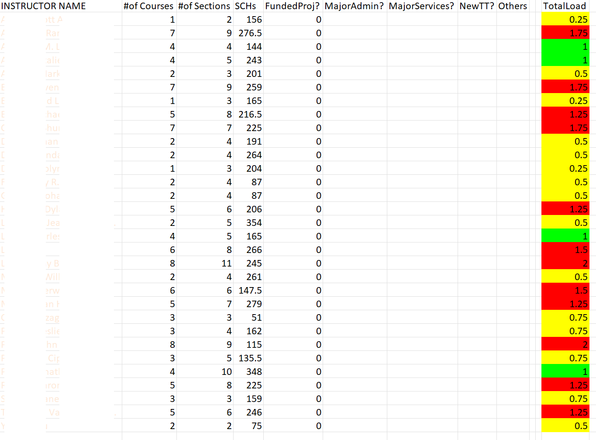

Slide 16
Data processing during the AI age
Instructions → Intentions

Slide 17
Students Using GenAI?

Slide 18
Students Perception Regarding AI Tools

Slide 19
Student Perception on Ethical Implications

Slide 20
Conclusions
Students’ awareness is crucial
Students need intentional preparation
Skill development
Ethics reminders
Navigation guidance
Hands-on experiences are helpful

Slide 21
Dr. Chuck Lesko
Department of Technology Systems

Slide 22
Should I dive in…?

Slide 23
A Recent AI Timeline
McCarthy
“Artificial
Intelligence”
Deep Blue
Beats Kasparov
Roomba is 1st Robo Vacuum cleaner
Amazon launches Alexa
ChatGPT made public
1956
1997
2002
2014
2022
1950
1964
1999
2011
2020
2025
Turing Test
Weizenbaum
Chatbot
Sony Launches AiBO
Apple integrates Siri into iPhone
GPT-3 is Introduced
Ethical AI & Regs
Multimodal AI
ChatGPT-5
Conversational AI
AI Chatbot builders
Small language Models

Slide 24
International Organization for Standardization (ISO)
ISO was founded with the idea of answering a fundamental question: “what's the best way of doing this?”
Standards are the distilled wisdom of people with expertise in their subject matter and who know the needs of the organizations they represent – people such as manufacturers, sellers, buyers, customers, trade associations, users or regulators.

Slide 25
ISO/IEC JTC 1 - Information Technology
ISO has a joint technical committee (JTC) with the International Electrotechnical Commission (IEC) to develop standards relating to information technology (IT). Known as JTC 1 and entitled "Information technology", it was created in 1987; its mission is "to develop worldwide Information and Communication Technology (ICT) standards for business and consumer applications."

Slide 26
ISO/IEC JTC 1/SC 42 - Artificial intelligence
At the 32nd ISO/IEC JTC 1 Plenary in Vladivostok, Russia in (Oct 2017), Resolution 12 established SC 42 as a system integration entity for Artificial Intelligence. The resolution also appointed Mr. Wael William Diab as Chair of the SC and Ms. Heather Benko was appointed as the Committee Manager. The inaugural meeting was held in Beijing, China in April 2018.
(39) p-members: Australia, Austria, Azerbaijan, Belgium, Canada, China, Cyprus, Congo, Denmark, Egypt, Finland, France, Germany, India, Ireland, Israel, Italy, Japan, Kazakhstan, Korea, Luxembourg, Malaysia Malta, Netherlands, Norway, Philippines, Portugal, Russian Federation, Rwanda, Saudi Arabia, Singapore, Slovakia, Spain, Sweden, Switzerland, Turkey, Uganda, United Kingdom, United States, Zimbabwe.
Liaisons: Big Data Value AISBL (BDVA); Consumers International (CI); European Commission (EC); European Trade Union Confederation (ETUC); Institute of Electrical and Electronics Engineers (IEEE); International Telecommunication Union (ITU); Open Geospatial Consortium (OGC); Small Business Standards (SBS); UNESCO; World Trade Organization (WTO)

Slide 27
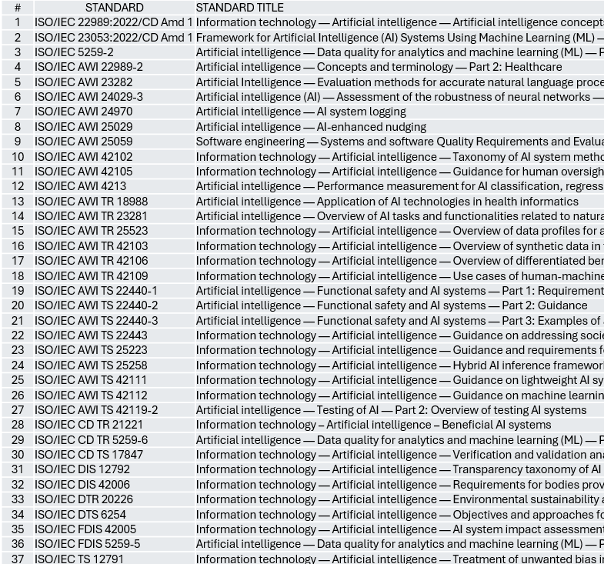
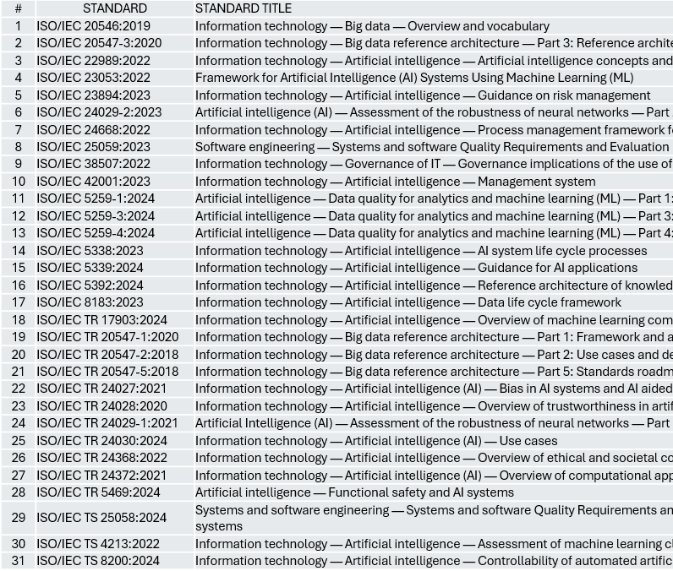
AI-Related ISO Standards
(37) Standards In Development
(31) Established Standards

Slide 28
A New Proposed ISO Standard
ISO 215xx – Proposed Title (Projects, programmes, portfolios management — Artificial intelligence — Concepts, applications, and implications)
Areas of focus for this standard to include:
AI governance
Machine Learning
Project/Programme Planning
Benefit management
Scope & Resources management
Cost & Schedule management
Risk & Issues management
Information and document management
Ethical considerations
Data quality, accuracy, bias and completeness
Privacy & Transparency
Socioeconomic inequality

Slide 29
Beginning Steps with Senior Capstone Course

Slide 30
Beginning Steps with Senior Capstone Course

Slide 31
Key AI Considerations
Promote AI innovation
Keep humans at the center of AI
Take an incremental approach to AI implementation
Consider industry/sector specific areas
Guard against AI unintentional/malicious use
I

Slide 33
Artificial Intelligence & Hospitality Business: A good partnership!
How can AI mesh with guest service to act as a framework for effective communications and guest satisfaction?
Hoteliers who do not engage with AI and its applications will be left behind.
Dr. Bob O'Halloran

Slide 34
Hospitality Goal – AI as a Tool
Hospitality industry seeks to embrace AI for its support and enhancement of: guest experiences,
Operational efficiency,
Planning and
Positive impact on the bottom line.

Slide 35
Applications
Operations
Revenue management
Marketing
Sales
Guest experiences
Human Resources

Slide 36
AI Tasks
Chatbots
Repetitive tasks
Predictive analytics-forecast, revenue management
Lodging operations – housekeeping, sensors
Maintenance- Climate control
Predictive customer care -staffing
Recruitment and selection

Slide 37
Benchmarks
Connie- Hilton
IBM Watson AI
Plus Marriott, Accor etc.

Slide 38
ChatGPT- response: AI recommended Applications
Personalized Guest Experiences: I reiterate that a balance is needed to provide optimal guest service. Technological efficiency and labor savings are great but not at the expense of guest service. A deep dive into target market segments and their demographics and preferences is in order.
Dynamic Pricing: AI can perform these tasks more quickly, but a reminder that the decisions on pricing are made by people. The machines are providing tools for decision-making).
Chatbots and Virtual Assistants: Again, I refer to market segments and knowing your guests. I hate talking to machines.
Operational Efficiency: This ties AI to sustainability and efficiency of operation. AI is perhaps a tool to help sustainability become truly mainstream in decision-making processes.

Slide 39
Continued
5. Staffing Optimization: As previously discussed, AI analysis of booking patterns can optimize staffing levels to provide the optimal level of service needed for a hotel.
6. Fraud Detection: AI can provide additional support for fraud detection and prevention.
7. Sentiment Analysis: A great tool, but managers and owners will need to input the needed parameters to help interpret guest feedback. Maybe the guest is not always right, but an appreciation of their impressions of receiving good value for the price charged is great information.)
8. Enhanced Booking Platforms: I can only imagine that booking engines will get better and make the experience easier and smoother than ever. The booking online platforms on a computer or using mobile apps are not always easy to navigate.

Slide 40
CHATGPT – Benchmark topics
Data-Driven Decision Making: Establish robust data collection and management systems to ensure accurate, comprehensive data is available for AI algorithms.
Personalization Strategies: Utilize AI to analyze guest data and tailor experiences, from personalized marketing to customized room settings.
Integrating AI with Existing Systems: Ensure that AI tools seamlessly integrate with existing property management systems (PMS), customer relationship management (CRM) systems, and other operational technologies for smooth functionality.
Real-Time Analytics: Implement AI solutions that provide real-time data insights, allowing hotel managers to respond quickly to changing market conditions, guest needs, and operational challenges.
Cross-Department Collaboration: Foster collaboration between departments (marketing, operations, customer service) to share insights gained from AI, ensuring that all teams are aligned in their approach to enhancing guest experiences.

Slide 41
Continued…
Continuous Learning and Adaptation: Regularly update AI models based on new data and changing market dynamics. Result: This ensures that AI systems remain effective and relevant.
Customer Feedback Integration: Use AI to analyze guest feedback and reviews continuously, identifying areas for improvement and adapting services accordingly.
Training and Development: Invest in training staff to work effectively with AI tools, ensuring they understand how to leverage AI insights in their daily operations and interactions with guests.
Ethical AI Practices: Prioritize transparency and ethical considerations in AI deployment, particularly regarding data privacy and security, to build trust with guests.
Scalability: Choose AI solutions that can scale with the organization’s growth, ensuring they can handle increased data and complexity as the brand expands.

Slide 42
AI in Business Analytics Studies
Dr. Lucky Xue

Slide 43
Generative AI in Business Analytics
Automating data analysis and visualization.
Enhancing decision-making with predictive modeling.
Personalizing customer experiences.
Improving operational efficiencies.

Slide 44
GAI in Accounting
Automated financial reporting and auditing.
Fraud detection through anomaly detection models.
Predictive cash flow forecasting.
Tax compliance automation.

Slide 45
GAI in Marketing
Personalized content creation for ads and campaigns.
Customer sentiment analysis for brand management.
Market trend predictions for strategic planning.
Chatbots and virtual assistants for customer engagement.

Slide 46
GAI in Insurance
Automated risk assessment and underwriting.
Fraud detection and claims processing.
Personalized insurance policy recommendations.
Predictive analytics for loss prevention.

Slide 47
GAI in Supply Chain & Operations
Demand forecasting and inventory management.
Route optimization for logistics.
Supplier risk assessment using AI insights.
Real-time anomaly detection in supply chain data.

Slide 48
Future of Generative AI in Business Analytics
AI-driven decision support systems.
Integration with Internet of Things (IoT) for real-time insights.
Advanced AI models for hyper-personalization.
AI-human collaboration for enhanced business intelligence

Slide 49
Panel Discussion – Question & Answer

Slide 50
Questions?
Thank you for your time
Jason Yao, PhD - yaoj@ecu.edu
Chuck Lesko, PhD - leskoc@ecu.edu
Bob O'Halloran, PhD - ohalloranr@ecu.edu
Lucky Xue, PhD - xuey@ecu.edu
John Southworth, PhD - southworthj@ecu.edu

