Slide 1
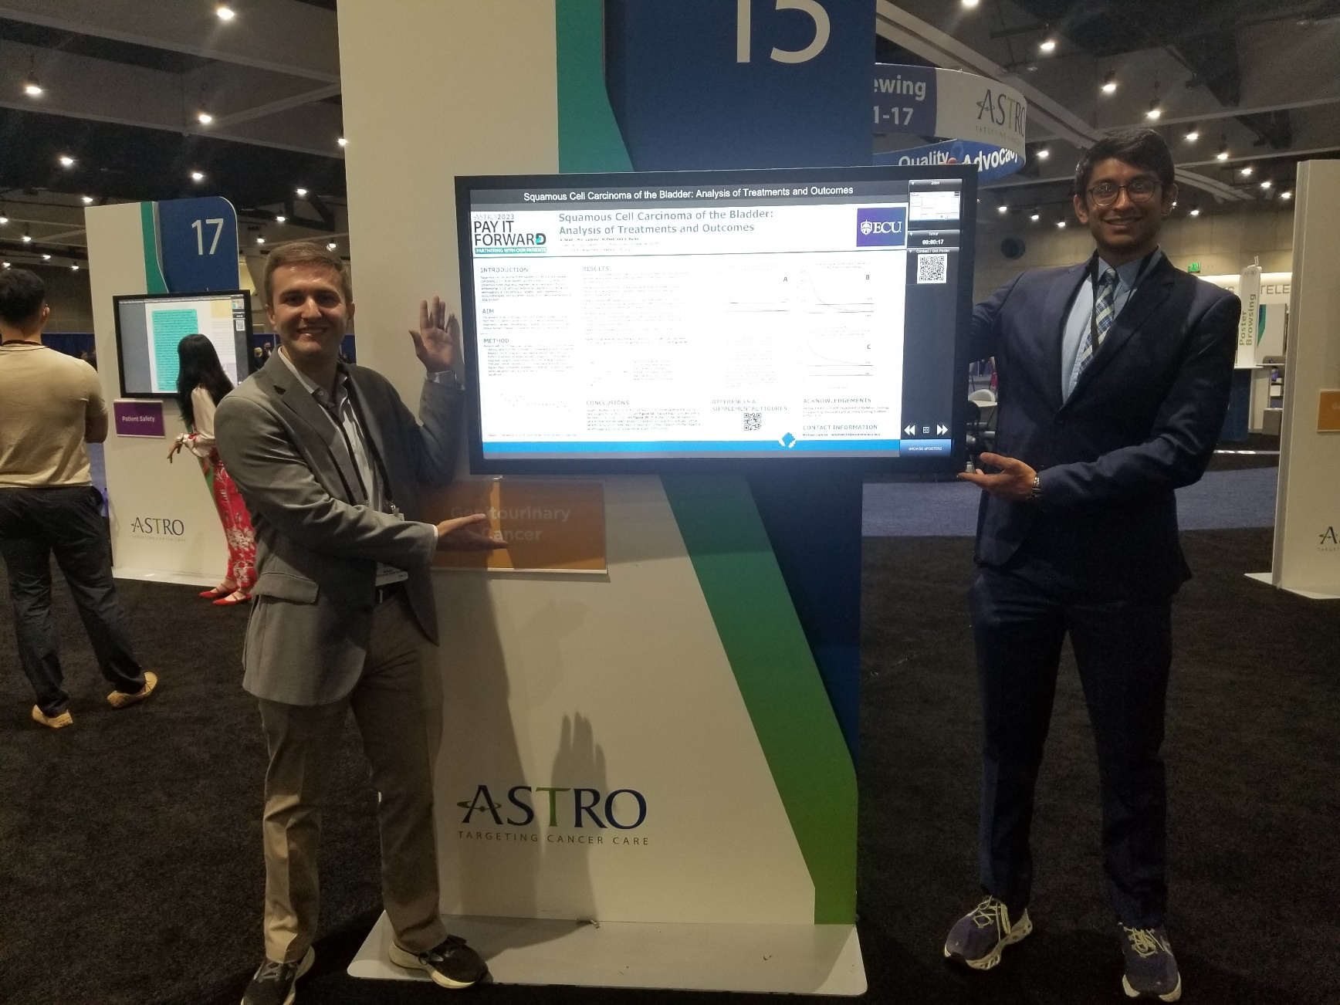
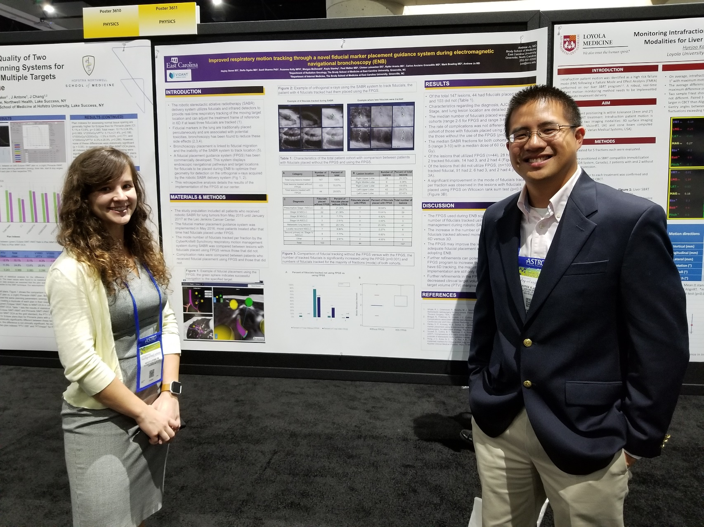
Andrew W. Ju, MD
2024/2025 Scholar Teacher
A framework for undergraduate/graduate clinical research organization
BSOM Dept. of Radiation Oncology
Greenville, North Carolina 27858
jus@ecu.edu
Introduction
Student resource characteristics:
Research organization characteristics:
The traditional structure of academic departments can limit efficient utilization of student resources available to the department
Clinical research is not often available to students below the graduate level
Doctoral students and physician residents/fellows often have competing responsibilities that limit the time available for clinical research projects
Opportunities for doctoral students to demonstrate leadership in directing research activities are often limited
A more flexible research organization that is designed to maximize the strength of the resources available can facilitate the successful completion of clinical research projects
High school students:
Strengths: Eager to participate in any sort of research including very basic tasks
Weaknesses: Clinical/medical knowledge very limited, instructions need to be direct
Special considerations: Authorization for records access often limited to age 18+
Undergraduate students:
Strengths: Eager to participate in clinical/human research, some measure of autonomy is developing
Weaknesses: Clinical/medical knowledge limited for chart reviews
Special considerations: May have availability to assist for up to 4 years if mentorships starts early
M1-2 medical school students:
Strengths: Stronger basic medical knowledge, have a summer between M1-M2 years of dedicated time, stronger
Weaknesses: Practical medical knowledge is nascent
Special considerations: Preparation for difficult classes and boards will become time consuming
M3-4 medical school students:
Strengths: Usually very motivated to finish projects for publication
Weaknesses: Clinical rotations will dictate availability
Special considerations: Sudden shifts in specialty/career interests can occur
Graduate (M.S. and Ph.D.) students:
Strengths: May have more dedicated time for research
Weaknesses: Participation in projects outside of their thesis project may be limited
Special considerations: Formal advising resources often available
Residents/fellows:
Strengths: Advanced clinical knowledge
Weaknesses: patient care will usually limit time available, dedicated research time can be difficult to organize
Special considerations: May be more willing to accept leadership roles
The “grunt work” of tedious, repetitive tasks is best suited for those who have the most time and are most eager, this starts to decrease during the M2 year
Databasing limited basic clinical data in a retrospective review may be a good use of this resource
Faculty will need to be very aware of the limitations of younger students and will need to closely supervise for errors
Very clear definitions of the data being collected will be useful, while keeping the format needed for final analysis in mind
HIPAA compliance with younger students will need extremely close supervision, safe habits will need to be developed early
CITI training will need to be taken seriously
A data collection system that allows for mistakes to be tracked back and corrected is highly recommended
Example, very frequent database backups with labels on who entered data is recommended
More senior medical students and residents/fellows should be encouraged to supervise youngers students in the analyses if feasible
Senior medical students can often recruit additional medical students for help more easily that faculty through classroom connections and can help assume responsibilities in passing the project to other students as needed
Faculty will need have awareness of when project timelines can be more flexible, and when they need to be strict based on student availability
Student presentation requirements are good opportunities for interim analyses
The students closest to submitting applications for their next stage in training will be the most motivated in moving the submission/peer review process forward
Case description
The Department of Radiation Oncology is a small department in the Brody School of Medicine at East Carolina University
Clinical research in the Department on the unique patient population of Eastern North Carolina supports the mission of the ECU Health system
The Department does not have medical residents, eliminating the usual primary source of labor for clinical research
The Department has a medical physics residency program (M.S. and Ph.D.)
Due to the limitations in basic science infrastructure in the department, clinical research is generally the avenue for tenure track faculty to generate a research portfolio
Departmental and University resources and partnerships are available to facilitate clinical research, including the following:
Opportunities for faculty to mentor high school, undergraduate, and graduate students organized by ECU
Brody Summer Scholars Program
The BSOM Research Distinction Track
The BSOM Honors Medical Research Program for Pitt County High School Students
BSOM student interest groups in related subspecialties
BSOM biostatistician support
Partnerships with the School of Public Health
Library resources:
Librarian consultations regarding journal submissions
Support for literature searches
Coverage of publication fees in select journals
Medical student research in encouraged through our Scarantino Award for the M4 student who
By working with students to maximize research output, our Department had the highest rate of publications per faculty member at BSOM in the 2023-2024 year
Conclusion
A well-organized infrastructure for project organization and mentorship between undergraduate and graduate learners facilitates clinical research activities

