Slide 1
Project Budget Building Fundamentals
Presented by:
Jeff Friedrich, Senior Sponsored Programs Officer, ORA
friedrichj14@ecu.edu
Karen Lombri, Director of Research Administration, HHP
lombrik21@ecu.edu

Slide 2
Session Overview
Today’s Session will Cover
Funder’s Budget Requirements
Cost Principles
Types of Costs
The Budget Narrative

Slide 3
Why is a Grant Budget Important?
Demonstrating Financial Responsibility: A grant budget shows the PI’s commitment to wise financial management, assuring funders that their investment will be used efficiently.
Ensuring Project Feasibility and Sustainability: A well-crafted grant budget helps evaluate your project's financial health, identify potential shortfalls, and demonstrate long-term viability to funders.
Building Trust With Funders: A transparent and well-prepared budget shows accountability, commitment, and paves the way for future collaborations with funders.

Slide 4
Keep in Mind the Following
A well-prepared budget should be:
Reasonable and demonstrate that the funds being asked for will be used wisely
As concrete and specific as possible
Consistent with your project narrative
Align with sponsor and federal guidelines

Slide 5
Understand the Funder’s Requirements
Carefully read the Funding Opportunity Announcement (FOA) or Request for Applications (RFA) for budget criteria.
Important points to note:
Anticipated budget period
Type of budget
Indirect cost recovery limitations
Maximum budget
Budget exclusions
Caps on certain expenses
Required costs
Cost share or matching funds
Budget narrative requirements

Slide 6
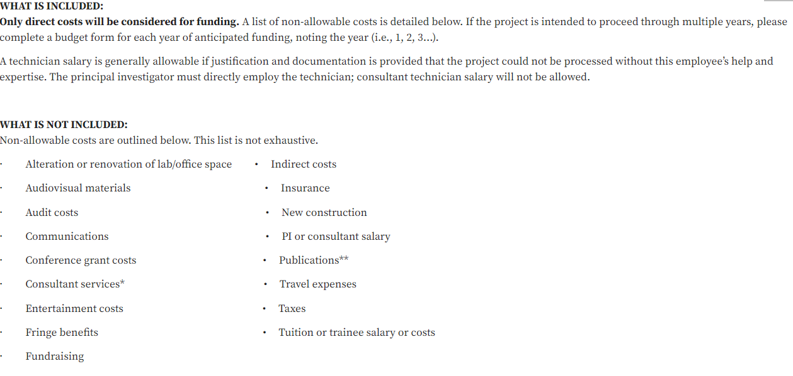
RFA Example

Slide 7
RFA Example

Slide 8
Federal Cost Principles https://www.ecfr.gov/current/title-2/subtitle-A/chapter-II/part-200/subpart-E
Federal cost principles are regulations that help recipients and subrecipients determine eligible costs for specific activities identified in grant agreements and contracts and outlines financial management requirements including audits.

Slide 9
Allowable Costs
Before a cost can be defined as allowable, all four cost principles must be applied.
The cost must be:
Reasonable: A prudent businessperson would have purchased this item and paid this price.
Allocable: It can be assigned to the activity on some reasonable basis.
Consistently Treated: Like costs must be treated the same in like circumstances, as either direct or indirect costs.
Conform: to Uniform Guidance and/or the Sponsored Agreement.

Slide 10
Reasonable Costs
A cost is reasonable if the nature of the good or service and the amount involved reflect the action of a prudent person.
Considerations in determining reasonableness:
• Necessary for the performance of the sponsored agreement;
• Determined by arm’s length bargaining of a prudent person;
• In accordance with the sponsored agreement terms and conditions;
• Consistent with established institutional policies and practices.

Slide 11
Example
If the PI includes local travel for stakeholder meetings in her budget:
Mileage reimbursement would be a reasonable cost.
A cost like a monthly car payment, would not be reasonable.

Slide 12
Allocable
A cost is allocable to a specific grant if it is incurred solely in order to advance work under the grant and is deemed assignable, at least in part, to the grant.
Considerations in determining allocability:
Does the cost benefit the project?
Does the cost advance the work on the project?
Is the cost necessary for the project?

Slide 13
Example
During the week the PI attends 3 community meetings and stops at Costco after one of the meetings because it is close by.
The PI can allocate the cost of gas, mileage, and parking for the meetings to the project.
The PI would not be able to allocate costs that are not essential to the purpose of the project, such as the mileage to and from work everyday or the mileage for the detour to Costco.

Slide 14
Consistently Treated
All costs must be treated consistently for all work of the organization under like circumstances, regardless of the source of funding.
Costs may be charged as either direct costs or indirect costs, depending on their identifiable benefit to a particular project or program.

Slide 15
Example
The PI needs to budget for a Community Outreach Worker who is 100% funded by this project.
The PI can budget the salary for the Outreach Worker to align with the salary of others in the same role with similar experience within the College.
The PI cannot budget the salary at a higher rate, even if the sponsor allows it.

Slide 16
Conformance
All costs must conform to or adhere to the cost principles, sponsor’s terms and conditions and institutional policies.

Slide 17
Types of Cost
Direct Costs vs. Indirect Costs

Slide 18
Direct Costs Costs that are directly attributed to the project and are allowable Typical Direct Cost Categories
Personnel Salary/Wages
Fringe Benefits
Travel
Equipment
Participant Support
Research Service Center Fees
Subawards
Contracted Services
Project Specific Materials and Supplies
Tuition
Animal Costs
Rental Fees
Data Management and Storage
Consultant

Slide 19
Personnel
Determine the amount of time (effort) that the PI will spend of the project
Calendar, Academic or Summer Months
Check with College to determine course buyout effort requirements
NEW - Every senior or key personnel associated with a sponsored project must have 1% or greater annualized effort included in the budget for that project as long as salary/fringe are allowable costs.
Determine the number, qualifications and effort needed for other personnel
Co-Investigators - Technicians - Postdoctoral Fellows - Graduate Students - Undergraduate Students
Fringe costs follows salary effort

Slide 20
Personnel (continued)
Each person listed in the budget should have a specific role on the project.
Be realistic about what each individual can accomplish and the time necessary for the work.
Explain any fluctuations in effort levels and/or staffing levels in the budget justification for subsequent years.

Slide 21
Fringe Benefits
Fringe benefits include items such as the employer’s contribution to:
Retirement
Health insurance
FICA and Medicare FICA
Unemployment compensation
Workers’ compensation
Income continuation insurance and life insurance
Requests for fringe benefits are calculated on the percent of salary being requested from the sponsor.

Slide 22
Equipment
Per unit acquisition cost with a value of $10,000 (NEW) or more and a useful life of more than one year
Use is primarily allocated to proposed research
Excluded from indirect cost base
Considerations
- Most equipment is requested during the first year of a project
- A strong justification is required especially if similar equipment is already available.

Slide 23
Direct Cost Considerations Subrecipient, Vendor, or Consultant
Determining whether an external individual or organization collaborating on an ECU sponsored project should be engaged as a subrecipient, a contractor (vendor), or a consultant can be a confusing task and one in which a degree of judgment is often needed.
The decision is significant because it:
determines the allocation of project responsibilities,
influences the appropriate application of indirect cost rates,
identifies applicable compliance requirements,
specifies the internal business process and type of legal agreement required,
identifies the type and level of monitoring of the collaborator’s work that will be required and governs audit requirements.

Slide 24
Subaward
Participate in a creative way in conceptualizing and /or designing the project.
Conduct an intellectually significant portion of the project.
Use funds to support ECU in conducting a project for a public purpose.
Must provide ECU with
Completed Subaward Commitment Form
Detailed Statement of Work
Detailed Budget and Budget Justification
Upon receipt of award, they must adhere to the terms and conditions from the sponsor.
The ECU PI/PD plays a significant role in monitoring the progress of the subrecipients on its scope of work and the subrecipient’s expenditure of funds during the conduct of the sponsored project.

Slide 25
Contractor (Vendor)
Provides little or no contribution to the conceptualization and/or design of the overall project.
Their intellectual contribution is limited and does not constitute a significant contribution to the overall programmatic effort.
Provides a good or service to ECU that is secondary to the central purpose of ECU’s project.
ECU specifies the work that is to be done and will request a price quote or estimated cost (with budget) from the entity.
Routinely provides similar goods and services to other entities as a part of its normal business operations.

Slide 26
Consultant
Individual who possesses special knowledge or skills and acts under self-employment (i.e., as an independent contractor as defined by the Internal Revenue Service) to provide that expertise to a client for a fee.
Is not acting in an employee/employer relationship with ECU as defined by the IRS (i.e., the consultant determines how the work will be accomplished, works independently, maintains own office or facilities, is compensated for deliverables rather than time worked, etc.).
Possesses a high level of expertise to assist with one or only a few very well-defined tasks of the sponsored project (e.g., developing a marketing plan or evaluating a project).

Slide 27
Indirect Costs or Overhead
The indirect cost rate is the mechanism used to reimburse ECU for the infrastructure support costs associated with sponsored research and other sponsored projects.
University costs incurred for common or joint objectives that cannot be specifically identified with a particular sponsored project or activity.
depreciation and use allowances,
general administration and general expenses,
sponsored projects administration expenses,
operation and maintenance expenses,
library expenses,
departmental administration expenses, and
student administration and services

Slide 28
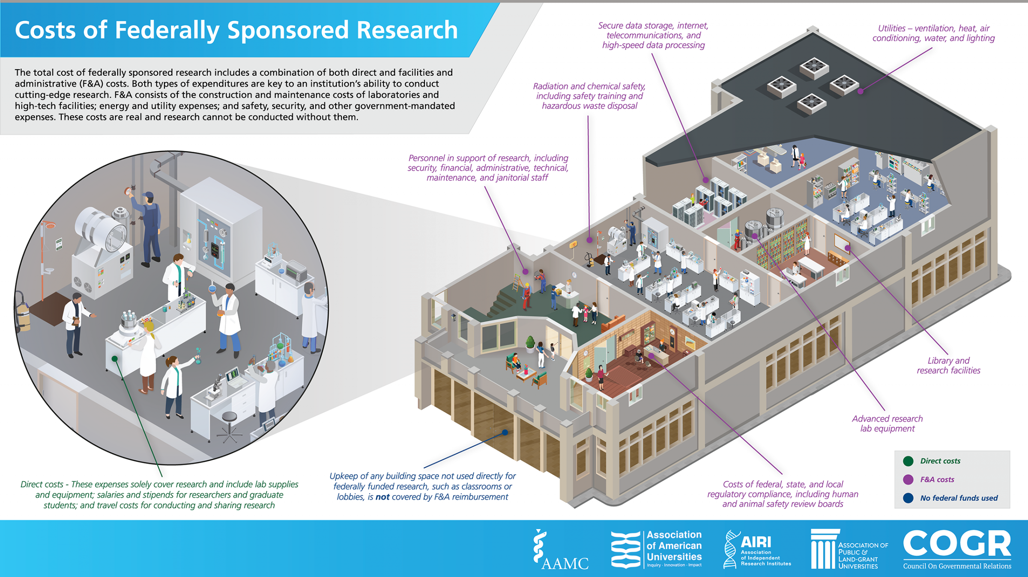
The Chicken Sandwich

Slide 29
ECU’s Indirect Cost Rate Agreement
Indirect costs are recovered by the application of a rate that is negotiated with the U.S. Department of Health and Human Services and is applied to a direct cost base.
https://rede.ecu.edu/ora/330-03-fa-rate-agreement/

Slide 30
Indirect Cost Updates - NEW
OMB has raised the de minimis indirect cost rate from 10% to 15% of the modified total direct costs, which includes all direct salaries and wages, applicable fringe benefits, materials and supplies, services, travel, and up to the first $50,000 (formerly, the first $25,000) of each subaward (regardless of the period of performance of the subaward).
The federal government and pass-through entities may not compel recipients and subrecipients to use an indirect cost rate lower than the 15% de minimis rate or elected de minimis rate, unless required by a federal statute or regulation. The use of a lower rate is allowable if the recipient or subrecipient chooses to do so.
ECU typically requests the full indirect costs allowed by our federally negotiated cost rate agreement

Slide 31
Indirect Cost Updates - NEW
NIH Supplemental Guidance to the 2024 NIH Grants Policy Statement: Indirect Cost Rates
Caps indirect costs at 15% for Universities
ECU’s Federal Funding – Executive Actions and Federal Agency Guidance
Provide principal investigators, research administrators, and campus leadership with guidance, updates, and links to relevant resources.

Slide 32
Cost Share
Cost-share, often called matching funds, describes the costs of a project which are not paid by the external sponsor. These costs must be allowable on a project and are considered to be “shared” by ECU.
Cash Match: includes cash spent for project-related costs. The allowable cash match must include costs that are necessary, reasonable, and allowable by the sponsor.
Third Party In-Kind Match: includes, but is not limited to, the valuation of non-cash contributions provided by a third party. An in-kind match may be in the form of services, supplies, real property, and equipment. The value of the service may be used for the matching requirements, if the services are necessary, reasonable, and allowable by the sponsor.
Mandatory: Required by sponsor.
Voluntary: Applicant initiated, not required by sponsor.

Slide 33
Budget Justification
The budget justification is a categorical description of the proposed costs.
It explains staffing and supply/service consumption patterns, the methods used to estimate/calculate (including escalation or inflation factors) and other details such as lists of items that make up the total costs for a category.
The budget justification should address each of major cost categories (salaries, fringe benefits, equipment, travel, supplies, other direct costs and indirect costs), as well as any additional categories required by the sponsor.
Reviewers and Administrators use this to determine if the scope of work matches request.

Slide 34
Sample Budget Justification Comparison #1
Personnel
Donna Jones, Ph.D., Principal Investigator (2 academic months and 1 summer month). Dr. Jones is a Professor of Biology at East Carolina University. Dr. Jones will be responsible for the overall coordination and supervision of all aspects of the study.

Slide 35
Sample Budget Justification Comparison #1
Personnel
Donna Jones, Ph.D., Principal Investigator (2 academic months and 1 summer month). Dr. Jones is a Professor of Biology at East Carolina University. Dr. Jones will be responsible for the overall coordination and supervision of all aspects of the study. This includes hiring, training, and supervising staff/students; recruiting study participants; coordinating treatment and assessment components; scheduling and staff assignments; and data management. In addition, she will conduct the orientation sessions, assist with statistical analyses, and be responsible for reporting the study’s findings.

Slide 36
Sample Budget Justification Comparison #2
Equipment
Biologs: Funds are requested to purchase three Biologs ($10,150 each). These are ambulatory physiological data recorders with multiple channels that will be used to record mothers' heart rate (RSA), activity level, and electrodermal activity (e.g., skin conductance).

Slide 37
Sample Budget Justification Comparison #2
Equipment
Biologs: Funds are requested to purchase three Biologs ($10,150 each). These are ambulatory physiological data recorders with multiple channels that will be used to record mothers' heart rate (RSA), activity level, and electrodermal activity (e.g., skin conductance). Recorded data is compactly stored on a removable memory card. When recording is complete, the card is inserted into a card reader which is connected to a PC through a serial port. Three Biologs are needed because there are several periods when assessment points overlap ( e.g., parental interviews, 6 months laboratory visits, 6 months home visits), and dedicated equipment for each type of visit will ease scheduling demands.

Slide 38
Budget Justification Comparison #3
Travel
Domestic Travel - $2,187 Support is requested for Dr. PI and Dr. Co-PI to attend the American Society for Cell Biology Association conference in year 3 to share results.

Slide 39
Sample Budget Justification Comparison #3
Travel
Domestic Travel - $2,339 Support is requested for Dr. PI and Dr. Co-I to attend the American Society for Cell Biology Association conference in year 3 to share results.
This estimate is based on $500 airfare per person, $105.20 hotel per night per person for four nights, and standard meal per diem rates of $49.70 per day for five days per person, the travel rates used by East Carolina University.

Slide 40
Budget Justification Tips
Organize the budget justification listing items in the same order and format as the sponsor’s budget categories.
Only include budgeted items.
Budget narrative must match the budget in terms of dollar amounts and language – double check everything.
Explain why items are essential in relation to the aims and methodology of the project as well as meeting the goals of the project.
Explain the line items. Do not merely restate the proposed expenditure.
Provide detail sufficient to justify the rationale for acquiring the item under the proposed project.

Slide 41
Questions?

Slide 42
Grant Writing Resources and Support
Office for Faculty Excellence – Training Sessions: https://ofe.ecu.edu
ORA Intranet - Policy and Guidance: https://rede.ecu.edu/oraintra/
eTRACS Proposal Development: https://etracs.ecu.edu/help/#creatingproposals
Budget & Cost Resources: https://rede.ecu.edu/ora/proposals/develop/budget-cost/
2 CFR Part 220: Cost Principles for Educational Institutions:
https://www.govinfo.gov/app/details/CFR-2013-title2-vol1/CFR-2013-title2-vol1-part220
Grants Administration Hubs: https://rede.ecu.edu/ora/proposals/develop/find-your-hub/
ORA Unit Liaisons: https://rede.ecu.edu/ora/liaisons/

