Slide 1
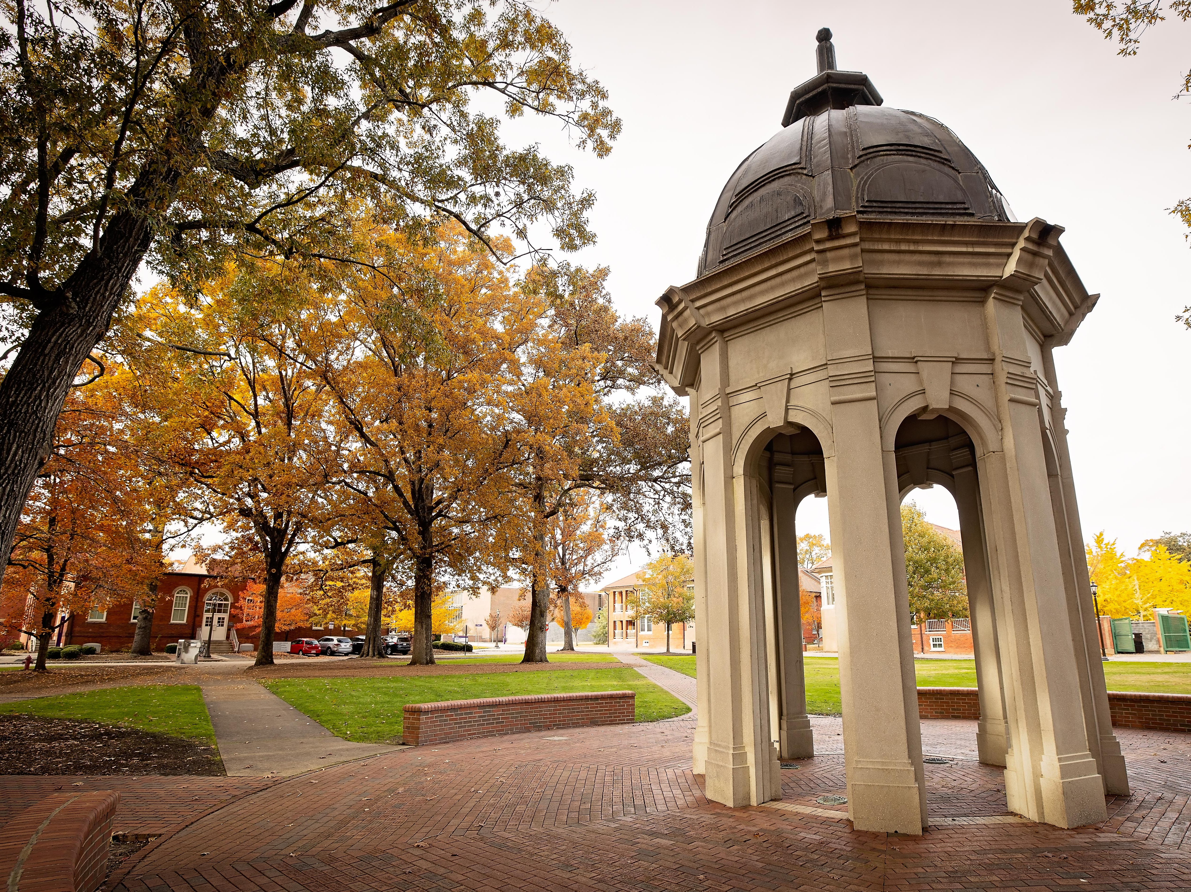

Slide 2
ECU Office of Faculty Excellence
Grant Series Presentation
9.18.2023
How to Make Your Case for Support
to Corporations and Foundations

Slide 3
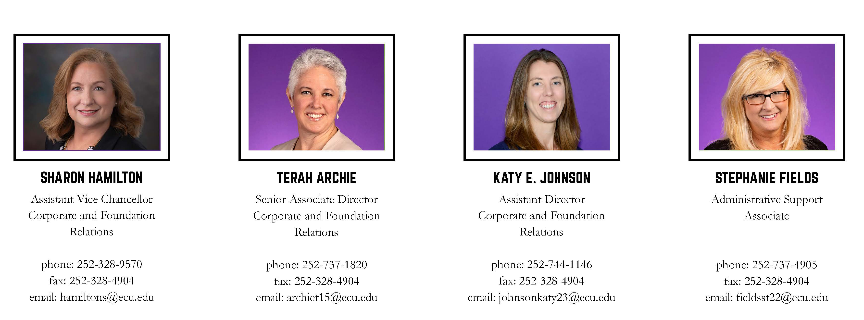
Meet the CFR Team

Slide 4

The Role of CFR at ECU
Coordinate fundraising efforts
Find the fit
Speak the language of the funder
University’s primary point of contact with private foundations and corporations

Slide 5
Who Gives the Gifts?
Giving USA 2022: The Annual Report on Philanthropy

Slide 7
Why Do Corporations Give?
Civic participation. Often restrict giving to places in which they operate.
Enlightened self interest. They need an educated workforce.
Individual leadership initiative. The CEO or senior leaders often shape giving priorities.

Slide 8
Why Do Corporations Give? Cont.
Quid pro quo. What’s in it for us and our shareholders?
Good corporate citizenship. Positive community image in places they operate.
Endowment is a hard sell for corporations.

Slide 9
Why Do Foundations Give?
To honor the donor
To make the world a better place
To meet community needs
Because they have to . . . IRS 5% rule

Slide 10
Who is Most Likely to Give Us a Grant?
Local and regional corporations and foundations whose interests are aligned with campus priorities
Corporate headquarters near campus, or much of their workforce/sales are in our area
Major corporations and foundations that fund nationally and at which ECU has alumni and other contacts in C-suite; must also be mission-aligned
Corporations that participate in on-campus recruitment for full-time employment and internships
Corporations interested in workforce development programs for their local and regional employees

Slide 11
Case for Private Foundations and Corporations vs. Federal Grants
Foundation funding can provide seed funding for projects needing more preliminary data
Many offer significant funding >$1 million
Serve as bridge funding between grants
Serve as a resume builder on researcher's CV

Slide 12

Is Your Project Fundable?
Fundability does not refer to the merits of the idea, rather the likelihood that corporate funders will support it.
Is it doable?
Can you answer the question “So What?”
How is your project unique?
Is there a focused goal that aligns with the corporation or foundation?
What are our strategic plans for carrying out the project, and what role does the corporate or foundation partner play?
Notes:
Move text in second line of second bullet, so it’s flush with “Can.”

Slide 13
Is Your Project Fundable?
Can we identify who benefits and how this benefits the corporate or foundation donor?
Why is ECU the best place to address this issue/need?
How will we know that the project has had impact?
How will the project be sustained financially after the funding period?

Slide 14
CFR Serves as Primary Point of Contact
Pre-proposal consultations with funders
Help them navigate campus
Build trust and transparency
Show appreciation for their metrics, business budget cycles
Function at the speed of business

Slide 15
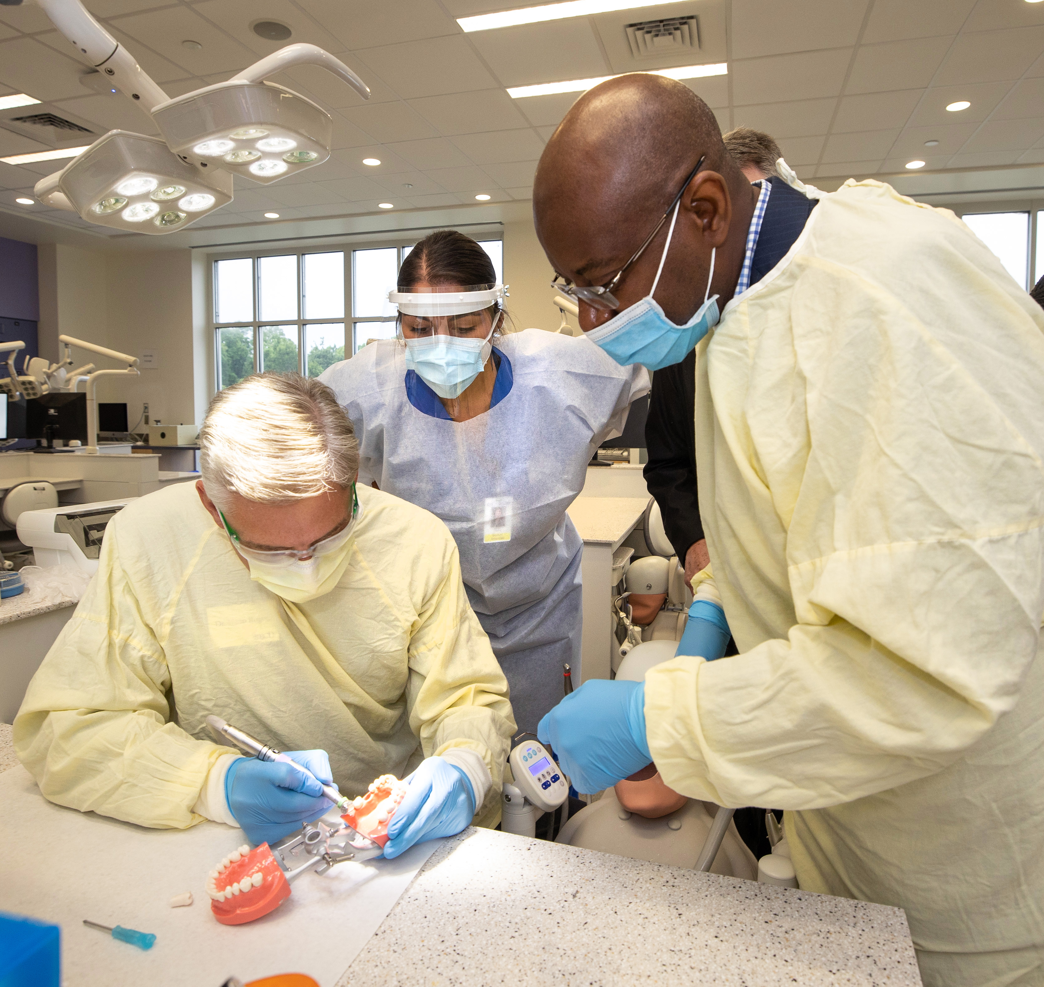
CFR also facilitates site visits for corporate and foundation partners.
ECU hosted Blue Cross and Blue Shield of NC executives in August 2021.
Notes:
Is font/font size consistent? Or should it be larger in the case of this slide? Question: on the slide with notes pages, I can only see Dr. Tunde on the right. Is that just the way it prints?

Slide 16
What Funders Want You to Know…
Their mission
Their focus areas
Their deadlines
Their guidelines

Slide 17
Elements of a Successful Proposal
To the point
Unique
A good fit
Accountable
Sustainable

Slide 18
Eight Ways to Earn a Quick Rejection
You fail to request a specific amount
You fail to show how the requested grant fits into the larger picture
You fail to show that others are committed to the project
You direct your proposal to the wrong person
You “scattershot” proposals to several corporations or foundation simultaneously
Your goal is unrealistic
You describe the problem but not the solution
You ignore established eligibility requirements

Slide 19
The Role of the Central CFR Office
Project concept form
Research and identification of potential funders
Pre-proposal consultations with funders
Proposal development
Proposal review and editing
Face-to-face visits with funders
Site visit preparation
Chancellor cover letters
Coordination of submissions and reports

Slide 20
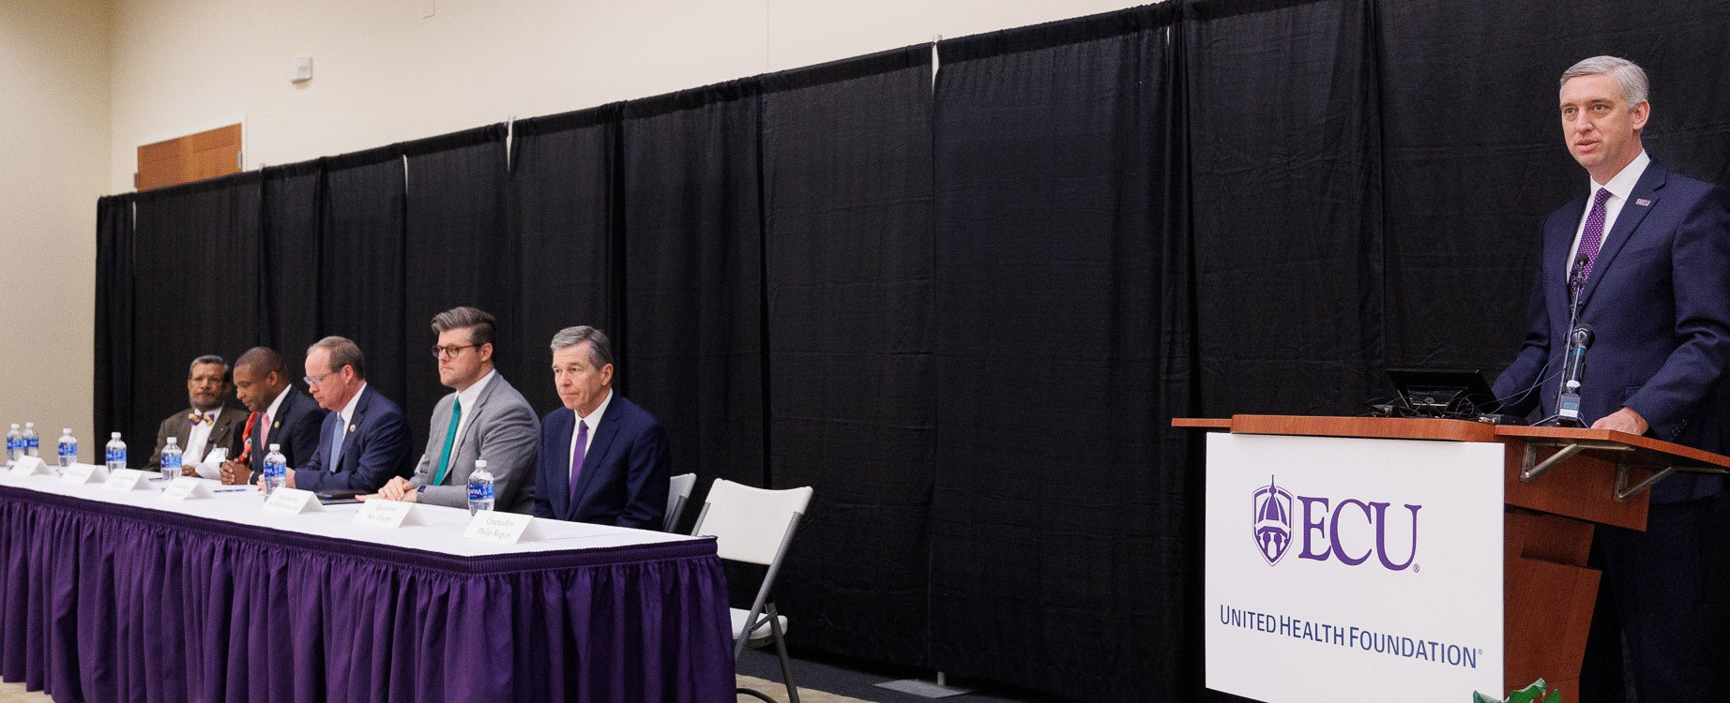
CFR Highlights for Fiscal Year 2023
Notes:
Change gold title. Is there a better photo of the UHF announcement?

Slide 21
CFR Highlights in Fiscal Year 2023
$14.6 million in gifts and grants
  United Health Foundation - $3.2 Million
  NC GlaxoSmithKline Foundation - $1.3 million
  The Duke Endowment- $687,712
  Hearst Foundation - $100,000*
  Preparedness and Treatment Equity Coalition (PTEC) - $50,000*
$5.3 million in pending solicitations
A healthy pipeline of ECU projects
*First-time funders

Slide 22
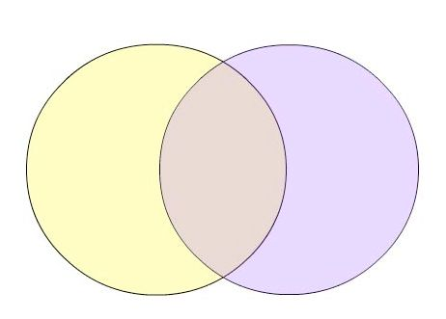
Collaborative Efforts with the Office of Research Administration
Office of Corporate and Foundation Relations
Office of Research Administration
eTRACS

Slide 23

Project Idea to Proposal: Working with CFR
LOI/Proposal Preparation
Supporting Documents
Budget Preparation
Site Visit
Coordinate Chancellor’s Involvement
Submit
Directly to Funder
If funds must go to a 501(c)(3) and the proposal doesn’t go through eTRACS.
CFR Funding Search
Project Idea
Project Concept Form
Identify Potential Funders
Route through eTRACS
Submit to Funder
PI or CFR may have to submit after eTRACS approval
Strategy Meeting
Work with CFR, project collaborators, HUB Research Administration

Slide 24
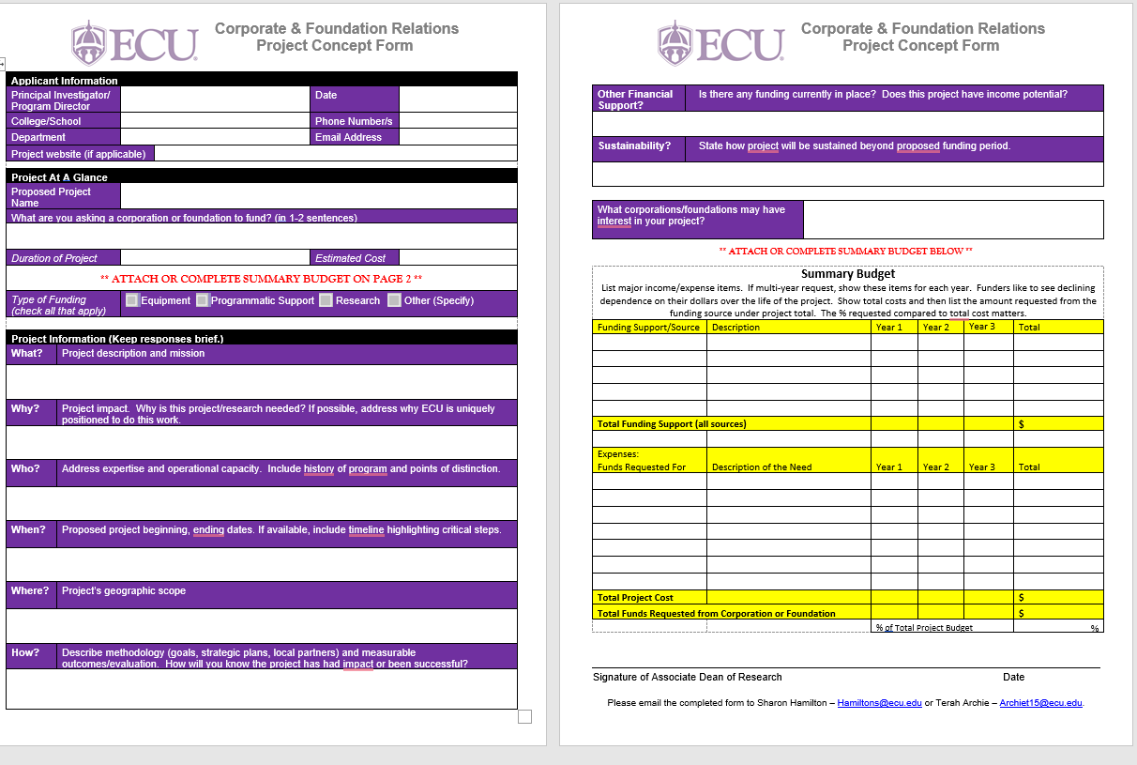
CFR Project Concept Form

Slide 25
University Policies
Faculty are required to inform CFR and the Office of Sponsored Research (ORA) before approaching corporations and foundations
Faculty do not have signatory authority for ECU

Slide 26
Keys to Success
Do your homework!
  Get to know the funder; make inquiries
  Make sure the funder is a good match for your project
Make sure the reader understands what you propose to do and how you will accomplish it.
  Have someone unfamiliar with your project read your proposal
Follow the guidelines! Address all questions.
Effective NEED Statement
  Ask yourself “so what”

Slide 27
If You’ve Seen One Foundation . . .
United Health Foundation
  Contacted ECU
  Concept paper vs. formal application
  23 days from first contact to award ($1.25 M)
Golden LEAF Foundation
  ECU contacted Golden LEAF Foundation
  Formal letter of inquiry and invitation to submit full proposal
  Lengthy due diligence process
  10 months from first contact to award ($1.9 M)

Slide 28

Q & A

