Slide 1
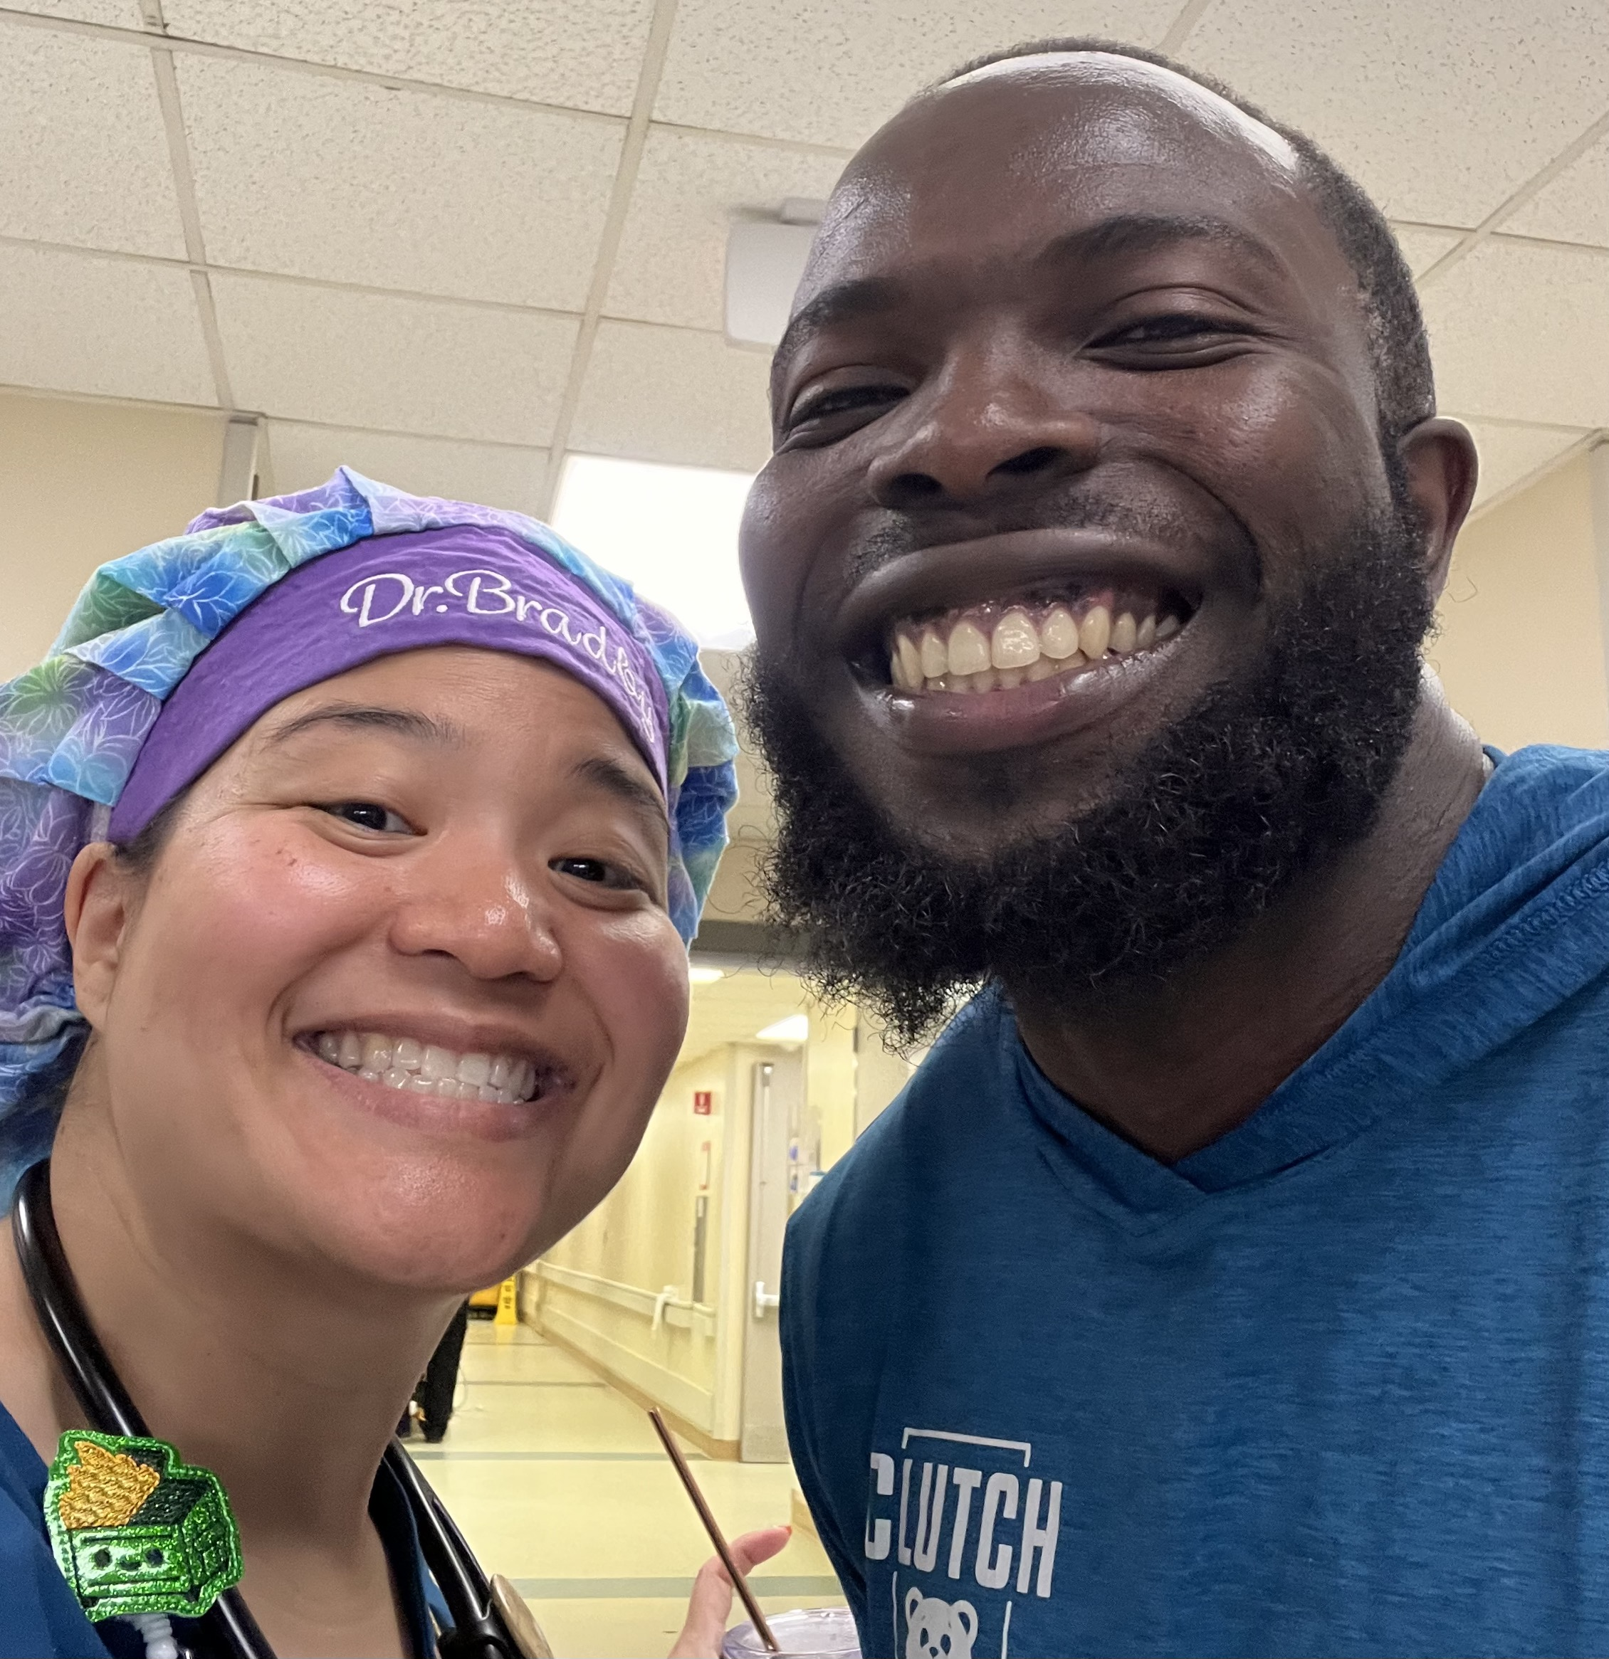
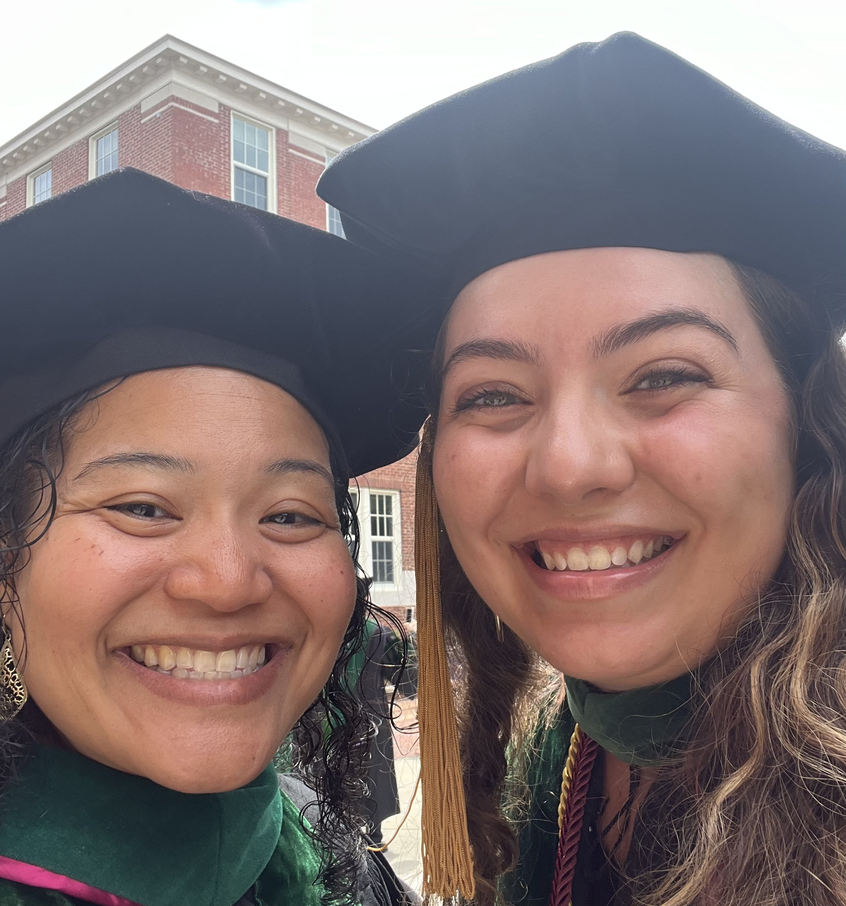
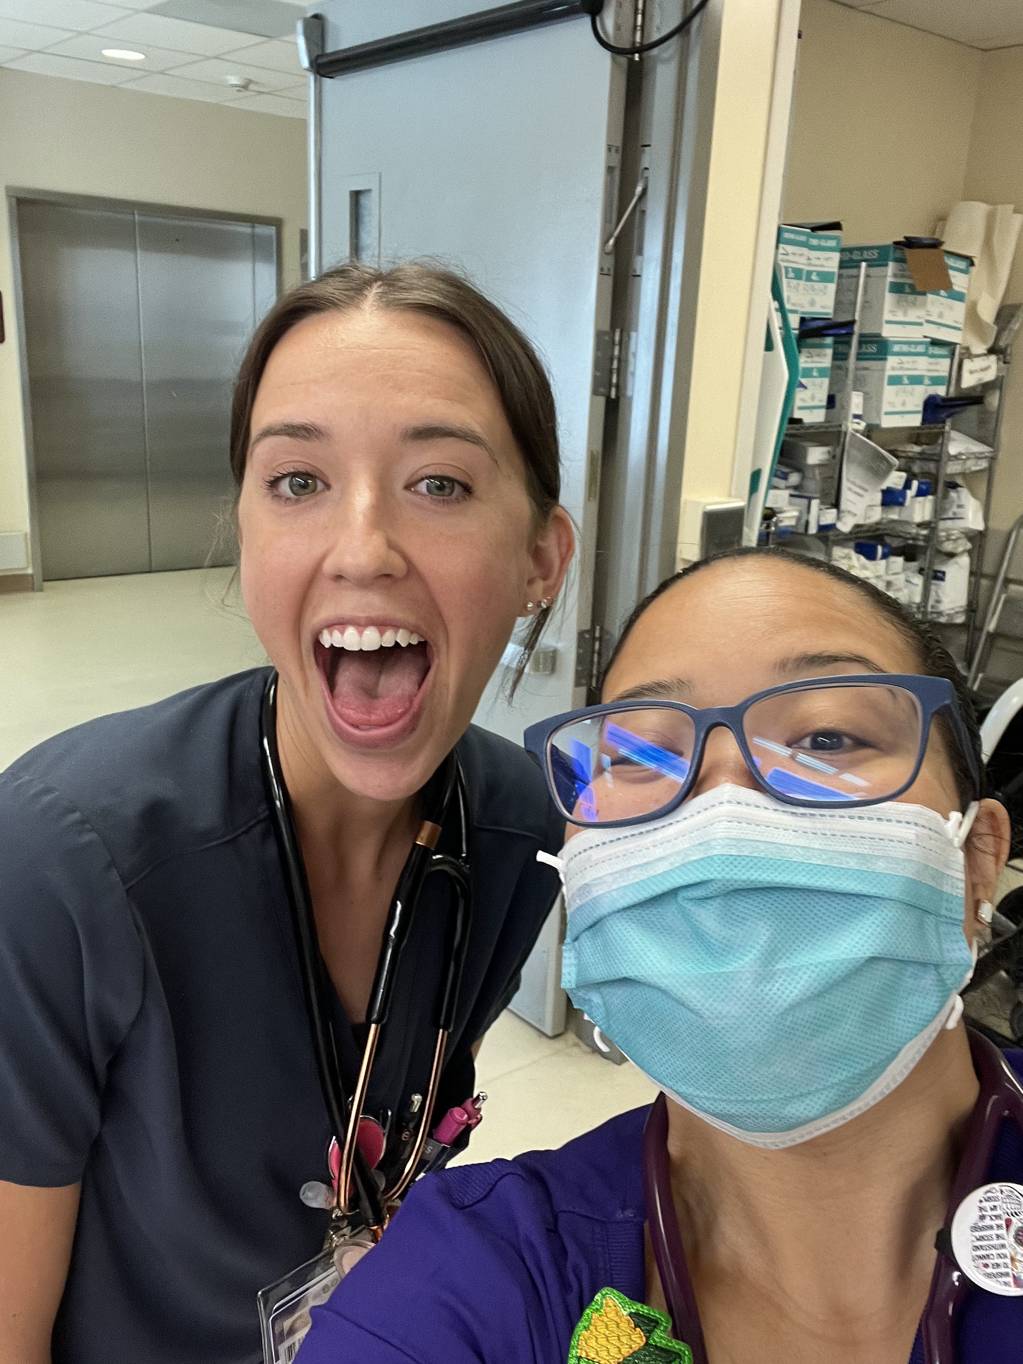
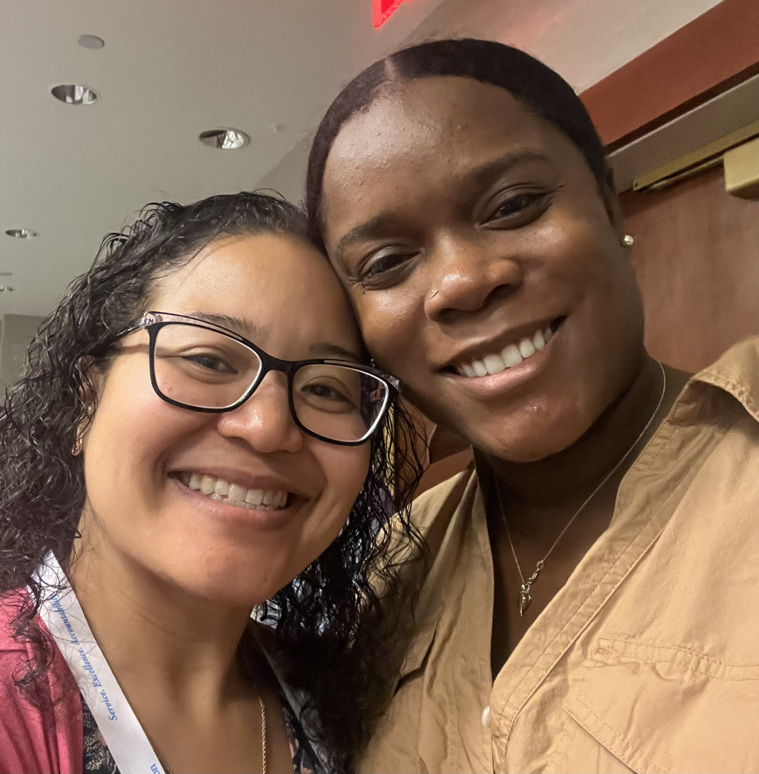
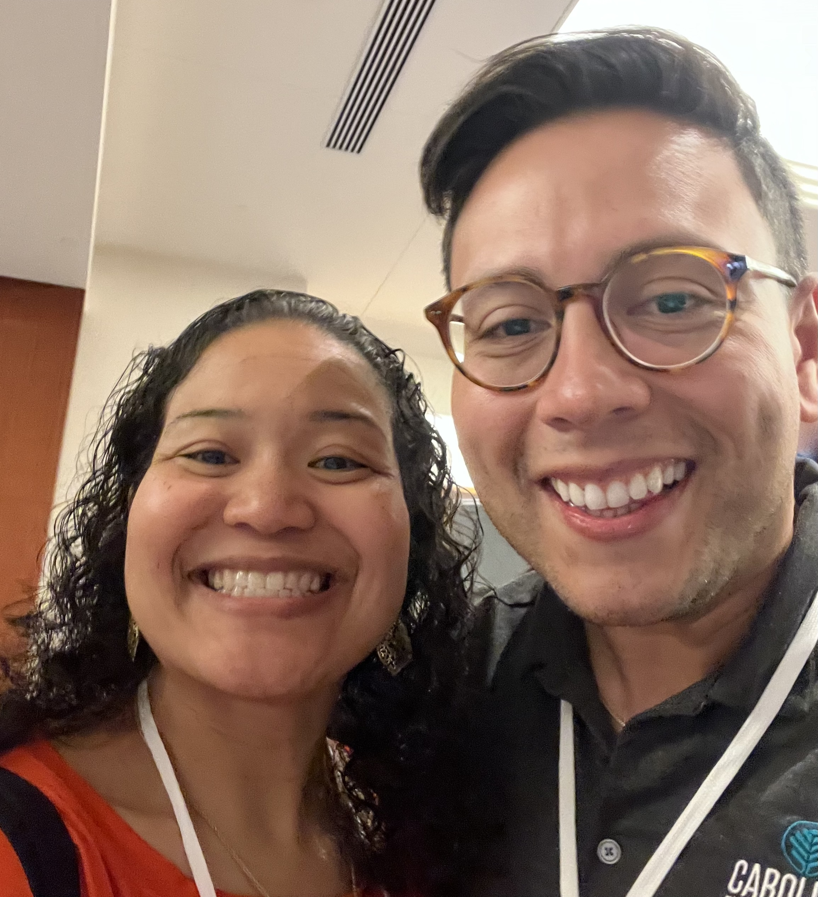
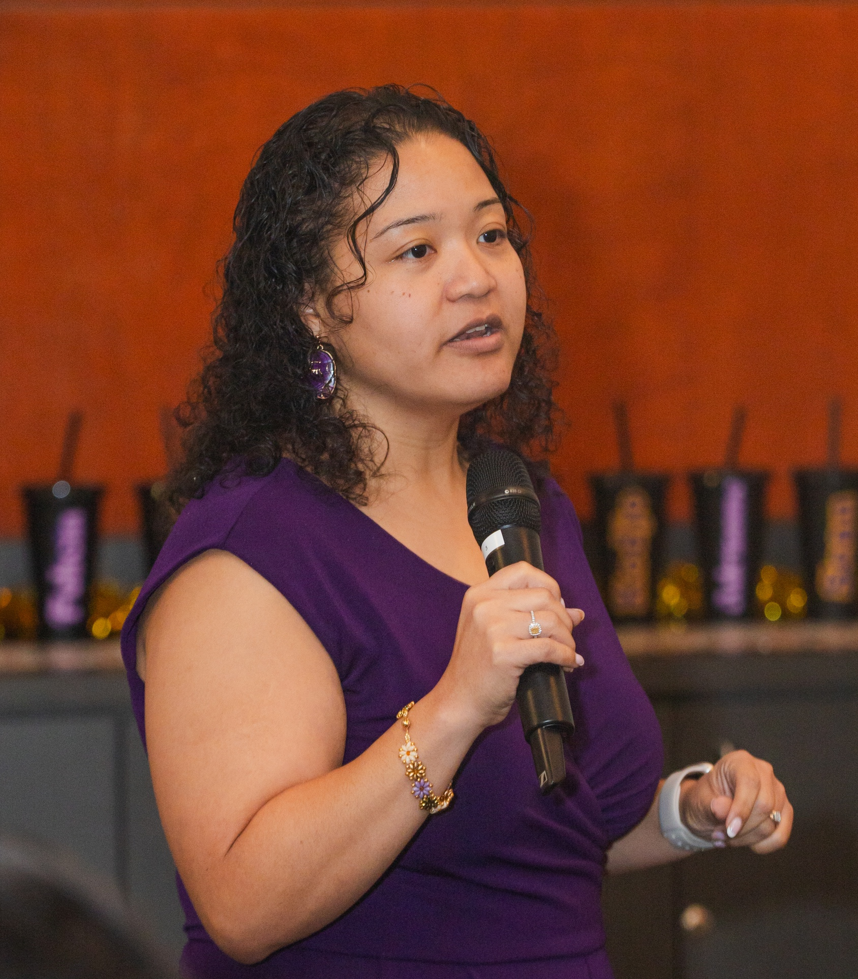
Inspiring the Next Generation of Physicians through Education and Mentorship
2024/2025 Scholar Teacher
Cassandra Bradby, MD
Assistant Professor
Residency Program Director
Department of Emergency Medicine
Greenville, North Carolina 27858
BradbyC14@ecu.edu
Summary Statement
Mentoring
Publications
I am honored to be a 2024–25 Scholar-Teacher Awardee from the Brody School of Medicine. This achievement would not have been possible without the support of my colleagues, residents, students, family, and friends.
As a physician, educator, and researcher, my focus has always been on fostering the growth and mentorship of students and residents. I view education as a pathway to personal development and self-reflection—core tenets that deeply resonate with my professional practice, which blends practical problem-solving with self-actualization.
Over the past decade, I have dedicated extensive time to mentoring premedical and medical students, as well as residents. This experience includes guiding students through the application process, interviews, and shadowing opportunities, with a particular focus on supporting underrepresented minorities.
I am proud to have mentored over 30 students who have gone on to become accomplished physicians in Emergency Medicine, Internal Medicine, Surgery, Family Medicine and OB/GYN, in addition to my role as EM Program Director. My mentoring approach emphasizes listening, appreciating individual experiences, and providing evidence-based guidance to support or challenge their plans. I view mentoring as a collaborative process of reflection and guidance rather than prescriptive direction.
Suh M, Bhananker A, Tomasino D, Carpenter K, Hwang U, Carpenter C, Chary A, Boatright D, Bradby C, Caterino J, Gilmore-Bykovskyi A, Goldberg E, Kennedy M, Liu S, Ordonez E, Rosen T, Samuels-Kalow M, Shah M, Yoon S. AGEM Topic Supplement: Strategies for Inclusion of Diverse Older Adults in Emergency Medicine Research. Journal of Geriatric Emergency Medicine. 2024; 5(4). https://institutionalrepository.aah.org/jgem/vol5/iss4/2/
Bradby C*. Spontaneous bruising finger. JACEP Open. 2024; 5:13311. https://doi.org/10.1002/emp2.13317
Bradby C*, March J, Portela R. Orbital damage due to falling screw. J Am Coll Emerg Physicians Open. 2024;5(5):e13318. Published 2024 Sep 29. doi:10.1002/emp2.13318. PMID: 39350916
Goldflam K, Bradby C, Coughlin RF, et al. Is boarding compromising our residents' education? A national survey of emergency medicine program directors. AEM Educ Train. 2024;8(2):e10973. Published 2024 Apr 15. doi:10.1002/aet2.10973. PMID: 38633136
Arno K, Bradby C, Shappell E, et al. Differences in emergency medicine resident procedural reporting by race and ethnicity. AEM Educ Train. 2024;8(1):e10930. Published 2024 Jan 16. doi:10.1002/aet2.10930. PMID: 38235392
Tsyrulnik A, Fleming-Nouri A, Ikejiani S, Bradby C, et al. Trends in nursing feedback for emergency medicine residents: A mixed-methods survey analysis of national practices. AEM Educ Train. 2023;7(5):e10915. Published 2023 Oct 8. doi:10.1002/aet2.10915. PMID: 37817838
Neff A, Bradby C*. Hemothorax after sneezing. J Am Coll Emerg Physicians Open. 2023;4(4):e13025. Published 2023 Aug 12. doi:10.1002/emp2.13025. PMID: 37576116
Ordonez E, Bradby C, Carey J, et al. Beyond diversity and inclusion: Developing a research agenda for anti-racism in emergency medicine education. AEM Educ Train. 2023;7(Suppl 1):S68-S77. Published 2023 Jun 27. doi:10.1002/aet2.10876. PMID: 37383834
Nadir N, Winfield A, Bentley S, Hock S, Backster A, Bradby C, Rotoli J, Jones N, Falk M. Simulation for diversity, equity and inclusion in emergency medicine residency training: A qualitative study. AEM Educ Train. 2023;7(Suppl 1):S78-S87. Published 2023 Jun 27. doi:10.1002/aet2.10870. PMID: 37383838
Goldflam K, Crichton IC, Coughlin RF, Bod J, Agrawal P, Bradby C, Tsyrulnik A. Meeting expectations: An exploration of academic emergency medicine faculty experiences and preferences in the virtual meeting environment by age, gender and parental status. AEM Educ Train. 2022;6(2):e10724. Published 2022 Apr 1. doi:10.1002/aet2.10724. PMID: 35368503
Teaching Responsibilities
Brody School of Medicine:
Course Director for Foundations of Medicine
Small Group Facilitator for M1 Foundations of Medicine
Small Group Facilitator for M2 Foundations of Medicine
Categorical Emergency Medicine Residency Director
Residency Administration Fellowship Co-Director for the Council of Residency Directors in Emergency Medicine
Research & Scholarly Activity
Didactic Presentations:
34 Local Presentations
2 Regional Presentations
33 National Conference Presentations
4 Invited Presentations & Grand Rounds
10 Webinars
2 Podcasts
Research Presentations:
9 Local Presentations
3 Regional Presentations
7 National Presentations
Publications:
10 Peer Reviewed Journal Publications
1 Published Abstract
2 Book Chapters
10 Web Publications
Funding:
2 Grants/Funding Sources
FemInEM Grant to establish an emergency childcare program for resident physicians
SAEM Project Proposal Funding to establish a pathway program for students interested in academic Emergency Medicine called the Leadership, Engagement, and Academic Pathway (LEAP) Program.
Selected Teaching Evaluation Excerpts
“Dr. Bradby created a comfortable learning environment while pushing me to excel. She allowed autonomy to perform, while actively teaching me throughout the shift.”
“Dr. Bradby is a breath of fresh air. She is honest and straight to the point and makes you think things through. I really enjoyed working with Dr. Bradby she gets down to business makes intelligent clinical decisions and her diagnostic skills are elite.”
“Dr. Bradby aside from being an incredible clinician is such a fierce advocate for students. She provided me with a level of autonomy that encouraged me to make my own clinical decisions all while knowing I was supported.”
Research Advising
1 Undergraduate Senior Honors Project Student
8 Medical Students
2 Research Distinction Track Students
1 Medical Education & Teaching Distinction Track Student
8 Research Presentations (local, regional & national)
4 Emergency Medicine Residents
3 National Presentations
4 Local Presentations
1 Publication

