Slide 1
Course Scheduling

Slide 2
Timeline
January | Begin entering courses for summer and fall into banner
February | Assign classrooms for summer and fall
March | Registration for summer and fall
September | Begin entering courses for spring into banner
October | Assign classrooms for spring
November | Registration for spring

Slide 3
Training
Developing a new training video in Cornerstone for creating sections
Those who currently have access to enter course information into banner will be required to take the training this January
Here is a link to our tutorial page with our guides to creating course sections: https://registrar.ecu.edu/scheduling-courses/

Slide 4
Classroom Assignments
Utilize 25Live to automate the classroom assignment process
Departments may request to pre-assign a general classroom (110 space) by emailing regis@ecu.edu
Usual pre-assignment approvals include accommodations needs for instructors; use of software in specific classrooms; classroom setup

Slide 5
Important Change
The site of instruction has changed and will no longer be added to the SSADETL form.
The site of instruction will be added in SSASECT as a building in the Meeting Times and Instructor tab.
This includes courses coded with an instructional methods of 07, WEBA, WEBS

Slide 6
Grade Appeals Process

Slide 7
Student must show:
An error was made in grade computation
Different standards were used in assigning the grade from those established
The instructor departed substantially from instructor’s previously articulated, written standards, without notifying the students
Grade assigned was arbitrary or capricious based on the info in the record

Slide 8
Grade Appeal Process
The grade appeal must be initiated within 48 hours following the “grades due” deadline on the academic calendar.
Student must submit a request to the instructor via ECU email.
Failure to do so will forfeit the student’s right to the appeal.

Slide 9
Grade Appeal Process
If the instructor is not able to participate or review the appeal due to other circumstances, then the instructor must notify their unit administrator within 24 hours of receiving the appeal and then the unit administrator will act in lieu of the instructor of record.

Slide 10
Grade Appeal Process
Step 1
  Student and instructor meet (virtual or face-to-face) no later than 96 hours after the grade submission deadline on academic calendar.
  If it is the unit administrator acting for the instructor, then it may occur within the first seven days following the deadline.

Slide 11
Grade Appeal Process
Step 2
  Consultation with the unit administrator
    Written statement - if the instructor and the student cannot resolve the appeal, then the student can submit a written appeal to the unit administrator by the end of the ten days (240 hours) from the deadline. Catalog states the information the student must submit.
    Review materials – the unit administrator will review the written appeal and request additional information from instructor. They will share all materials with the instructor.
    Instructor’s decision – The instructor will convey their decision in writing to the unit administrator within seven calendar days.

Slide 12
Grade Appeal Process
Instructor’s decision continued:
  The unit administrator will discuss this response with the instructor and will provide the student with written notification of the outcome within 48 hours of receiving the instructor’s response.
  If the instructor does not respond or does not provide grades or other material or otherwise declines to participate at any point in the process, the appeal will be presented to the Grade Appeal Committee.

Slide 13
Grade Appeal Process
Step 3
  Appeal to Grade Appeal Committee
    Statement of Appeal - If after the review of the written notification of the outcome from the unit administrator (or the person serving in lieu of the unit administrator) the student wishes to pursue the matter further, the student must submit the appeal record to the dean’s designee within seven calendar days so it can be conveyed to the committee.
    The dean’s designee will form a three-member hearing committee that includes three faculty members from the college; one selected by the student, one selected by the instructor of record (or unit administrator acting in lieu of the instructor of record), and one appointed by the college dean.
    Hearing will be held within 1 week. Members will meet prior to the hearing and elect a chair.

Slide 14
Grade Appeal Process
Grade appeal committee hearing –
  The committee members will be furnished with all relevant materials in the case under consideration as soon as the committee is formed.
  The hearing, which may be virtual or face-to-face, will be attended by the student, the instructor, the committee, and the dean’s designee.
  The student and the faculty member will each state their view of the situation, provide documentation, and respond to questions from the committee, the dean’s designee, and each other, as appropriate.
Deliberation of the committee –
  The function of the Grade Appeal Committee shall be to evaluate the appeal in terms of the stated grounds for the appeal.
  A majority shall prevail in the committee.
  The dean’s designee does not have a vote.

Slide 15
Grade Appeal Process
Committee recommendation –
  Present a written recommendation to the Dean either to keep the grade or raise it.
  They cannot recommend a reduction in the grade.
  Provide a written justification of its recommendation to the college dean, including minority opinions (when they exist), no later than seven calendar days after the committee’s hearing.
Final decision by the Dean –
  The college dean shall make the final decision on the grade appeal following receipt of the recommendation from the Grade Appeal Committee.
  The dean will inform both the student and the instructor of the decision, in writing, within seven calendar days.
  The dean will also inform the student and instructor of the committee’s recommendation and provide both parties with copies of the committee report.

Slide 16
Grade Appeal Process
Updating the Academic Record –
  In the case of a change of grade, the dean will implement the change of grade on the student’s official transcript through the change of grade procedure within 3 days of receiving the Grade Appeal Committee’s Recommendation.
Notification of other parties –
  The college dean will forward a written record of the results of all grade appeals to the appropriate Vice Chancellor within fourteen calendar days.
  College deans will also provide an annual summary to the Faculty Senate of the number of cases heard and the aggregate result of the process.

Slide 17
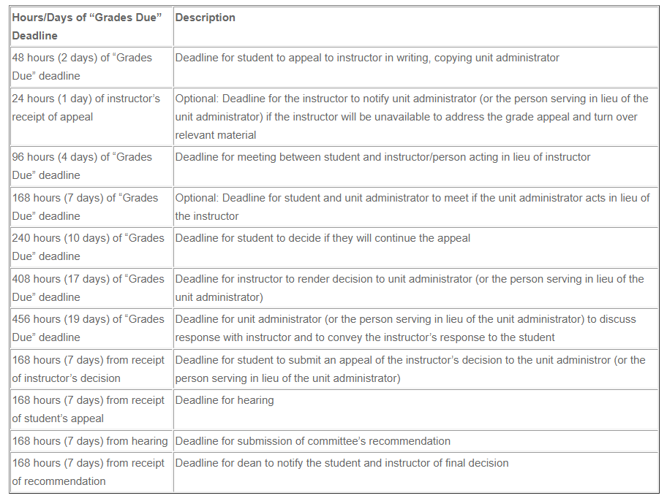
Grade Appeal Process

