Slide 1

Course Management and Organization
An Overview

Slide 2

Learning Objectives (LO)
Define course organization standard practices from industry experts.
Identify the purpose of backward design in course creation.
Illustrate course pacing and consistency throughout modules.
Recognize the importance of scaffolding in meeting course/module objectives.

Slide 3

Quality Matters (QM)

Slide 4


Quality Matters

Slide 5
Quality Matters
8 General Standards
44 Specific Standards

Slide 6

Plan Backwards
Review your course outcomes.
Create micro/module outcomes that relate back to the overall goal.
Sustains effort and persistence by heightening the salience of goals and objectives (UDL).
  Students need to be aware of the course goals and the steps they will take to reach those goals.

Slide 7
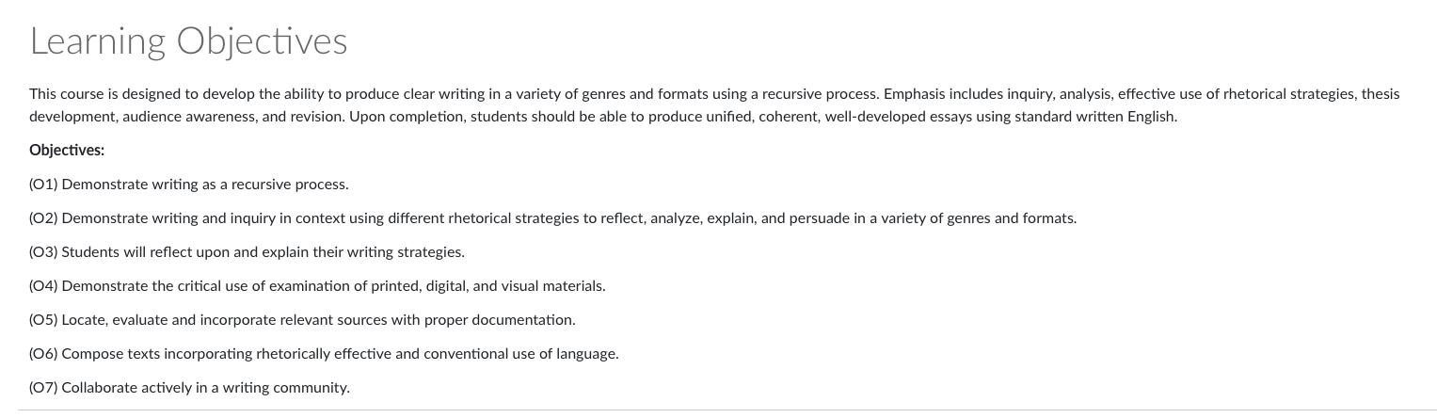
Plan Backwards

Slide 8
Decide How Modules will Flow
One module per week?
One every two weeks?
One every unit?

Slide 9
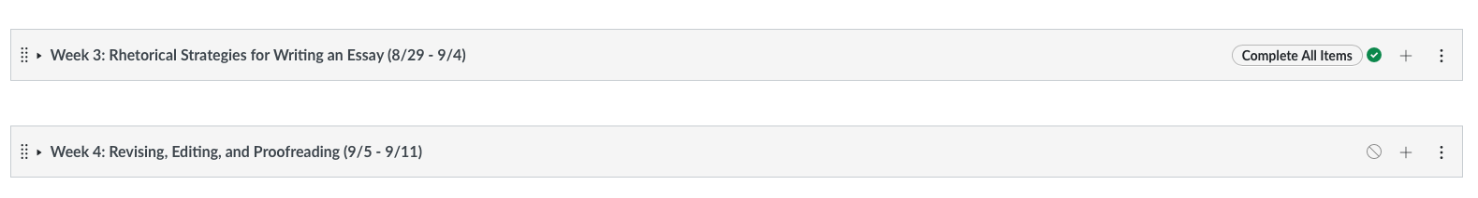
Decide How Modules will Flow

Slide 10
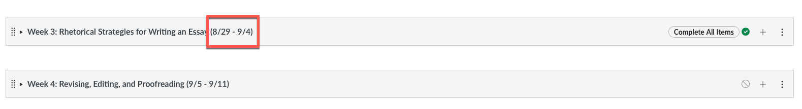
Decide How Modules will Flow

Slide 11
Create Consistency Among Modules
Help students know what to expect each module
  This will help students plan their time better

Slide 12

Create Consistency Among Modules
Prepare to engage
Activate prior knowledge
Navigate the resources
Demonstrate understanding
Articulate learning

Slide 13

Create Consistency Among Modules

Slide 14

Create Consistency Among Modules
Engage
Listen, Watch, & Learn
Deepen Thinking
Practice & Reflect
Close Strong

Slide 15
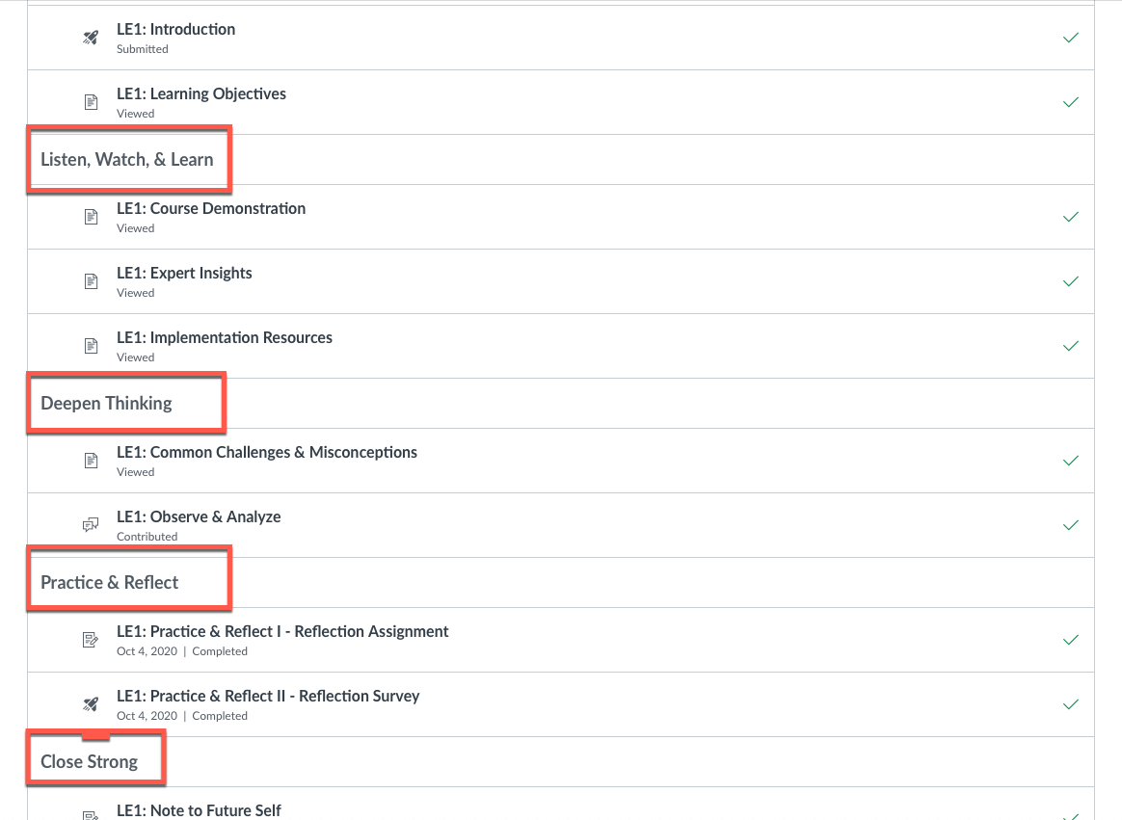
Create Consistency Among Modules

Slide 16
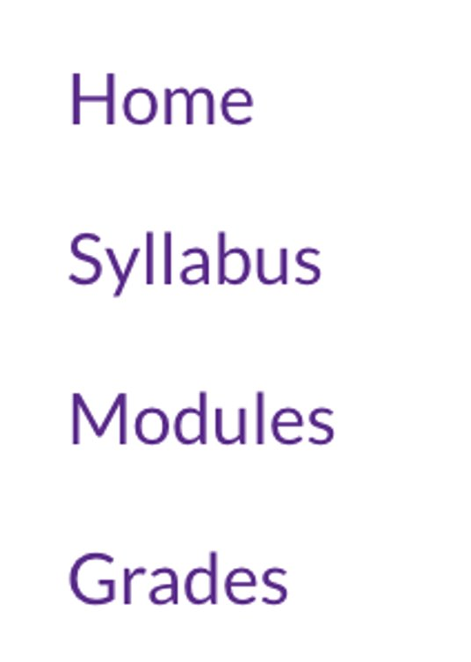
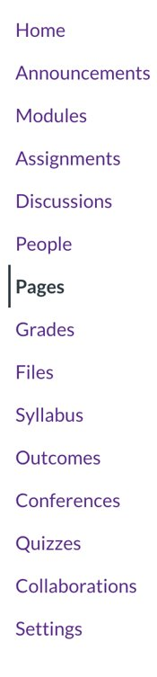
Eliminate Barriers

Slide 17
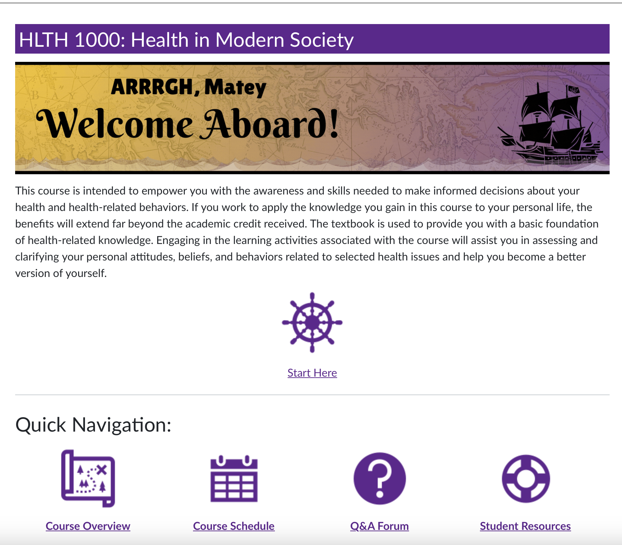
Create a Powerful Homepage

Slide 18

Vary Demands and Resources to Optimize Challenge (UDL)
Scaffold both module and course assignments, activities, and instructional materials.
Students need an opportunity to practice and make mistakes in low or no stakes spaces.

Slide 19
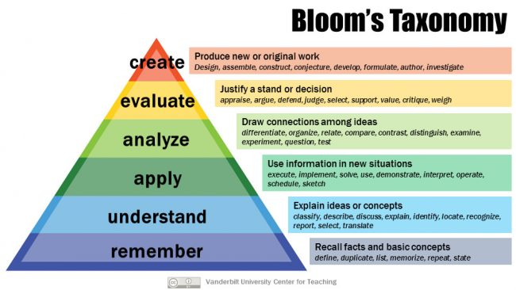
Vary Demands and Resources to Optimize Challenge (UDL)

Slide 20
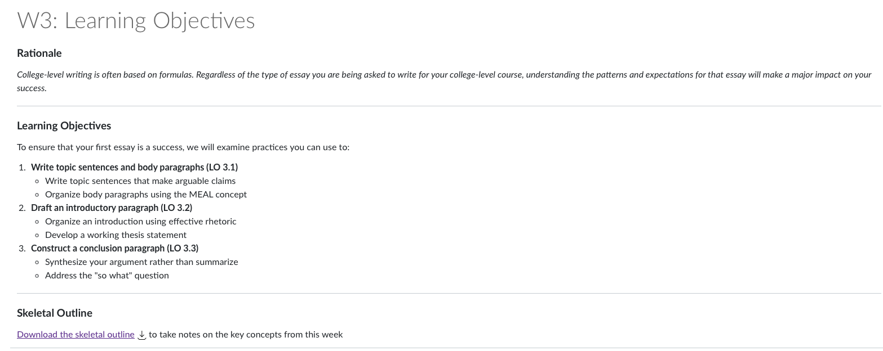
Remember – Define Goals and Objectives

Slide 21
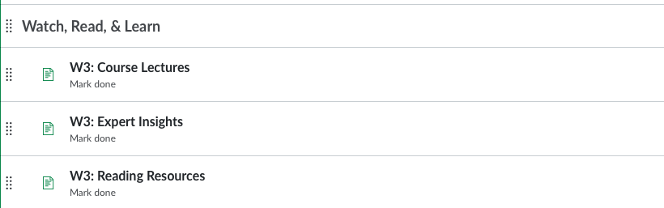
Understand – Provide Instructional Resources

Slide 22
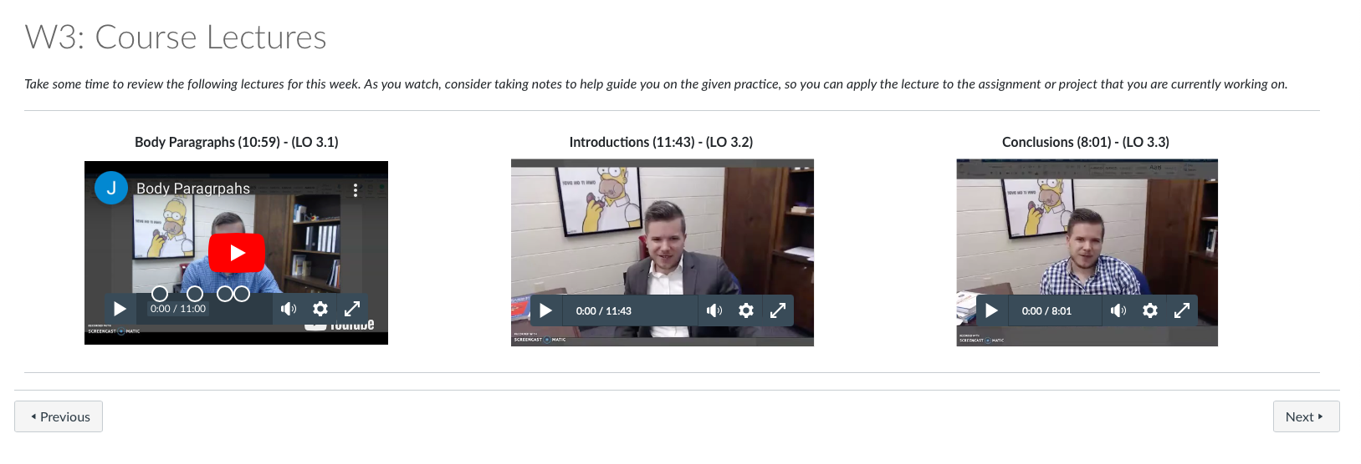
Understand – Provide Instructional Resources

Slide 23
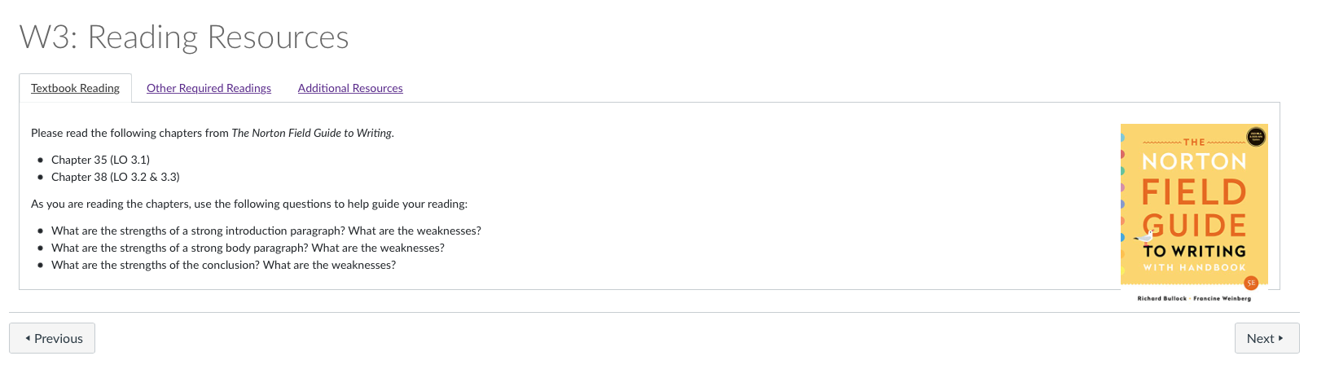
Understand – Provide Instructional Resources

Slide 24


Apply – Practice the Instructional Material

Slide 25
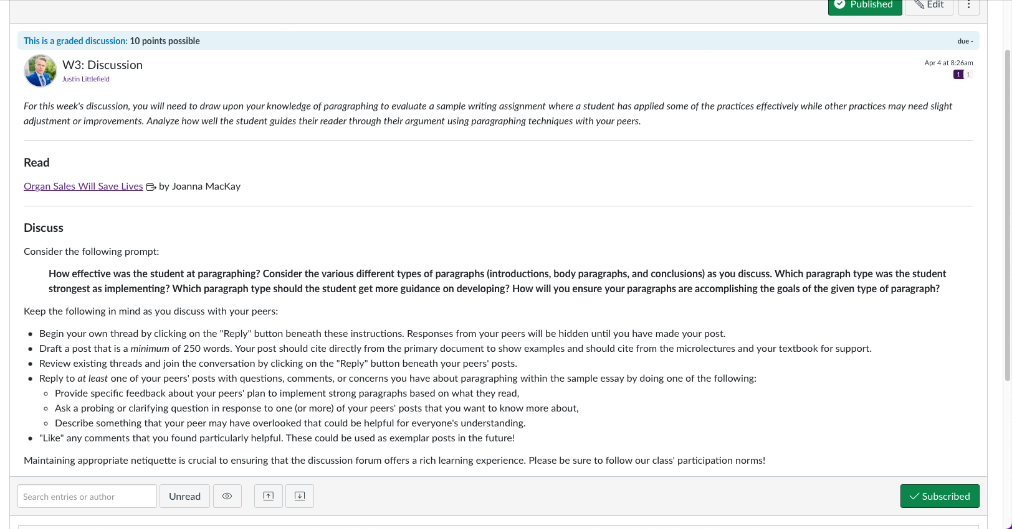
Analyze – Evolve Thinking

Slide 26
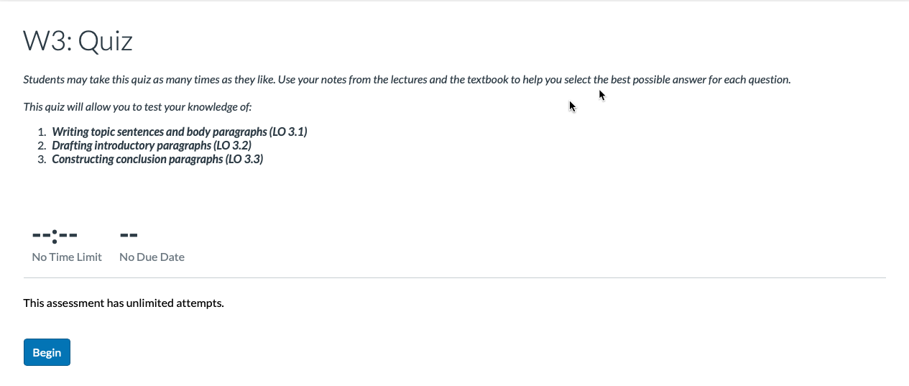
Evaluate – Demonstrate Understanding

Slide 27
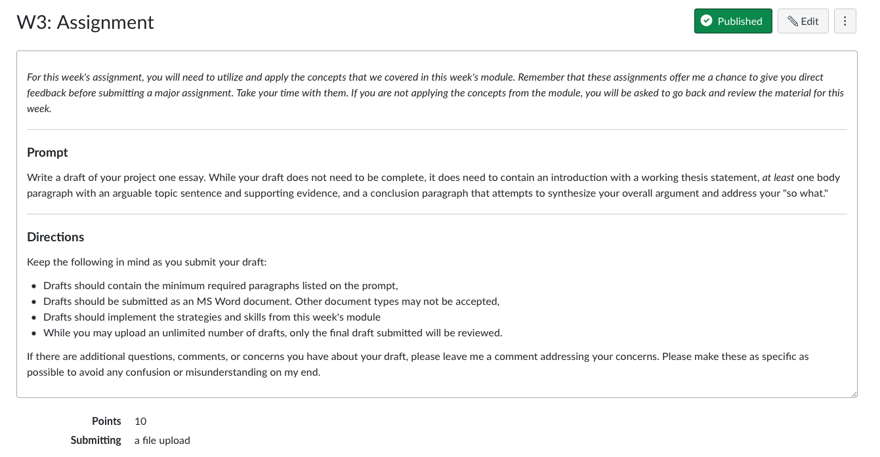
Create – Produce Original Work

Slide 28

Questions?

Slide 29

For More Help
Justin Littlefield
Phone: 737-4607
Email: littlefieldj22@ecu.edu

