Slide 1
DATAset Discourse: The great search for missing data
MENU
ANALYSIS
CONTACT
Jamie Bloss, Amy Cooley, David Durant, Jeanne Hoover, and Xiaolan Qiu

Slide 2
Dataset Discourse Discussion
01
Overview
02
Resources for finding data
03
Discussion

Slide 3
Background
Federal agencies needed to comply with Executive Orders to remove information on topics.
Data and information is being removed temporarily or permanently
Data and information is being edited
Executive Orders may be in the process of being challenged in courts which may change the full impact of the orders.
Federal judge orders some information and data to be restored on health-related websites
For example: CDC restored webpages and datasets on adolescent health, HIV, and more.

Slide 4
Background
The Office of Personnel Management provided the following guidance based off Executive Order 14168, Defending Women from Gender Ideology Extremism and Restoring Biological Truth to the Federal Government
"Take down all outward facing media (websites, social media accounts, etc.) that inculcate or promote gender ideology."
"Withdraw any final or pending documents, directives, orders, regulations, materials, forms, communications, statements, and plans that inculcate or promote gender ideology"
"Ensure that all applicable agency policies and documents, including forms, use the term "sex" and not "gender."

Slide 5
Background
The Office of Personnel Management provided guidance related to Executive Order 14151, Ending Radical and Wasteful Government DEI Programs and Preferencing
"Withdraw any final or pending documents, directives, orders, materials, and equity plans issued by the agency in response to now-repealed Executive Order 14035."
"Take down all outward facing media (websites, social media accounts, etc.) of DEIA offices"

Slide 6
TIMELINE
January 21: Federal health agencies ordered to pause all external communications
MMWR suspends publication for first time since 1952
January 30: USDA orders deletion of webpages referencing climate change
January 31: CDC removes data sets & webpages discussing gender identity and equity
Also retraction/recall of research articles containing banned terms related to gender/sexuality

Slide 7
TIMELINE
Early February: Widespread purging of references to climate change from numerous agency websites
February 6: MMWR resumes publication
February 11: Judge orders restoration of some CDC/FDA content (Doctors for America v. Office of Personnel Management et al)
February 24: Lawsuit demanding restoration of climate change data to USDA website (Northeast Organic Farming Association of New York v. U.S. Department of Agriculture)
Numerous efforts to download/archive federal data/websites

Slide 8
TIMELINE
NCI: Researchers prohibited from submitting publications containing terms like: vaccine, fluoride, autism (https://www.propublica.org/article/national-cancer-institute-flagged-topics-vaccines-autism-rfk-jr)
USCG Academy: "climate change" censored from curriculum (https://insideclimatenews.org/news/07032025/coast-guard-academy-censors-climate-change-terminology/)
EPA: Office of Research and Development to be substantially eliminated (https://www.nytimes.com/2025/03/17/climate/trump-eliminates-epa-science.html?unlocked_article_code=1.6U4.qBUb.4jGpdWZTrgzY&smid=url-share )
Current situation is very much unsettled

Slide 9
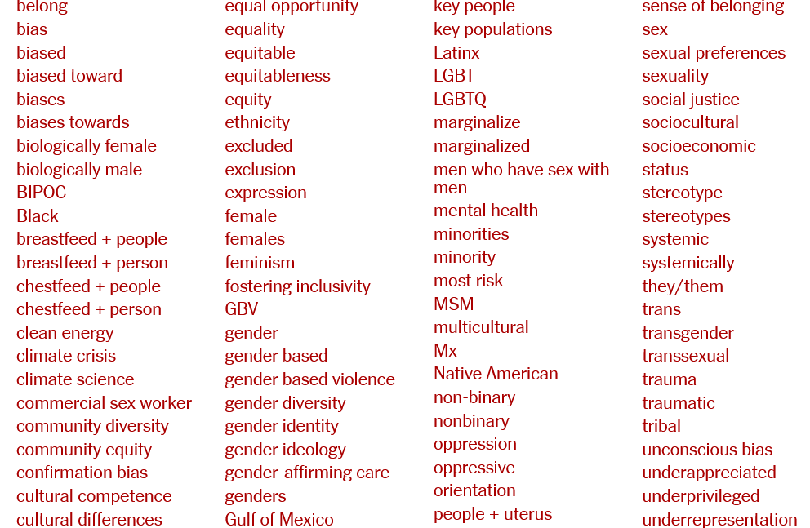
BANNED TERMS IN FEDERAL RESEARCH
Source: https://www.nytimes.com/interactive/2025/03/07/us/trump-federal-agencies-websites-words-dei.html?unlocked_article_code=1.6U4.9vrT.SK3JT1kxePT7&smid=url-share

Slide 10
Where is the data?: A Checklist
Confirm that the data you need is not available:
Search data.gov
Check the agency website
Check the Internet Archive Wayback Machine
Archived sites may have what you need
Check the Data Rescue Project's Data Rescue Tracker (updated, but not comprehensive)
Explore other archives
This adapted list is by Jessica Breen and Gwendolyn Reece is used under a CC BY NC 4.0 license.

Slide 11
Where is that Information?: A Checklist
Locating potentially redacted websites
Compare archived versions of the webpage in the Internet Archive Wayback Machine
Check the End of Term Archive which archives government websites at the end of an administration.
Confirming undocumented data redactions
Compare snapshots of the same dataset or webpage against archived copies
Diffchecker can check to see differences between files
Check for metadata or file size discrepancies
Look for references to the data in other sources, like academic publications
This adapted list is by Jessica Breen and Gwendolyn Reece is used under a CC BY NC 4.0 license.

Slide 12
Resources for locating data
Laupus Library Data Research Guide: Includes links to resources and data repositories (DEMO)
Data Lumos (ICPSR): Data archive of public government data. They accept submissions from users.
ICPSR: Data repository of various data sets from the Census Bureau, National Center for Education Statistics, Bureau of Justice Statistics, and more. Focused on Social Sciences.
Harvard Law Library Innovation Lab: Archive of data.gov which includes over 311,000 datasets. Access is challenging, but available.
Internet Archive Wayback Machine: Collection of archived websites
GODORT: ALA's Government Documents Round Table. They provide resources, communication recommendations, articles, and statements.
End of Term Web Archive: Captures U.S. Government sites at the end of presidential administrations since 2008.

Slide 13
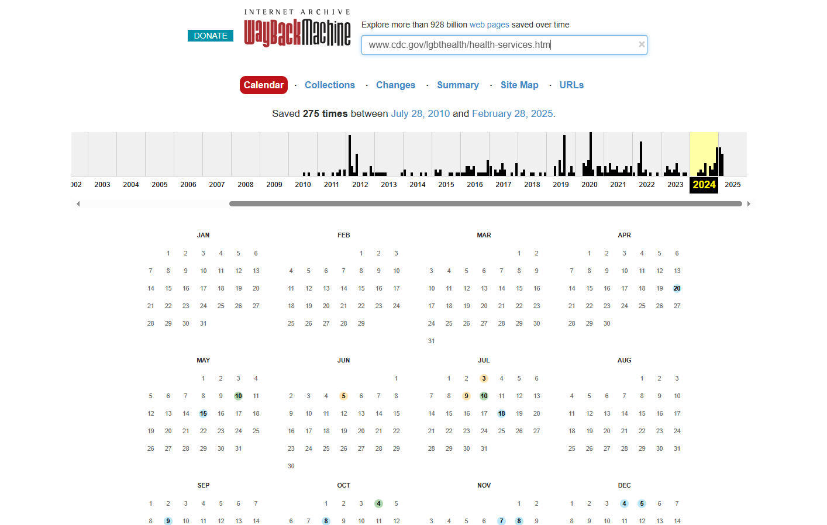
Using the internet archive wayback machine
Search for: www.cdc.gov/lgbthealth/health-services.htm
Hover over dates captured and click to go to that date

Slide 14
places to get involved
An initiative to identify, obtain, reformat, clean, document, publish and disseminate government datasets of public interest
The Data Liberation Project
https://www.data-liberation-project.org/
Clearinghouse for data rescue-related efforts & data access points for public US governmental data currently at risk. Established data & website efforts & Data Rescue Tracker
Data rescue project
https://www.datarescueproject.org/
The Internet Archive Wayback Machine is a service that allows people to visit archived versions of Web sites
The wayback machine
https://web.archive.org/
Safeguarding Research & Culture (SRC)
https://safeguarding-research.discourse.group/
Creating an alternative infrastructure for archiving and disseminating of cultural heritage and scientific knowledge. Identify Data at risk of disappearing

Slide 15
Where do we go from here? Open Discussion-
What can we do?
As individuals
Collectively
How should we address this with our departments?
Impact to researchers and/or particular fields
Larger community (ECU, Greenville, UNC system schools, additional institutions, etc.)
How can we stay up-to-date on latest digital preservation developments?

Slide 16
Questions?
MENU
ANALYSIS
CONTACT
Jamie Bloss
blossj19@ecu.edu
Amy Cooley
curtisam19@ecu.edu
David Durant
durantd@ecu.edu
Jeanne Hoover
hooverj@ecu.edu
Xiaolan Qiu
qiux24@ecu.edu

