Slide 1
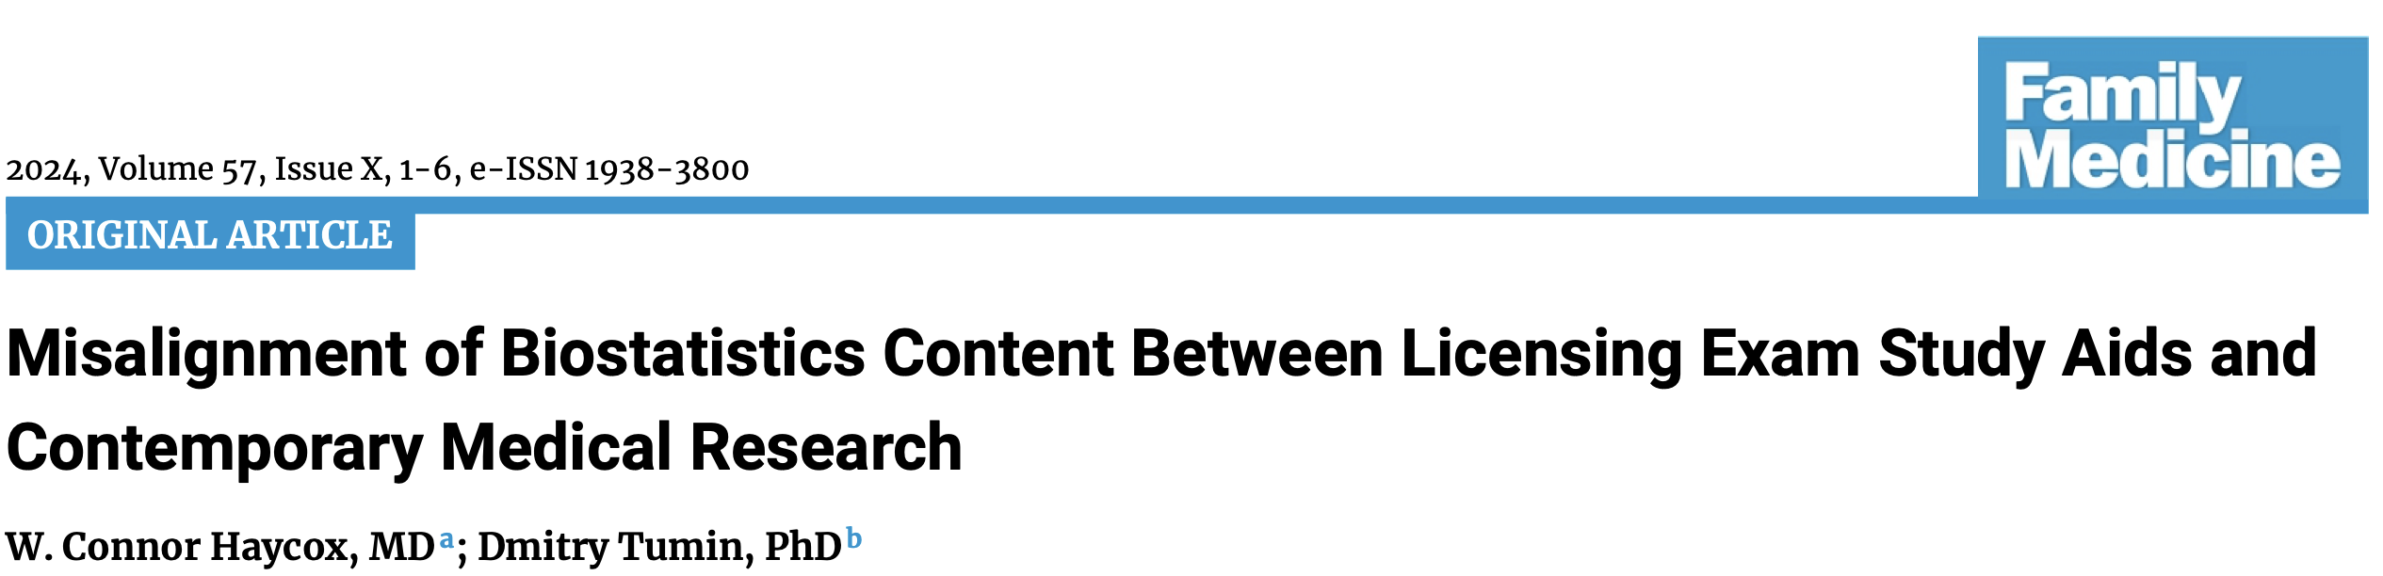
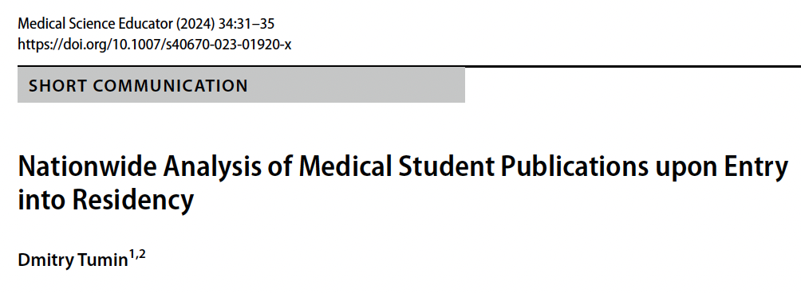

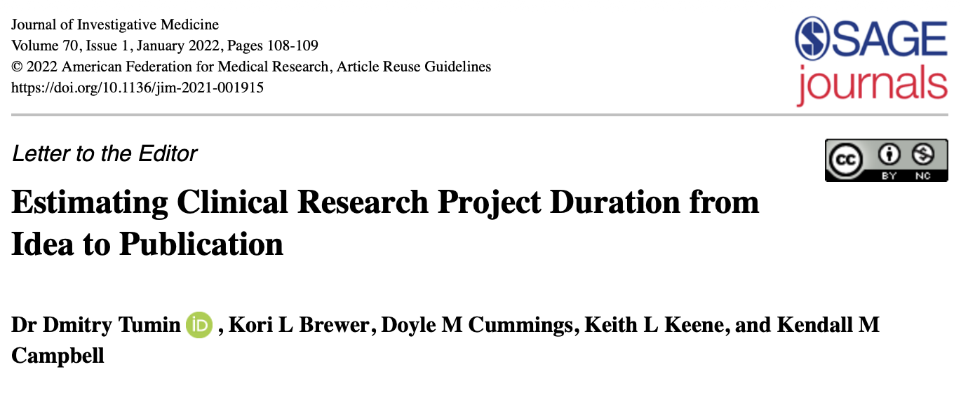
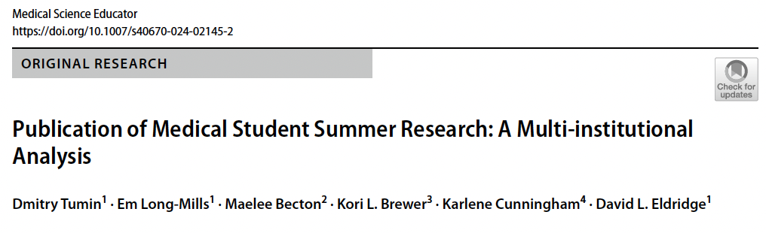
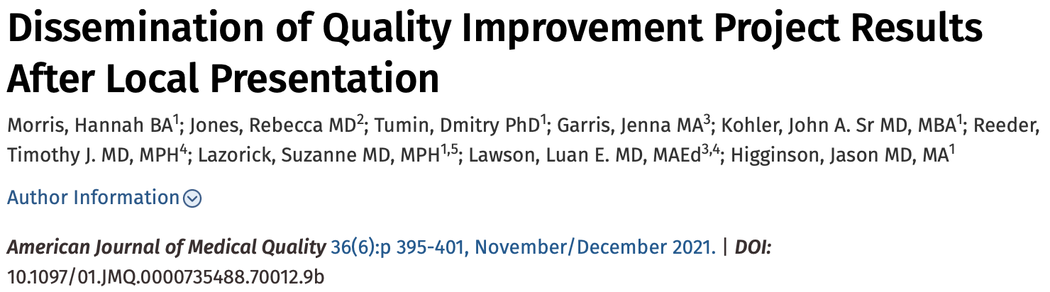
Dmitry Tumin, PhD
Assistant Dean of Clinical and Educational Scholarship
2024/2025 Scholar Teacher
Brody School of Medicine at East Carolina University
Greenville, North Carolina 27858
tumind18@ecu.edu
Evidence-based
research mentorship
BSOM Office of Clinical and Educational Scholarship
Evidence-based biostatistics education
“How much research do I need?”
“How long does research take?”
“What are my chances of
getting published?”
”Can I publish scholarly work
other than research?”
Project development
Project tracking
Research advising
Research education
M1
Data structure, inference, comparison
M2
Prediction, agreement
Clinical and population health applications
Step 1 review
M3
M4
Step 2 review
Advanced methods
(specialty-specific)
Transition to residency
Results – Medical Student Publications
GME
Journal club
review
National norm: 43%
Summary
I lead the Brody School of Medicine Office of Clinical and Educational Scholarship (OCES), a unit of the Department of Academic Affairs, which supports learner, faculty, and staff excellence in scholarly activities pertaining to patient care, population health, health professions education, and professional development in academic medicine. This office manages clinical and educational scholarly projects within Brody School of Medicine, provides education and consultation on project methodology and dissemination of findings, and fosters scholarly collaboration within the Brody School of Medicine and ECU Health. Through my role in OCES, I also collaborate with BSOM and ECU Health leadership to provide ad hoc and longitudinal education on biostatistics and research methods in the undergraduate medical curriculum and as part of graduate medical education (GME) of resident and fellow physicians. To inform my work in research mentorship and biostatistics education, I have conducted a wide range of educational research projects providing evidence on the conduct and publication of clinical research; the importance of biostatistics resources for scholarship in academic medicine; and the use of biostatistics methods in medical literature.
OCES
established
Figure 1. Percent of BSOM graduates with any publications during medical school, by graduating class.
Figure 2. Types of publications, by medical school graduating class.

