Slide 1
Navigating the Role of ECU CONNECT in Concerns about Student Progress:
Identifying and Addressing Key Issues with Confidence

Slide 3
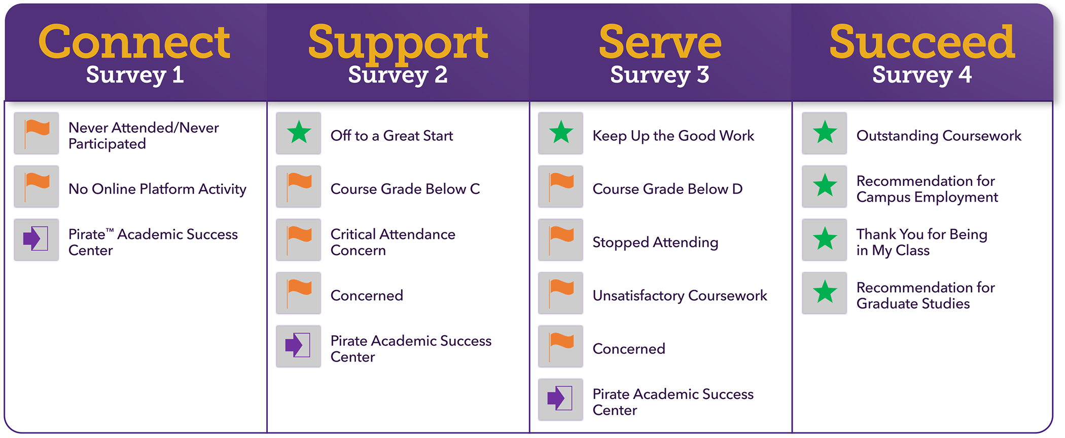
Understanding the Student Journey! Why we chose a thematic approach

Slide 4
Understanding the Student Journey! Roster Verification
Notes:
Making sure students understand that they are in classes and that attendance is an important contributing factor to success

Slide 5
Understanding the Student Journey! Supporting Students with ECU Resources

Slide 6
Understanding the Student Journey! Mid-Semester Feedback
Open | March 3rd
Deadline 1 | March 12th
Deadline 2 | March 19th
Close | March 26th
Notes:
Last day to W/D March 27 we got his information from talking to our pilot of academic advisors, they wanted time to reach out to students to make sure they knew about the withdrawal date.

Slide 7
Understanding the Student Journey! Finish the Semester Strong
Notes:
Finish Strong, students getting that final push from instructors to finish strong before exams
Closes on the last day of Class (4/29)
Opens 4/7

Slide 8
Why Should I Raise an Item?
Don’t Let Classroom Contact Go to Waste
Average first semester student hours spent….
“In all cases analyzed, midterm grades strongly predicted final grades… Midterm grades were also strongly correlated in a variety of other academic disciplines at the liberal arts college, including the humanities, the social sciences, and the fine arts”
– James Barron & Phillip Jensen
Journal of College Science Teaching (2014)
1 in an advising office
225 in a classroom, assuming full courseload
Notes:
Koproske, C., Gfeller, H., Silverman, A., Hickman, C., & Ho, M. (n.d.). Faculty as Individual Contributors. In Defining the Faculty Role in Student Success (pp. 38–38). essay, EAB.

Slide 9
Empowered to Go Beyond the Survey Approach
The Ability to Raise Items Manually
Can happen at any moment in the semester to any student or multiple students.
Viable option when you need to raise concerns or give praise outside of the survey window.
Notes:
You can raise items that are not on the survey

Slide 10
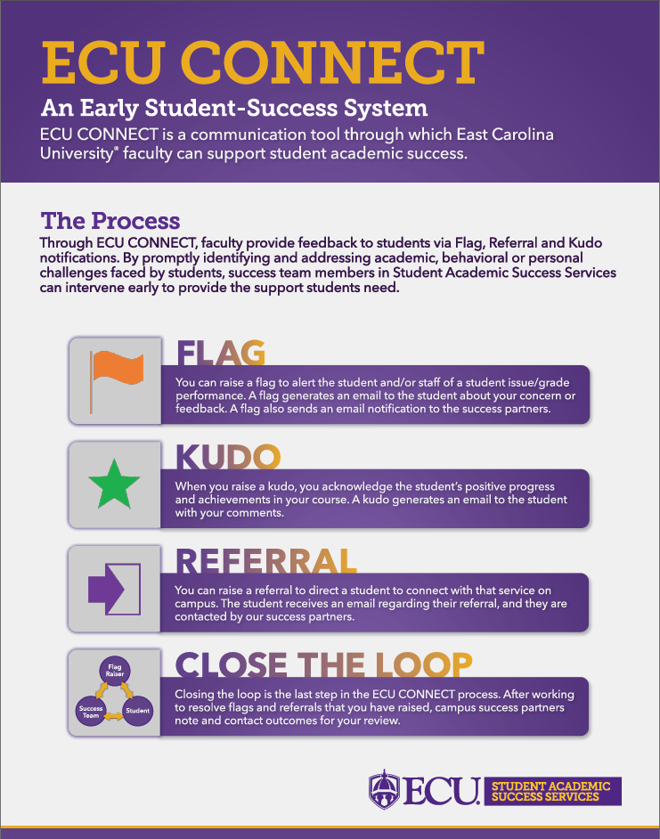
Which Item Should I Raise? The Power of Choice, but Paralysis Analysis
Notes:
The options you have in a progress survey vs the options you have as a manual raiser
You will have a PDF of this attached to this session on OFE’s website

Slide 11
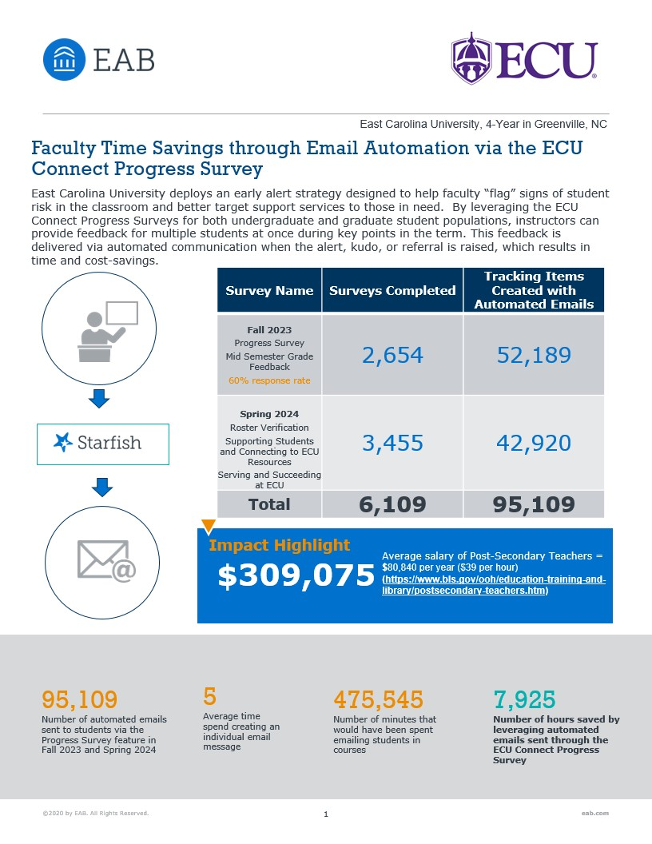
How ECU CONNECT Can Help You
Notes:
95K automated emails sent from AY23-24
Saved 7,925 hours for our raisers

Slide 12
Resources
URL: https://libguides.ecu.edu/SummerMelt
https://universitybusiness.com/the-top-5-campus-communication-mistakes-to-avoid/
Coghill, E. (2024) The top 5 campus communication mistakes to avoid.

Slide 13
Thank You!
Dylan Moore
Mooredy22@ecu.edu

