Slide 1
Using Grant Databases to Find Funding Opportunities
Jamie Bloss – Research Librarian and Jeanne Hoover - Head, Scholarly Communication
blossj19@ecu.edu
hooverj@ecu.edu
Notes:
Jamie & Jeanne

Slide 2
Agenda and learning outcomes
Locate grant research sources on the library homepages
Be able to access and run a search in the SPIN database
Recall how to set up SPIN funding alerts
Learn how to search the Foundation Directory Online
Notes:
Jamie:
Today I am going to show you 2 grants searching tools: SPIN and Foundation Directory Online. Both of them can be found and access via the database list in our website.
SPIN: SPIN, which stands for Sponsored Programs Information Network, is an extensive research funding opportunity database. SPIN contains over 40,000 opportunities from more than 10,000 sponsors. With SPIN, you can: Access funding information online from any browser, organize grant information in one convenient place, gain access to the largest keyword list, allowing for greater flexibility in your searches, quickly locate Limited Submission Opportunities with Federal or non-Federal programs, and locate all types of funding information—Fed Business Opps / Federal Register Guide. SPIN is a funding opportunity search engine which is for existing/active opportunities.
Foundation Directory Online supports multiple Research Clusters. Provides information on over 100,000 foundations, corporate giving programs, and grantmaking public charities. Includes a searchable database of millions of recently awarded grants. Foundation Directory Online is more like a database of past grants records.

Slide 3
Library homepage & links for access
Grant Research Guide link: Grants for Research - Grants - Research Guides at East Carolina University Libraries (ecu.edu)
Libraries link: Libraries | Information | ECU
Databases: Database List - ECU Libraries & List of Grant Databases
SPIN: https://lib.ecu.edu/databases/go/547
Foundation Directory Online: https://lib.ecu.edu/databases/go/191
Library catalog: https://librarycatalog.ecu.edu/
Notes:
Jamie:
Grant Research Guide: http://libguides.ecu.edu/grants
Search the library catalog
Grant writing
Grant proposals

Slide 4
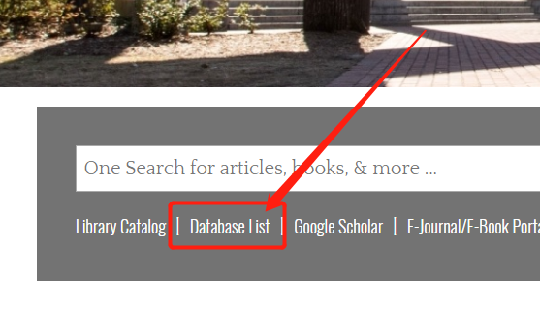
SPIN
-Entry
Library website entrance
Registration with ECU email
Setting account after approval
Notes:
Jeanne:
I am going to show you how to use SPIN to search. First I’ll show you how to enter SPIN from the ECU website.
Setting up an account (not needed, but helpful for saving searches or bookmarking opportunities)
Go to Login
Click on Create a New Account (Username can be anything, but it needs to be attached to an ECU email)
Accounts need to be validated by the library so please give us at least 24 hours with 48 hours on the weekend to approve it.

Slide 5
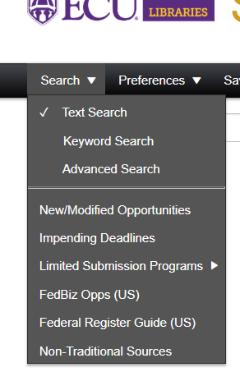
SPIN
-Search
Text Search
Keyword Search
Advanced Search
Predefined search - updated results
Different search types
Predefined search
Notes:
Jeanne:
There are 4 search types: search using free text, search using keywords, advanced search and predefined search.
Go out of the presentation and demonstrate to them
Text: using double quotes to combine the words you need for a search term such as “adult education”, etc. However I will suggest you to use the keyword search when you need a combined searching term. (show them how to use keyword search)
Advanced search is the type of search with which you can specify many conditions for the search. You can also use text search or keyword search and then set your search preference to get the same results.
There are several predefined search here.
New/Modified opportunities is the search for the opportunities over the past seven days;
Impending deadlines is to search for the opportunities with deadlines in the next 8 weeks or with open deadlines.
Limited submission programs is the search (preference?)
FedBiz opps are the search for the US business opprotunities which are sorted automatically by the date updated.
The other 2 item, federal register guide and non-traditional sources are some guide and resources that you may use for your funding search.
Basic Keyword Searching
Health literacy--- auto searches for both terms (auto adds AND between the terms)
Can add OR, point out search help in upper right corner under help link
Review an entry and show the different tabs—highlight the Keywords on first tab and the Opportunity URL on the last tab. The opp. Url links to the website/funder offering the funds.
Show how to email opp. In upper left OR bookmark opportunity if logged into account

Slide 6
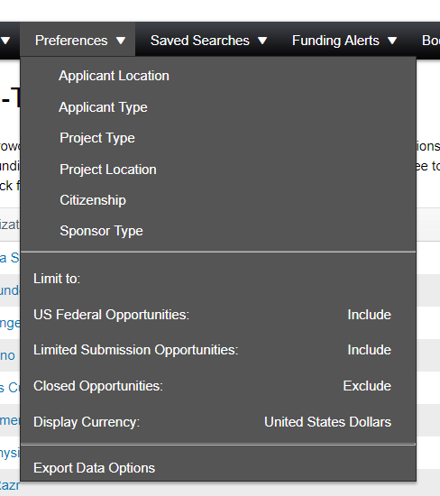
SPIN
-Search Preference
Notes:
Jeanne:
Now let’s see preference. It is where you configure your search results, or filter the results before you do the searching.(demo) Show how to narrow by results by adding “Preferences” under the Preferences tab. This helps refine your results. If signed in, your preferences will be auto saved to your account.
Example: Project Location --Select location as North Carolina. Results should be funding opportunities that allow for projects within North Carolina. NOTE: if a location isn’t specified, it will come up anyway. This is why you may see unrelated opps show up.

Slide 7
SPIN
-Management
Saved Search - Opportunity group
Bookmark - Single opportunity
Funding Alert - Bond with saved search
Saved search
Bookmark
Notes:
Jamie:
Public search: updated by Office of Sponsored Programs 2906 Greenville Centre
You can save your search as “saved search”. By the time you save it, you can set the funding alerts. You can also set the funding alerts of your saved search later in “funding alerts”
Bookmark is to bookmark a single opportunity and you will need to create a group for your bookmarked opportunities or save it into an existing group.
Your Account:
Log into SPIN, and show the same search.
Save Search
Bookmark 1-2 options

Slide 8
Foundation Directory Online
Database List in Joyner Library website;
Historic grants records with details
Find Funding
Pathways
Resources
Notes:
Jamie:
They have the same principles of searching. FDO has a better user interface with the auto droplist and tips in the fields.
FDO is more like a grants record database that you can find how did the fundings and grants do, who was the recepients and who was the grantmaker, how was the funding details, etc. It offers good reference information.

Slide 9
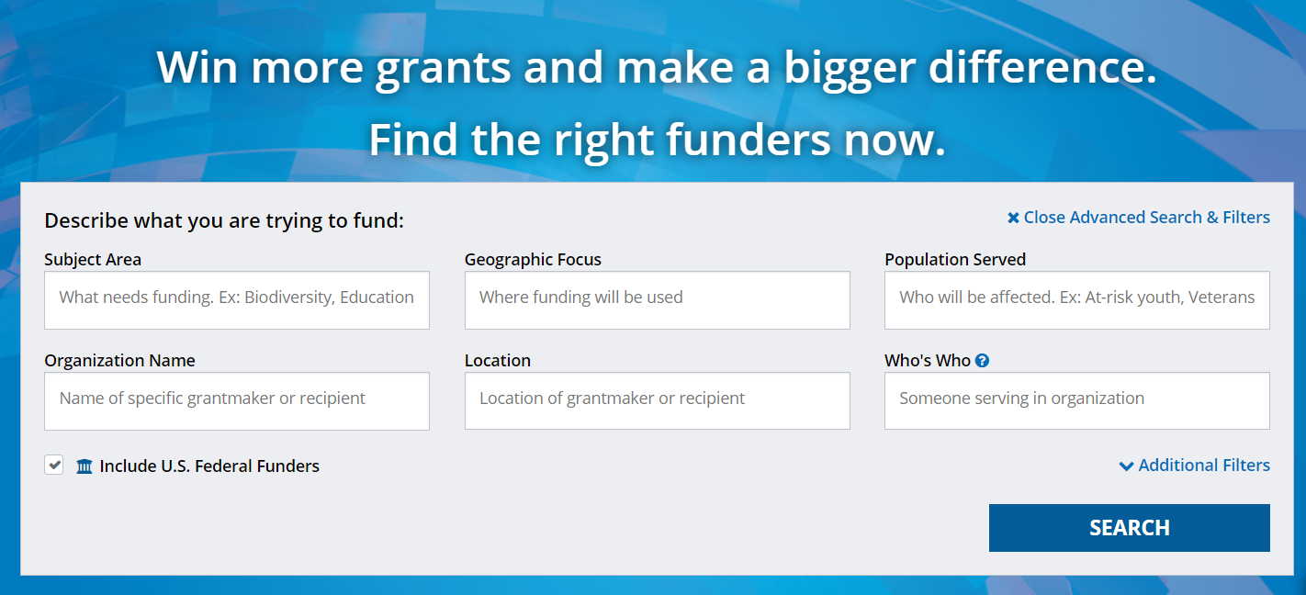
Foundation Directory Online
Practice search for grantmakers and grants
Seek support from the Office of Corporate and Foundation Relations at ECU_CFR@ecu.edu
Notes:
Jamie:
Foundation Directory: exercise AND youth
PowerSearch and refine to Grantmakers
Point out “Geographic Focus” and “Applications Accepted”
Select “North Carolina”
Grants--Same search, go to first example

Slide 10
Additional Resarch & Publication Support
Journal selection and research impact metrics
Data management support, including review of data management plans*
Support with ORCID IDs, ScienCV, and NIH/NSF biosketches
Systematic review and other evidence synthesis assistance
Copyright and Fair Use
Open access publishing support, including options for free or reduced OA costs for ECU authors
Joyner Library Laupus Library
scholarlycomm@ecu.edu Jamie Bloss, blossj19@ecu.edu
Xiaolan Qiu, qiux24@ecu.edu *

Slide 11
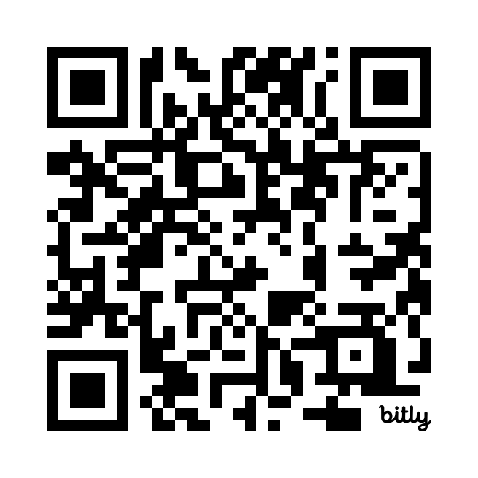
Thank you! Please fill out feedback form.
Notes:
Jamie & Jeanne:
https://ecu.az1.qualtrics.com/jfe/form/SV_4MEsrrQUOzvNDOC

