Slide 1
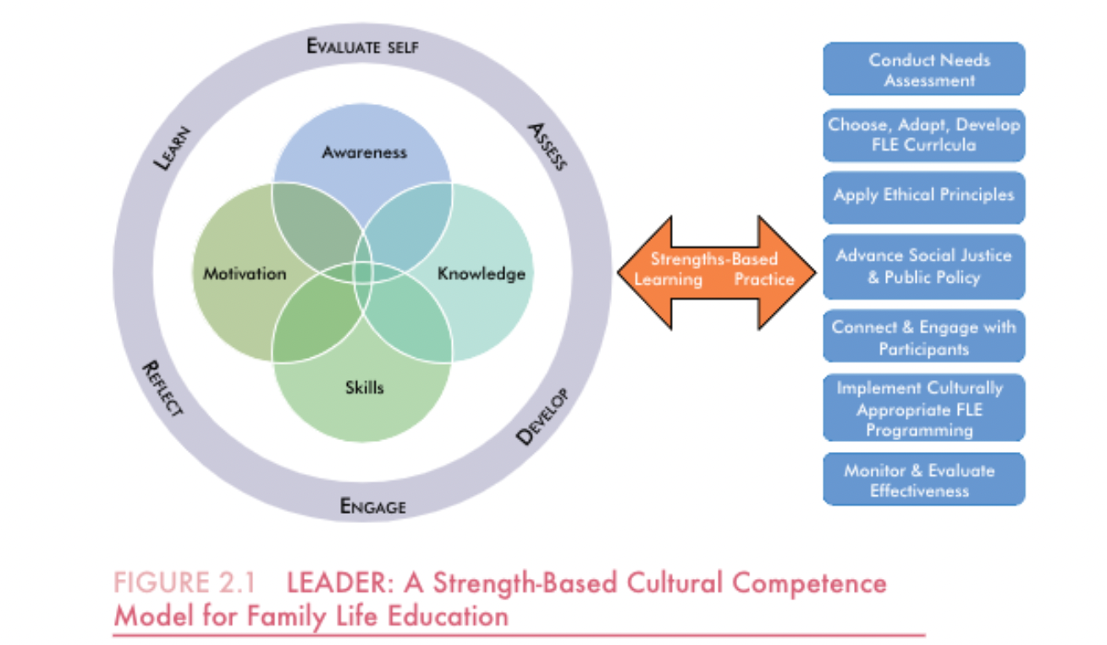
Jacquelyn Mallette, PhD, CFLE
College of Health and Human Performance
2024/2025 Scholar Teacher
Human Development & Family Science
Greenville, North Carolina 27858
mallettej16@ecu.edu
SHARP/WEAR Program Evaluation
Research-Based Teaching
I create a cohesive classroom experience that unites teaching and research, enabling me to develop teaching practices grounded in evidence-based methods while supporting the growth of my students. By sharing my research and experiences with the research process, I invite students to engage in critical thinking and encourage them to see learning as a dynamic, ongoing process.
Grant Writing, Fundraising, and Leadership Development - students collaborate with community partners, identifying organizational needs, and developing grant proposals and fundraising projects that are directly tailored to the needs of the organization.
Family Life Education - students research and develop educational programming that could be implemented and evaluated to benefit specific families within the local community, incorporating information from textbook chapters that I have coauthored.
Research Methods in Child and Family Studies - students develop a research proposal based on a topic of their own interest. This process-oriented approach prepares them for the demands of thesis/project work and future research endeavors, further linking my teaching and research to student success.
I am the evaluation PI of a federally funded initiative, SHARP/WEAR, in collaboration with the Pitt County Sheriff’s Office, which provides evidence-based life skills, relationship skills, and substance use disorder treatment programs to incarcerated participants at the Pitt County Detention Center. I have received three internal grants and one external grant to evaluate the SHARP/WEAR program at the Pitt County Detention Center, which employs undergraduate and graduate student assistants.
The students reflected on their experience: “Throughout my time working on the SHARP/WEAR grant, I have seen myself grow as an academic, a researcher, and a family life educator.”
“I have found so much value in the journey of working on this project, not only in the development of soft skills....but also in acquiring practical skills that will undoubtedly serve as invaluable assets throughout my career.”
“We’d both like to thank Dr. Mallette for the opportunity and for being such a great mentor on this project.”
Strengths-Based Research
Using a strengths-based approach, I have examined risk and protective factors, romantic and coparenting relationship functioning, father involvement, and psychosocial outcomes for vulnerable families. I have (co)authored twenty-one peer-reviewed journal articles and six peer-reviewed book chapters. I value student involvement in research and have included student co-authors in ten journal publications and eleven research presentations. Examples include:
Asbury, J., Mallette, J.K., Sira, N. (2024). Exploring parenting behaviors, stress, and closeness among foster parents. Children & Youth Services Review, Advance Online Publication.
Mallette, J.K. & Elmore-Li, C. (2024). Foster caregiver experiences: Implications for retention and satisfaction. Journal of Family Issues, 45(8), 2077-2099.
Almond, L., Mallette, J.K. (2022). Intentions, results, and disuse of online dating for religious and non-religious emerging adults. Journal of Media and Religion, 21(1), 38-54. https://doi.org/10.1080/15348423.2021.2017738
Almond, L., Baugh, E.J., Mallette, J.K., Harcourt, K.T. (2021). Together We Can: Increase Couple Functioning for Low-SES Families. The Family Journal, 29(2), 190-199. https://doi.org/10.1177/1066480720977514
Mallette, J.K., Almond, L., & Leonard, H. (2020). Fostering healthy families: An exploration of the informal and formal support needs of foster caregivers. Children and Youth Services Review, 110, 104760. https://doi.org/10.1016/j.childyouth.2020.104760
LEADER: Cultural Competence Model for FLE
Service-Oriented Mentorship
I believe in the motto “to serve” I use collaboration, empathy, and build trust to nurture the individual development of those I mentor, whether that is students who will create the future of family science or faculty members seeking to refine their teaching or research approaches.
In recognition of mentorship, I was nominated for the James R. Talton Leadership Award by a former graduate student:“ Dr. Mallette was my professor, assistantship director, and mentor. Within my time at ECU, and still to this day, Dr. Mallette has made a significant and lasting impression upon me as a servant leader, through her passion for teaching, mentoring, research, and service to the community.”
This model presents teaching and learning strategies for cultural competence as a characteristic of transformational leadership for our students. It helps new Family Life Educators to provide effective and engaging practices within a multicultural society.

