Slide 1
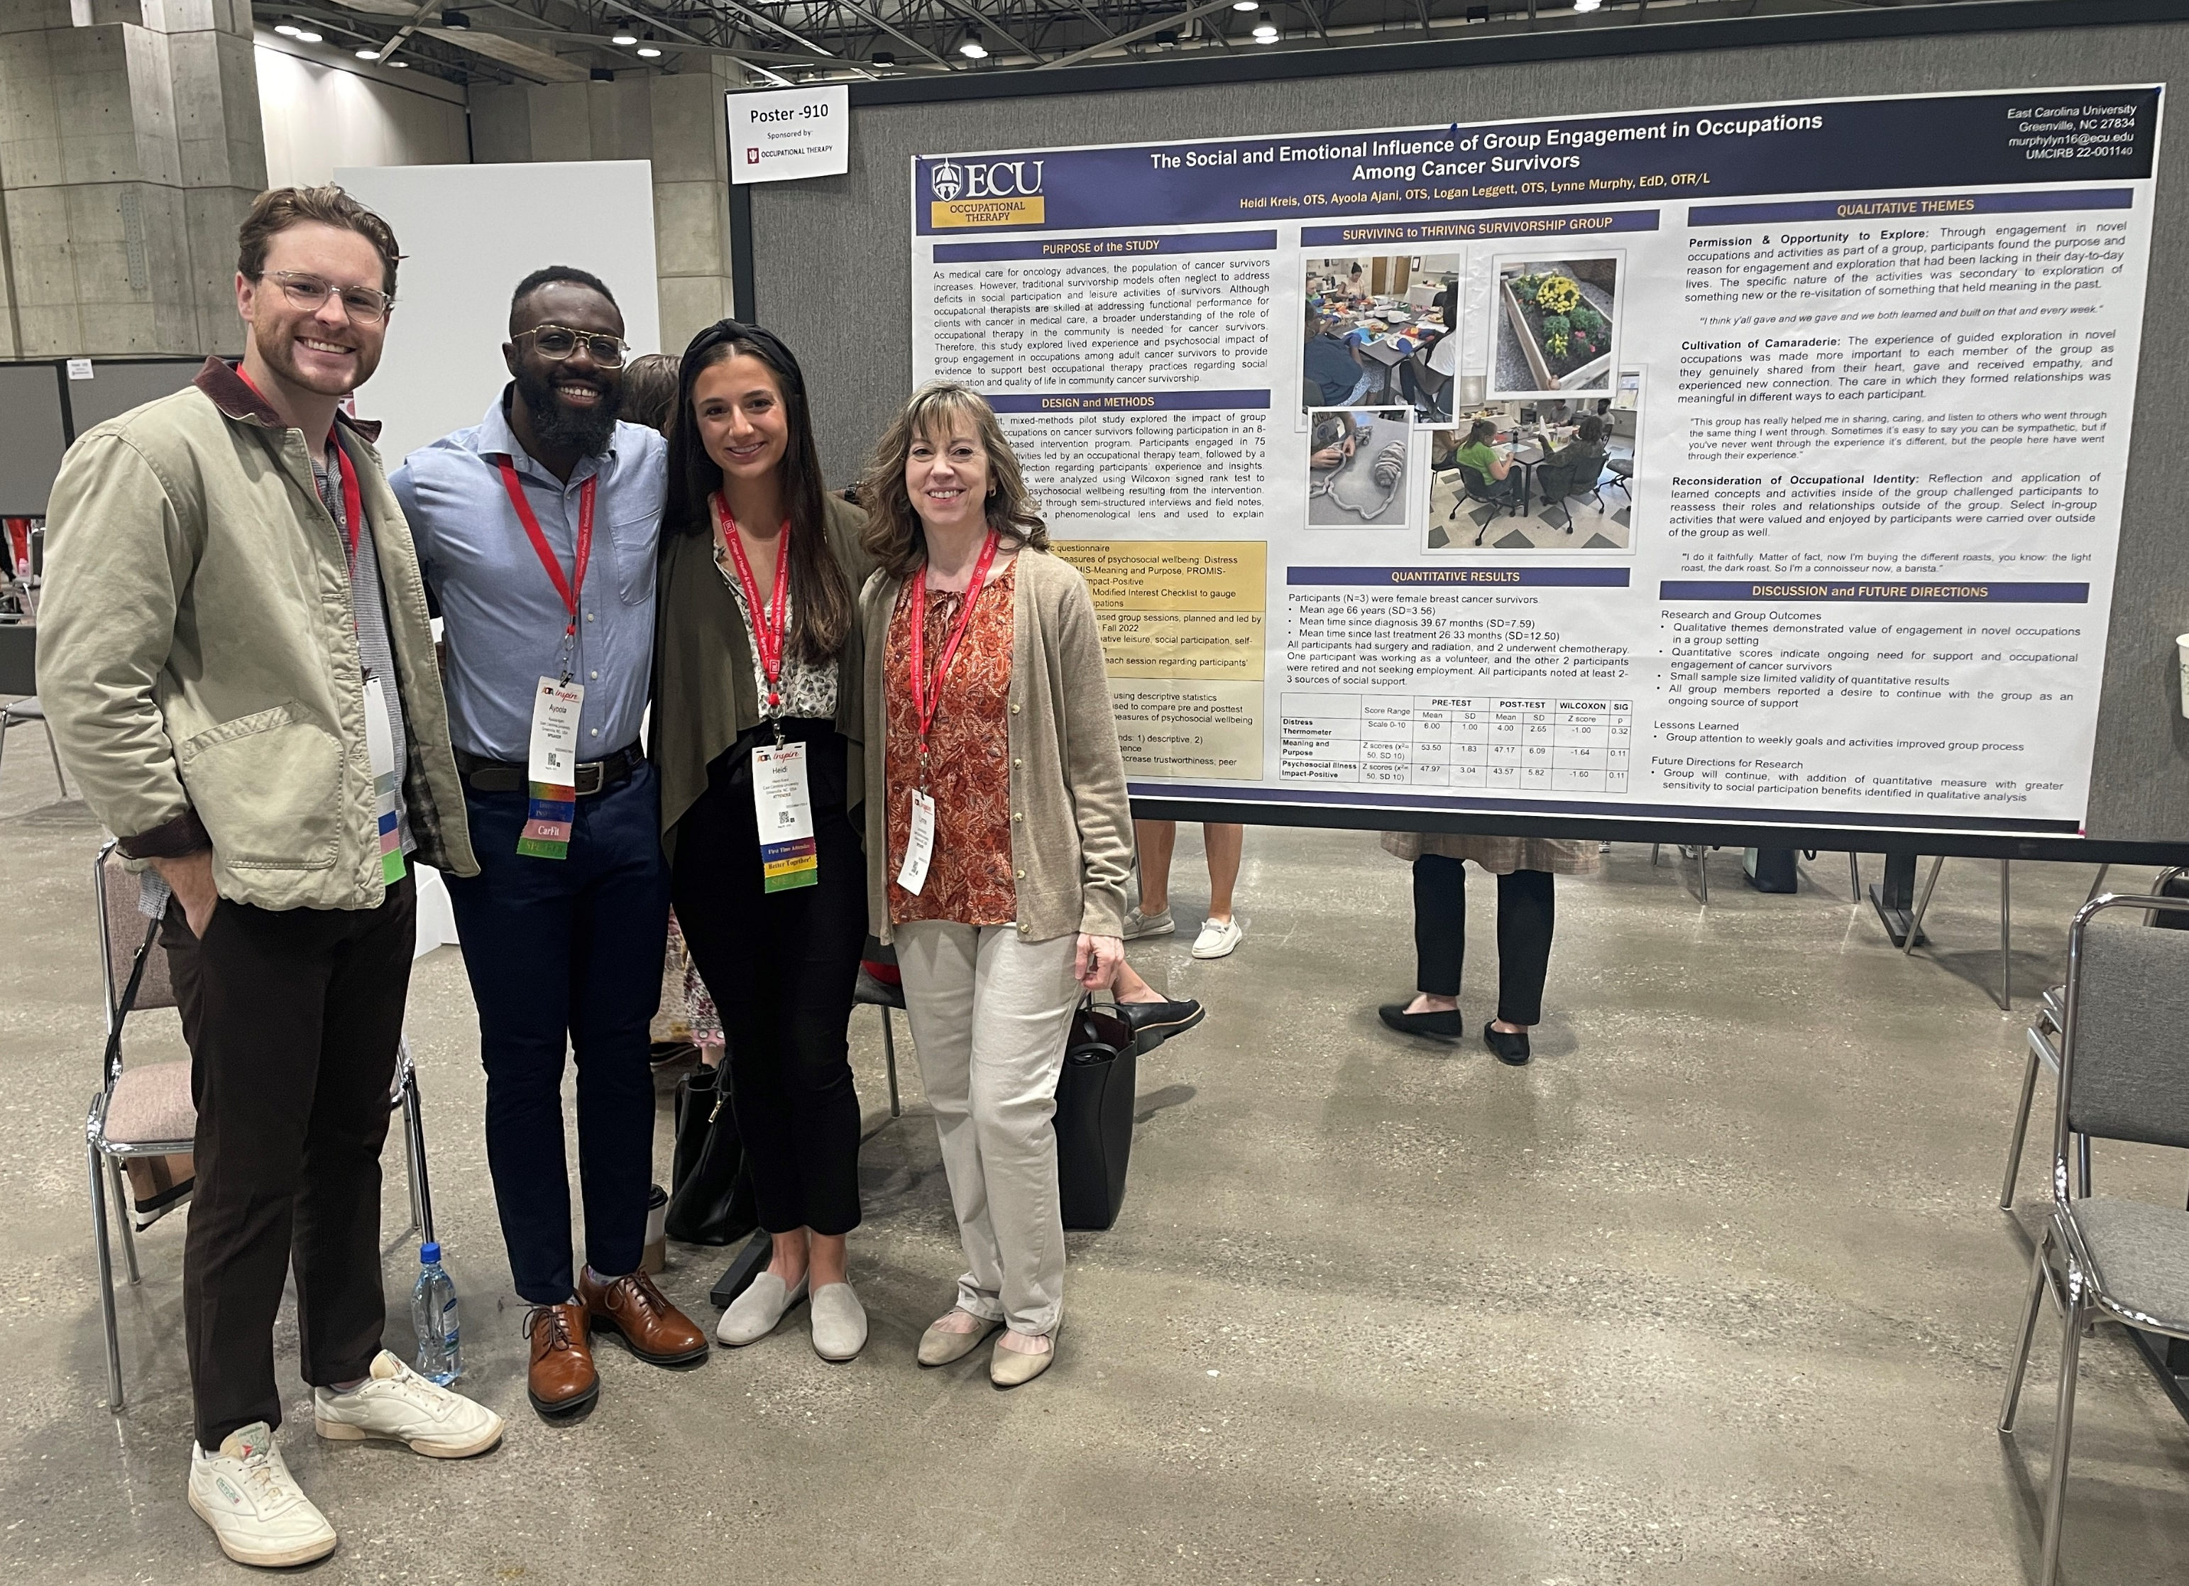
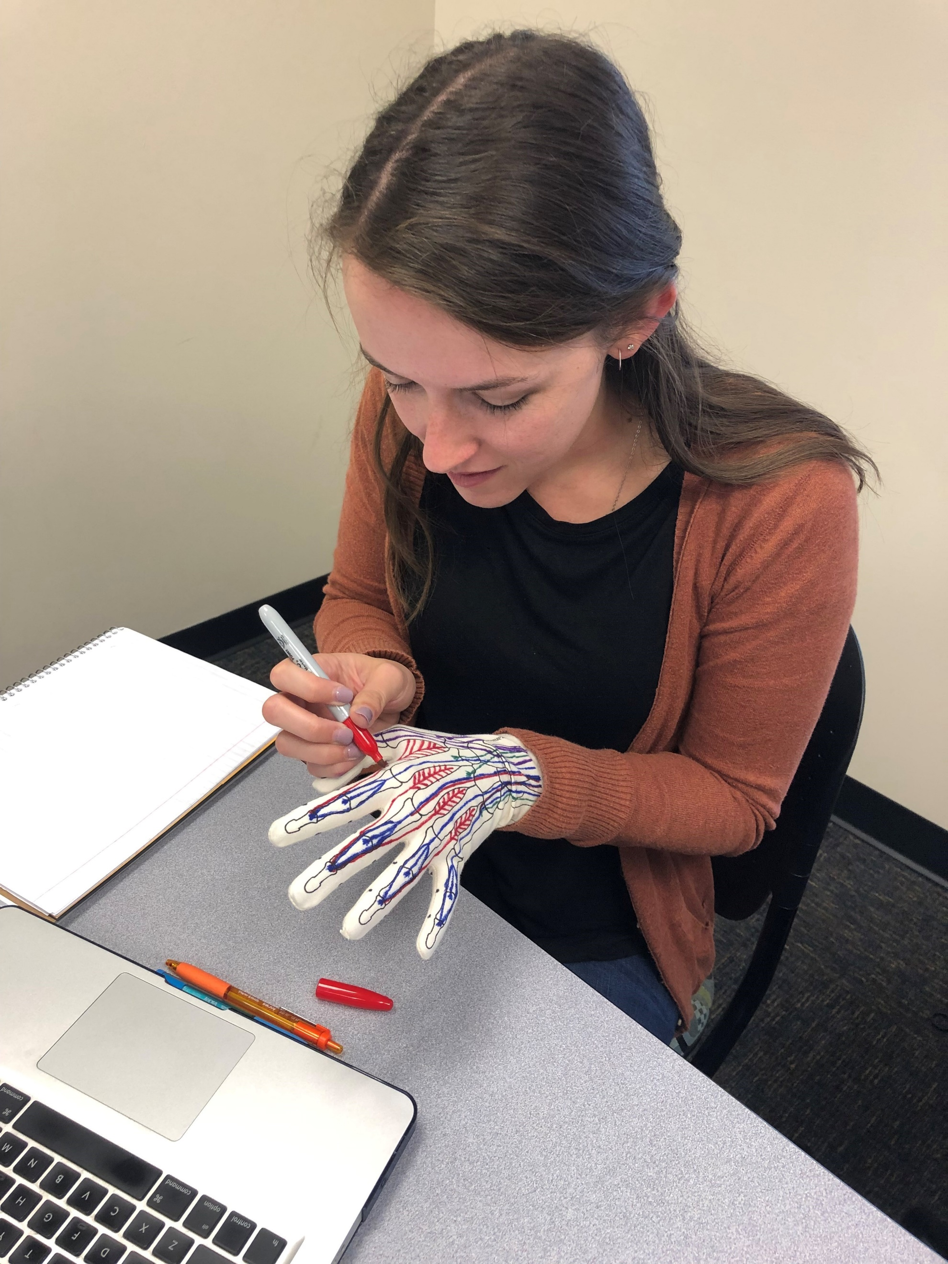
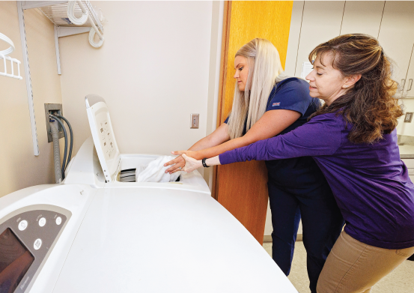
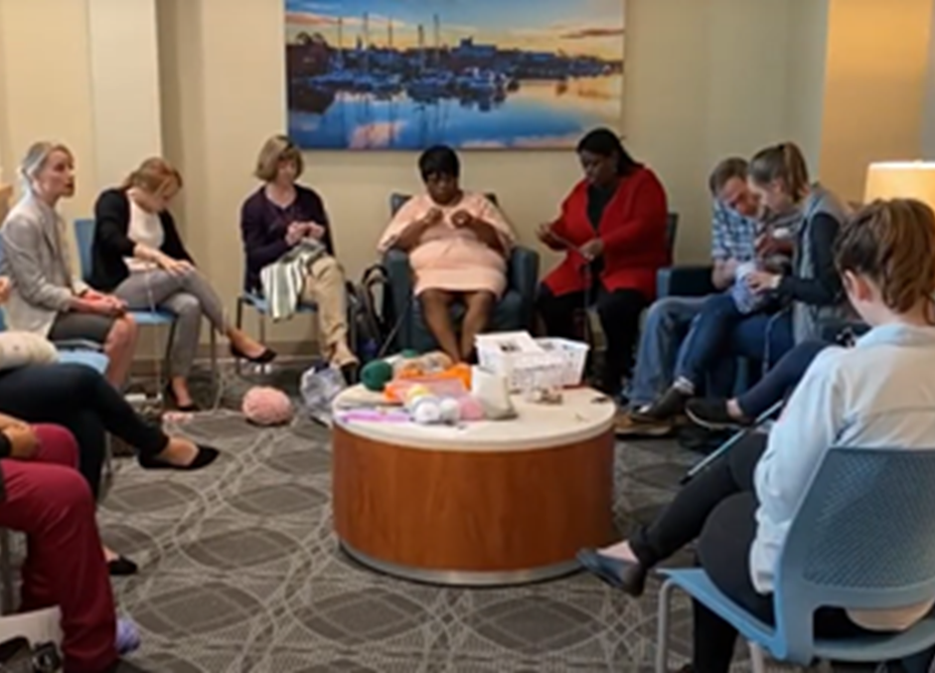
Student Engagement in Active Learning for
Teaching and Research
Lynne Murphy, EdD, OTR/L
Department of Occupational Therapy
College of Allied Health Sciences
Greenville, North Carolina 27858
Murphylyn16@ecu.edu
Teaching Philosophy
Importance of Collaboration
Although teaching is my second career, I have found joy in watching my students grow and thrive, becoming the future of the occupational therapy profession that has always matched my core values.
Teaching clinical skills and habits of mind, I believe, relies on student engagement in active learning. Learning is achieved through engaging in activities that make the content relevant, meaningful, and situated in real-life contexts
Research has been an effective tool in helping me become a better teacher. My research regarding occupational therapy education has included:
Development of Clinical Reasoning
Universal Design for Learning
Interprofessional Education
Case-Based Learning
Anatomy Glove Learning System
Student-Run Clinic Outcomes
Collaboration with other researchers, both faculty and students, is energizing. My collaborations have allowed me to learn new skills, embrace learning about new areas of practice, and achieve shared goals for research dissemination.
As I’ve developed a deep appreciation for qualitative research, the value of a collaborative and creative team has become evident. Discerning meaning and understanding of lived experiences makes research all the more exciting for students and faculty collaborators.
Finally, shared dissemination activities with students will hopefully continue to inspire our graduates to continue research well into their professional careers.
Selected Collaborative Scholarship
Dickerson, A., Murphy, L., & McIntyre, M. (2024). Outcomes from a driving and community mobility intervention designed for novice drivers with autism from the perspective of the participants and their parents. Journal of Autism and Developmental Disorders. https://doi.org/10.1007/s10803-024-06618-6
Murphy, L., Panczykowski, H., Kreis, H., Ajani, A., & Leggett, L. (2024). Qualitative analysis of group engagement in occupations among cancer survivors. Journal of Cancer Rehabilitation, 7(3), 102-110. https://doi.org/10.48252/JCR100
Panczykowski, H., Murphy, L., Christmas, V., & MacIntrye, W. (2024). Practice and recommendations for Universal Design for Learning in occupational therapy client education. The Open Journal of Occupational Therapy, 12(1), 1-11. https://doi.org/10.15453/2168-6408.2115
Panczykowski, H., Murphy, L., Heyward, K., & Hupp, T. (2022). Lived experiences of parents of children with disabilities engaged in a support group incorporating equines. Research in Developmental Disabilities, 128, 1-10. https://doi.org/10.1016/j.ridd.2022.104294
Murphy, L., Ellis, K., Jennette, N., Lee, S., Lennon, R., & Norton, G. (2022, April 3). Impact of a cancer survivorship program on well-being and community involvement. [Research Platform Presentation]. American Occupational Therapy Association (AOTA) Annual Conference, San Antonio, TX, United States.
Murphy, L. & Eglseder, K. (2019, October 18). The anatomy glove learning system for teaching hand anatomy and function: Learning outcomes and student perceptions [Research Platform]. American Occupational Therapy Association (AOTA) Education Summit, Las Vegas, NV, United States.
Murphy, L., Goehmann, B., & Panczykowski, H. (2019). Healing with horses: Pilot study of equine-facilitated cancer therapy. Alternative and Complementary Therapies, 25(4), 201-207. https://doi.org/10.1089/act.2019.29229.lmu
Research Experience
A Doctorate of Education enabled me to further develop my skills of teaching and research, including the study of the cognitive processes required of students who were becoming healthcare professionals.
To facilitate student development as both creators and consumers of evidence, research with student teams has focused on studying the outcomes of occupational therapy interventions, including
Cancer Survivorship
Equine Assisted Therapeutic Activities
Transportation Planning for Older Adults
Driving and Community Mobility Bootcamp for Young Adults with Autism
Community-based Ergonomic Programs

