Slide 1
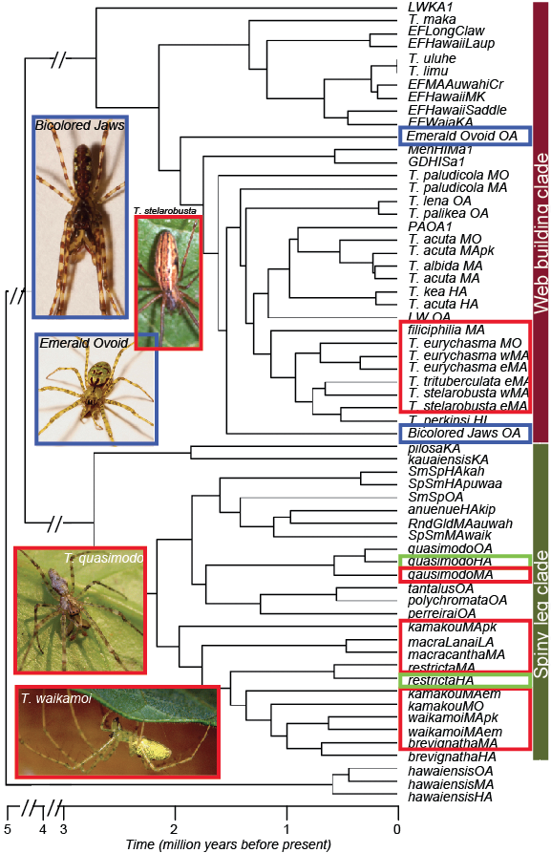
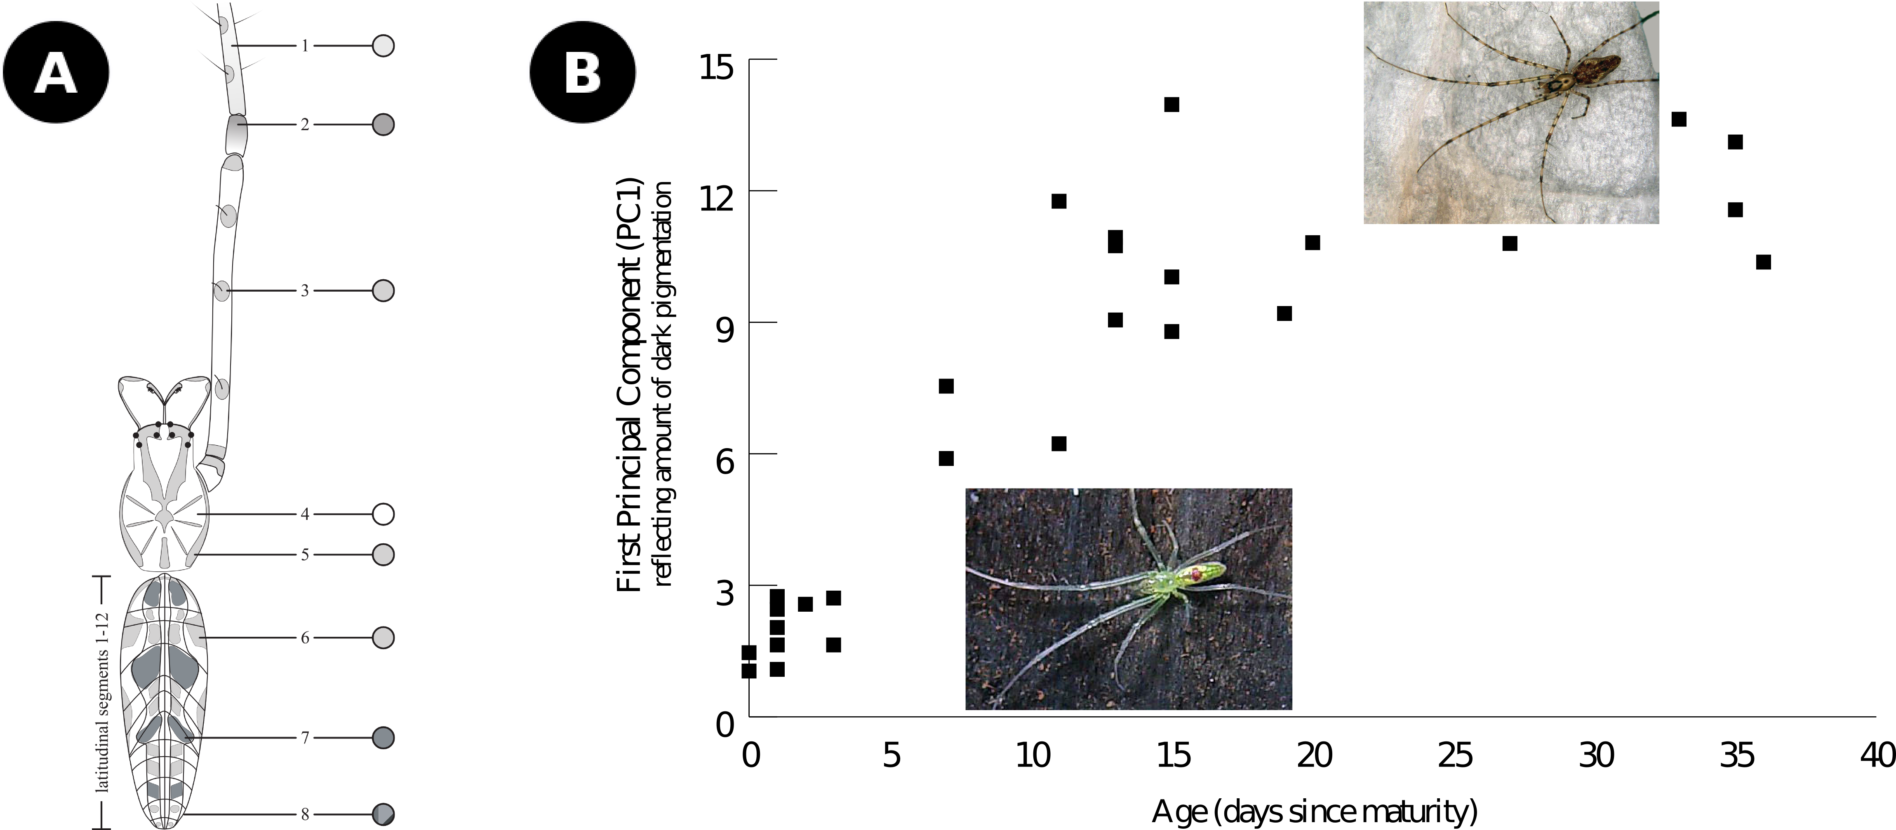
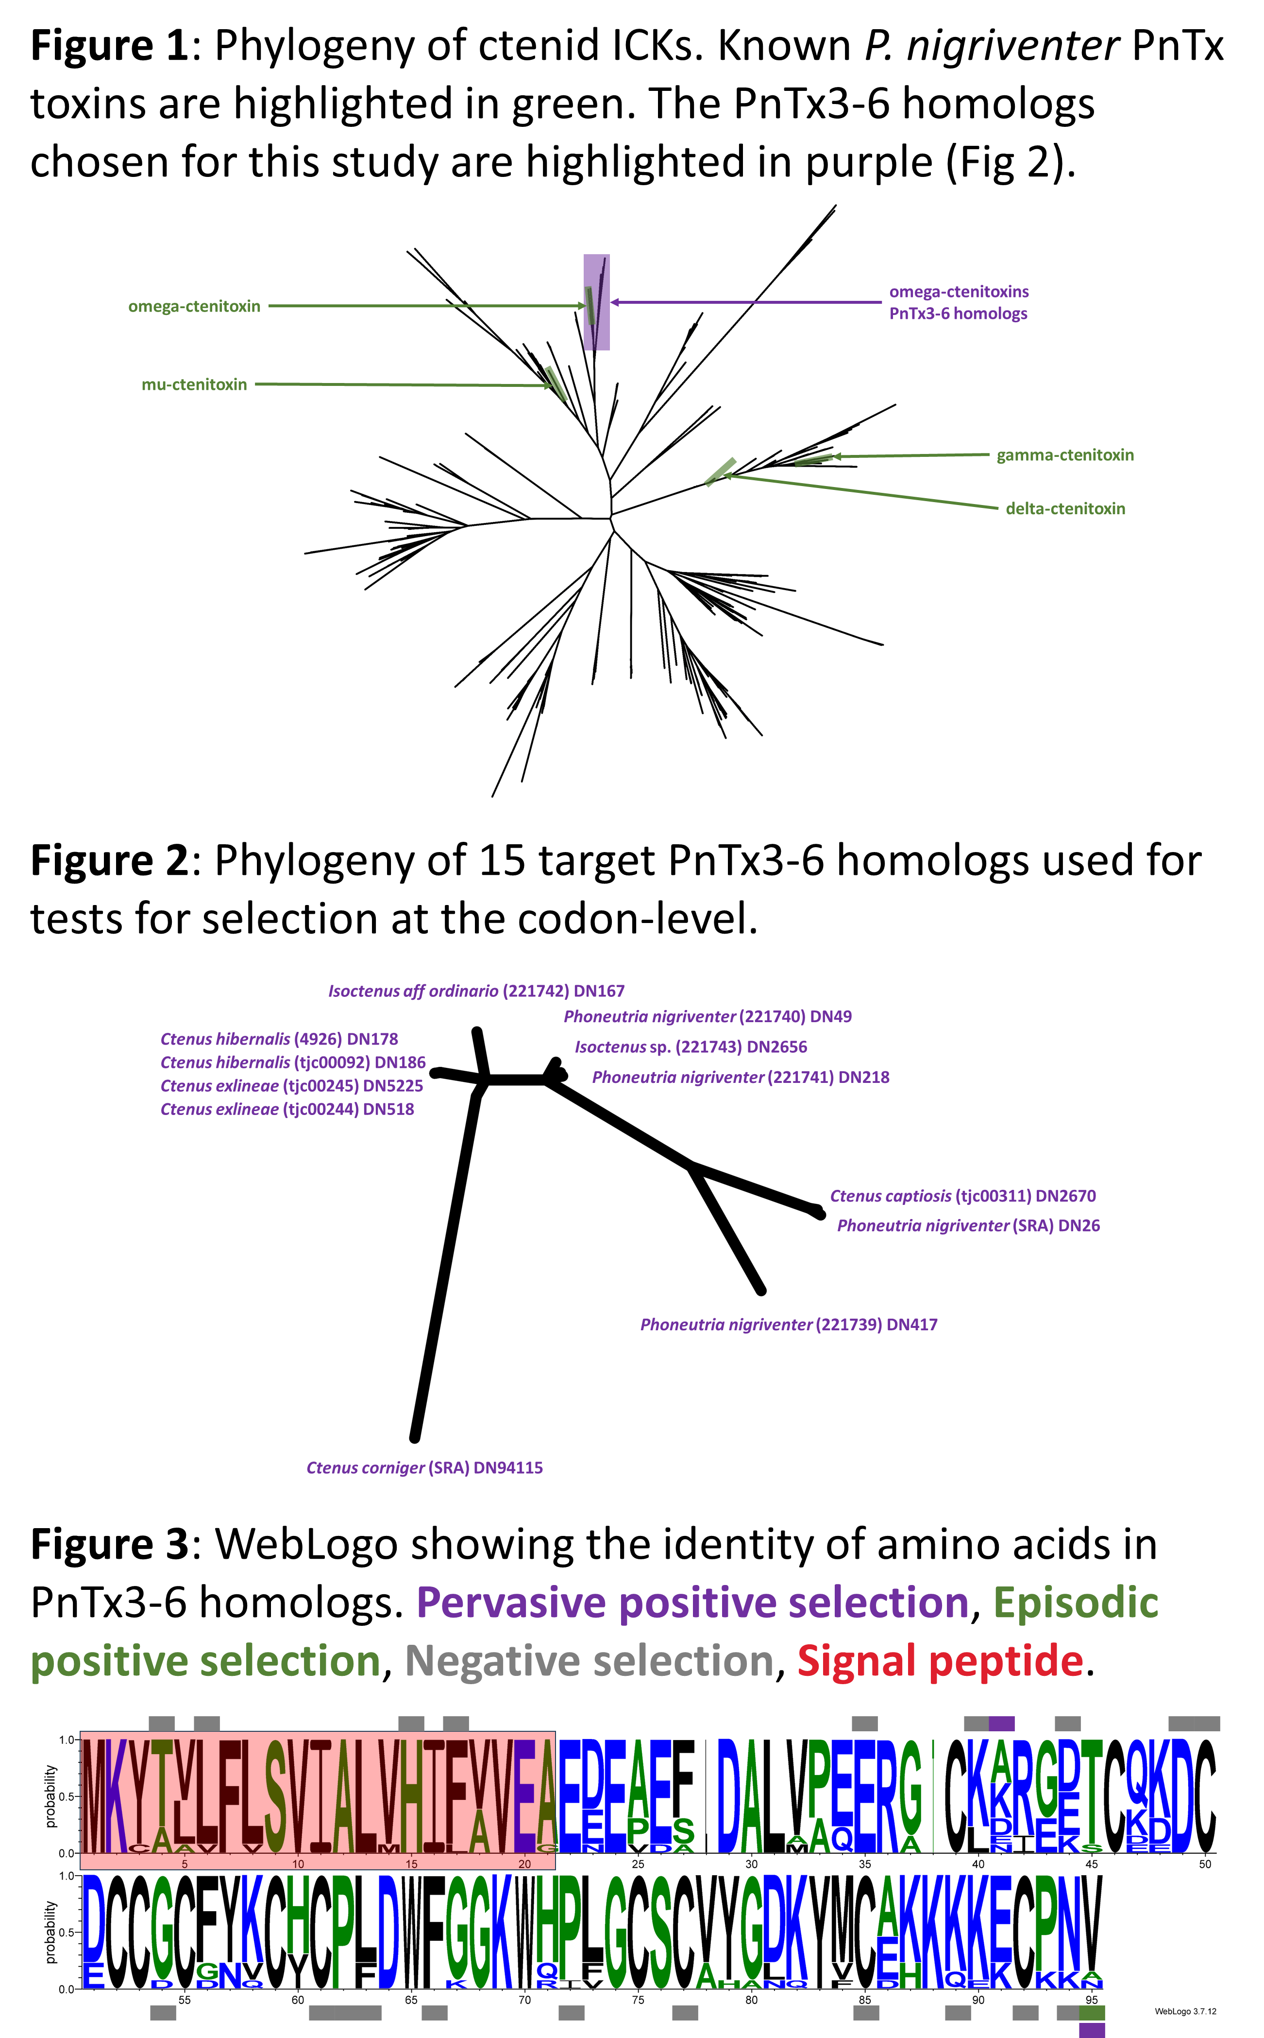
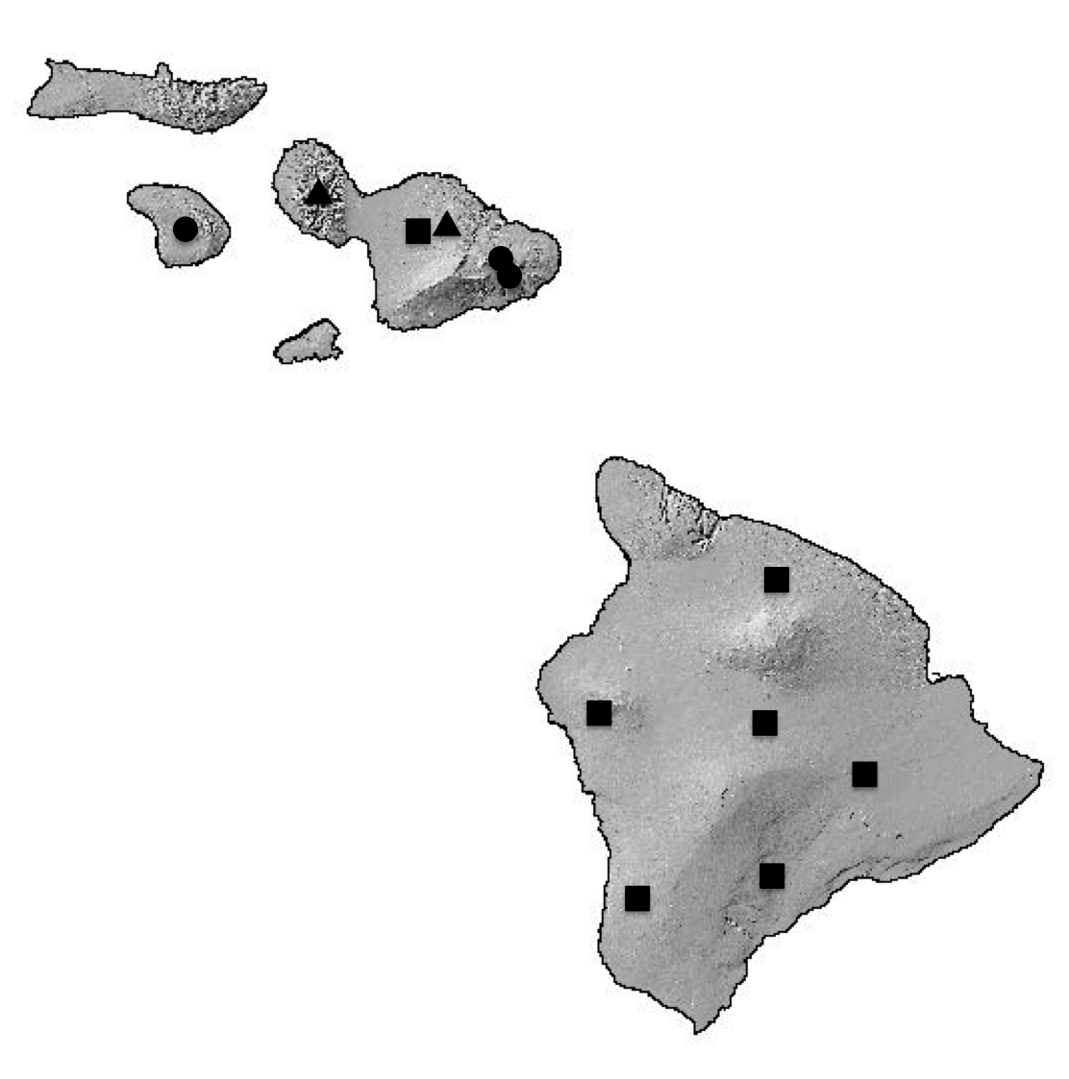
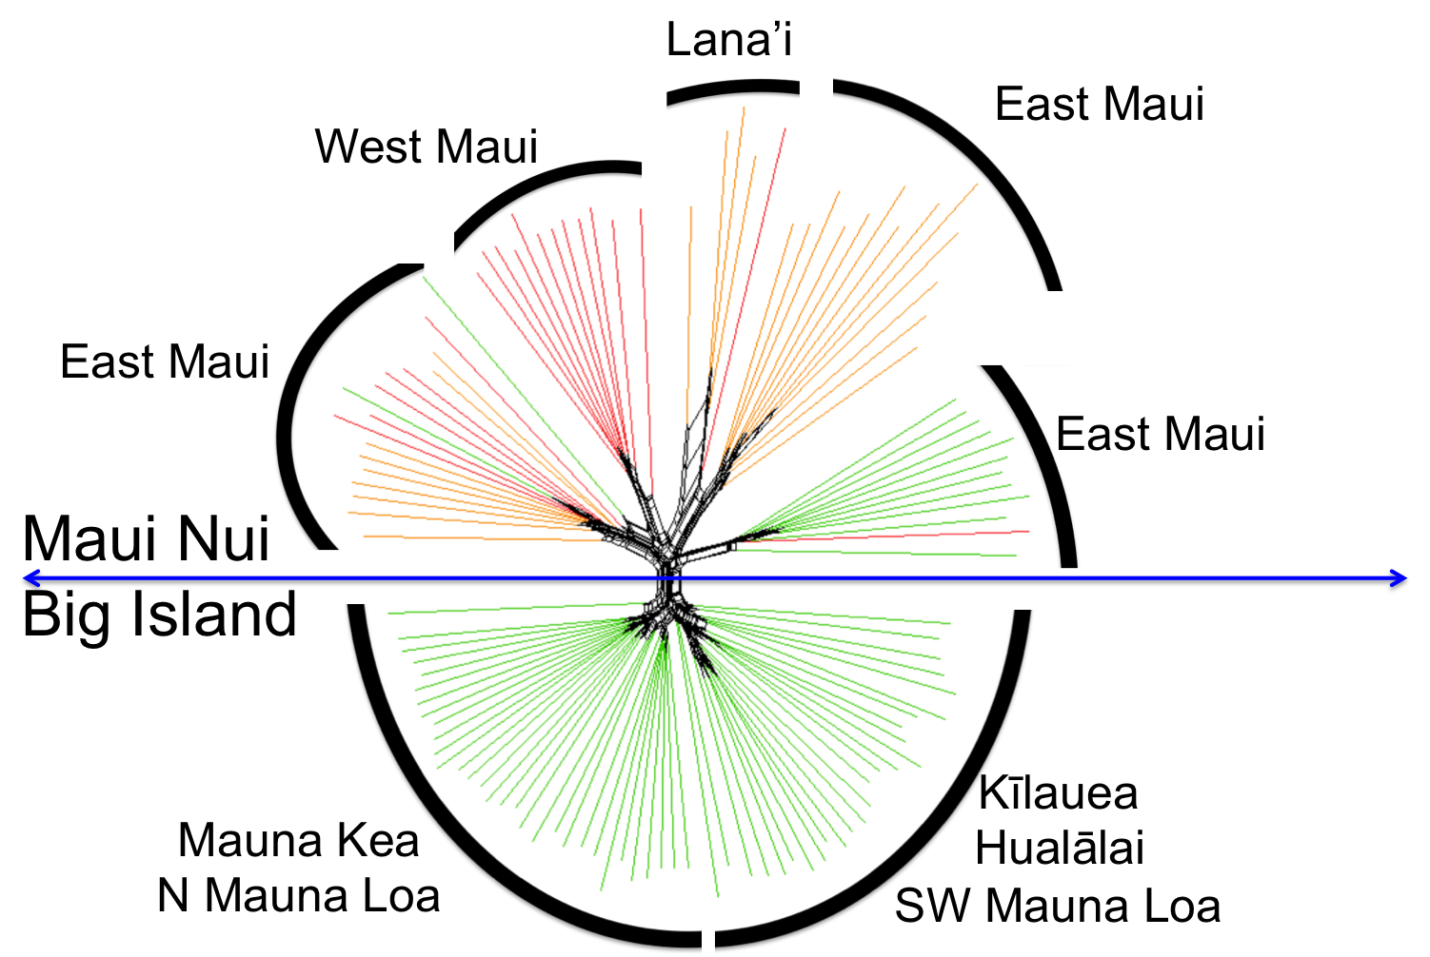
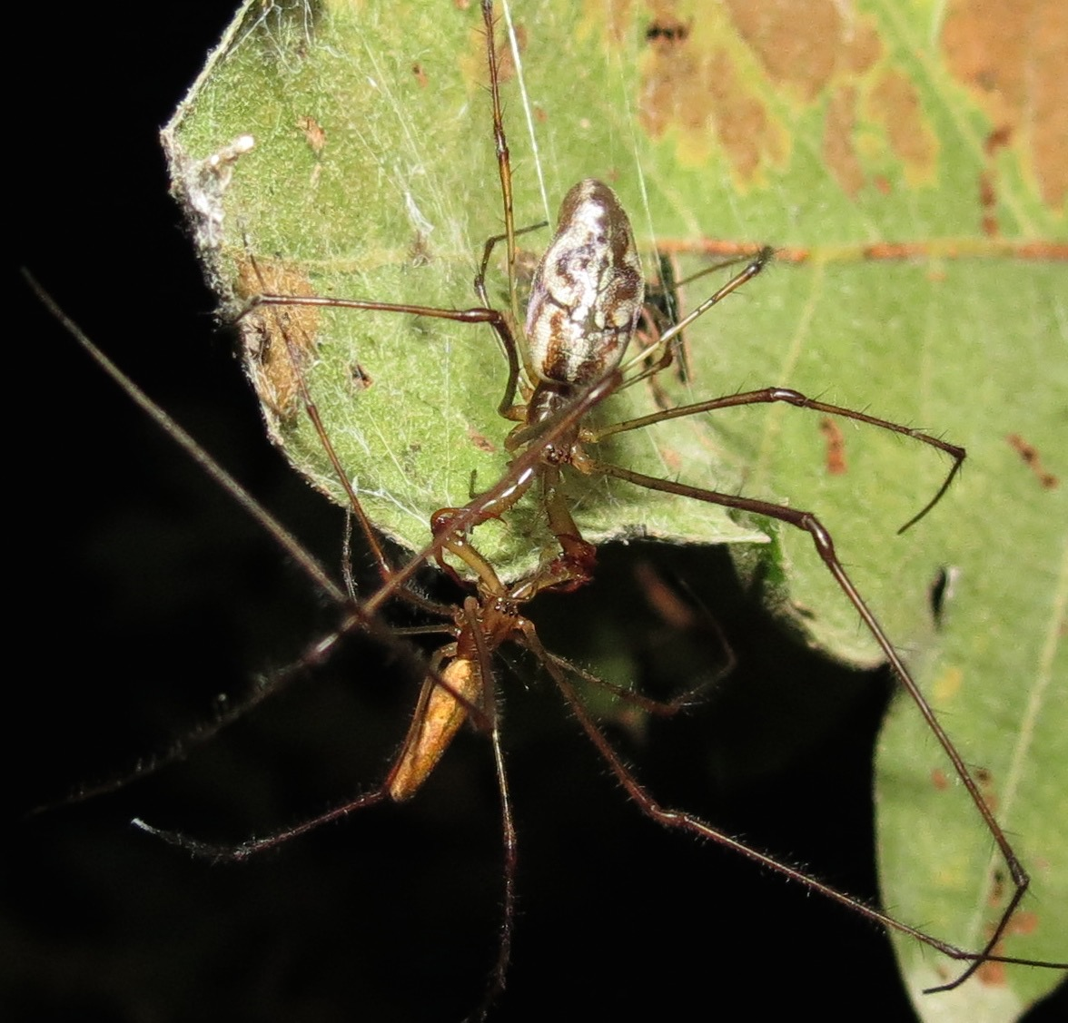
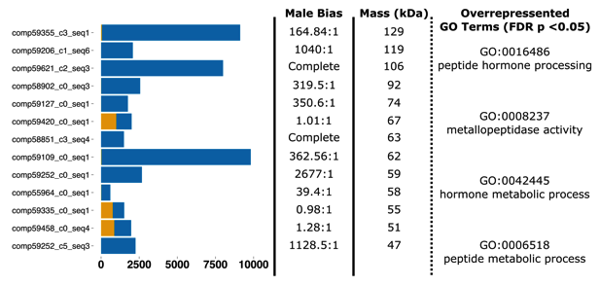
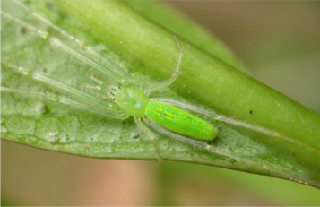
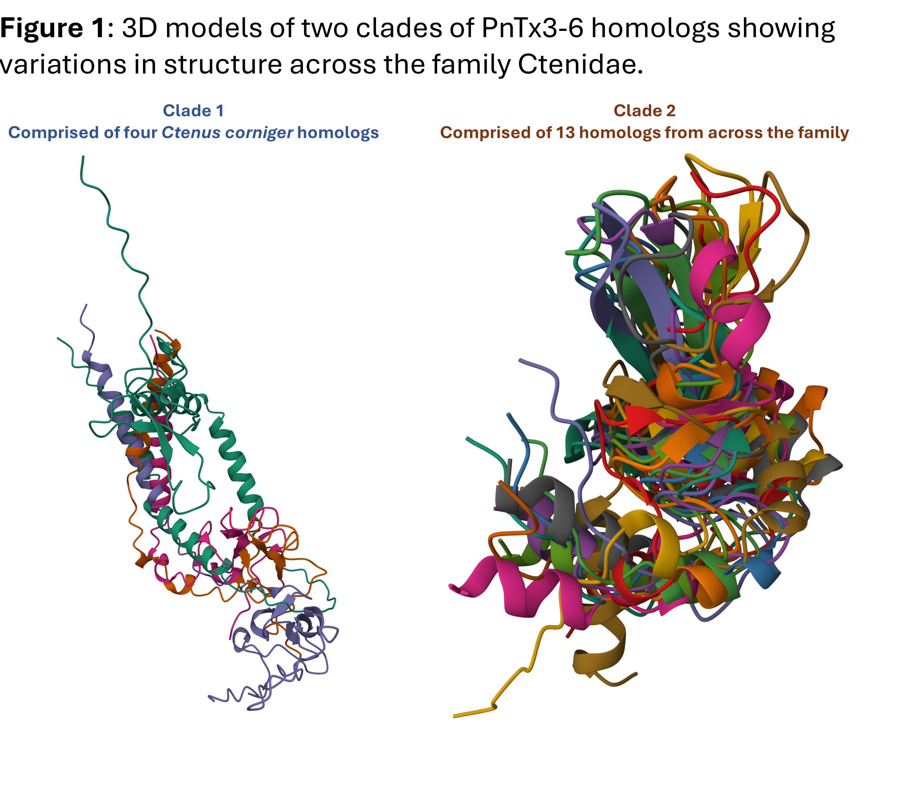

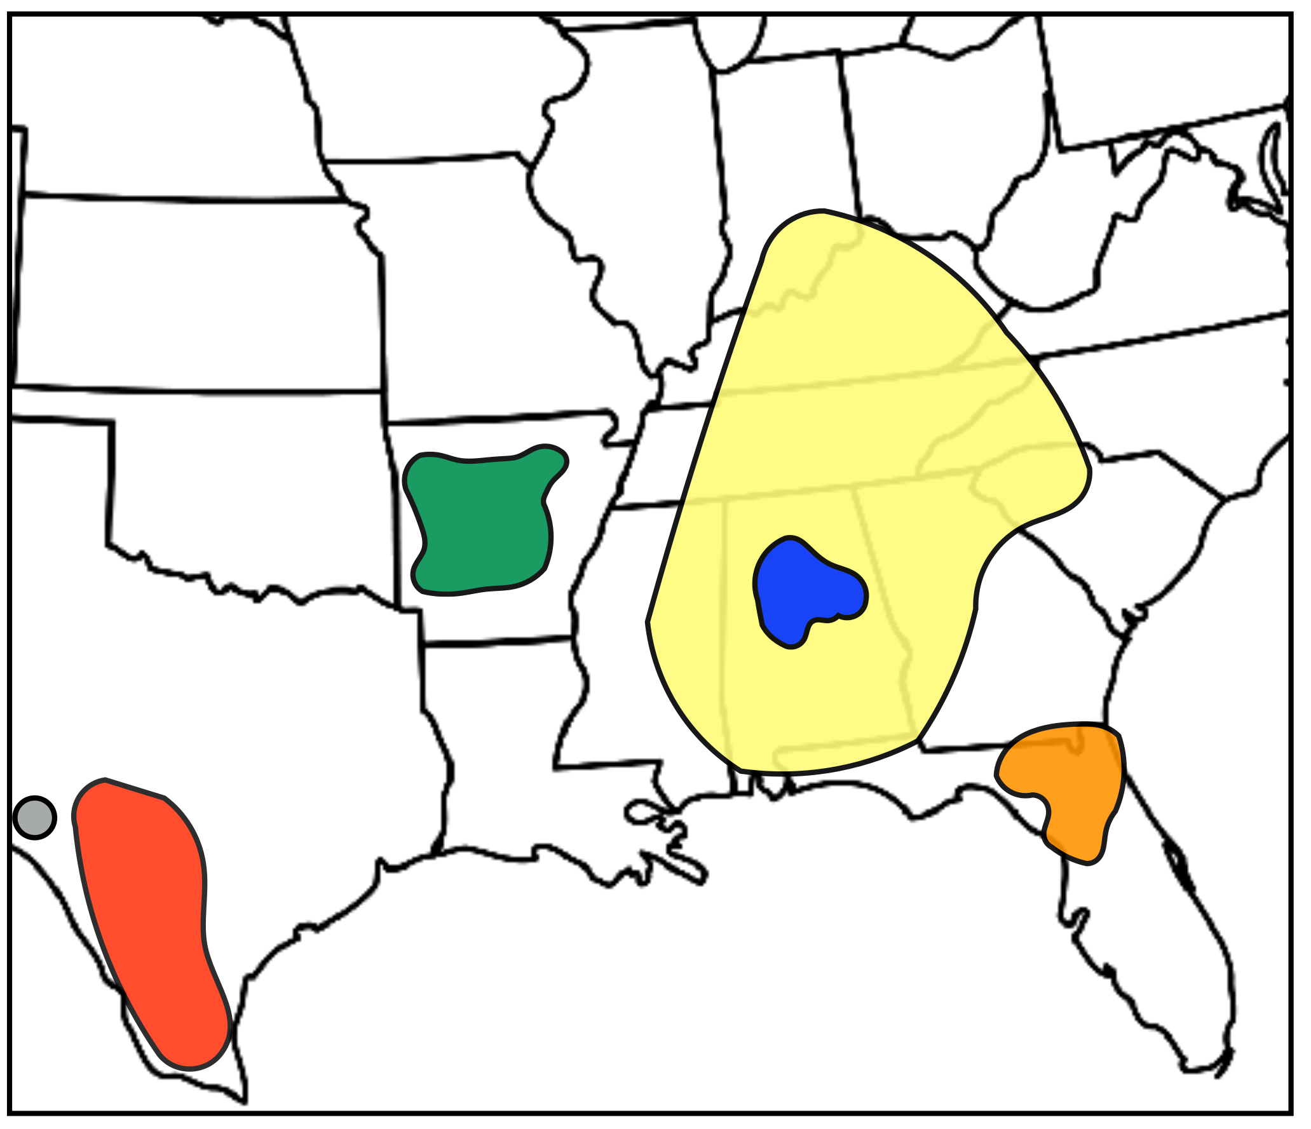
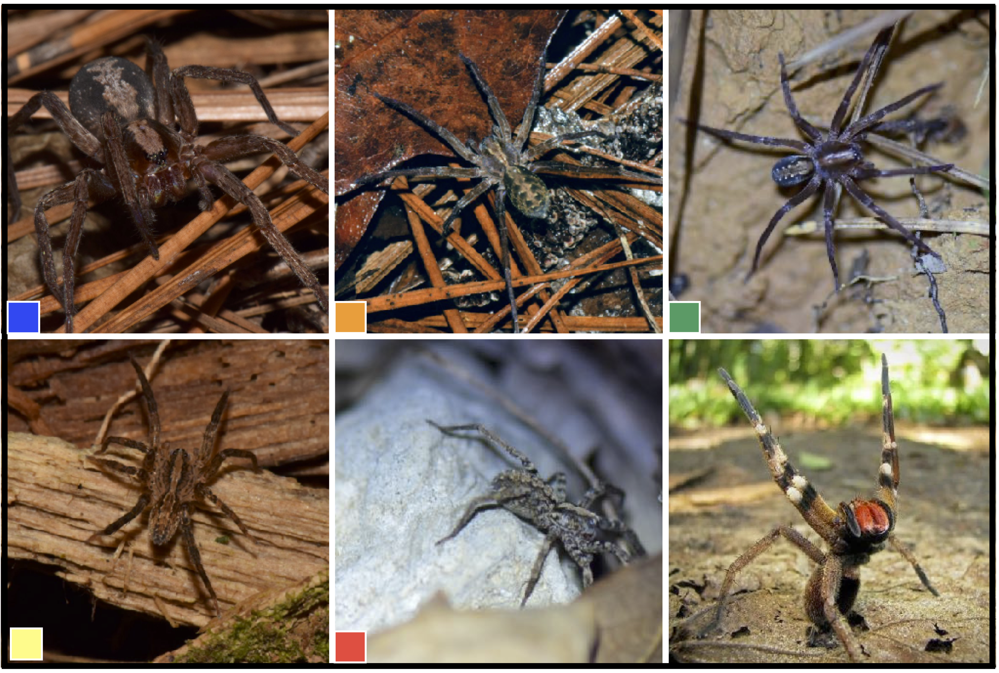

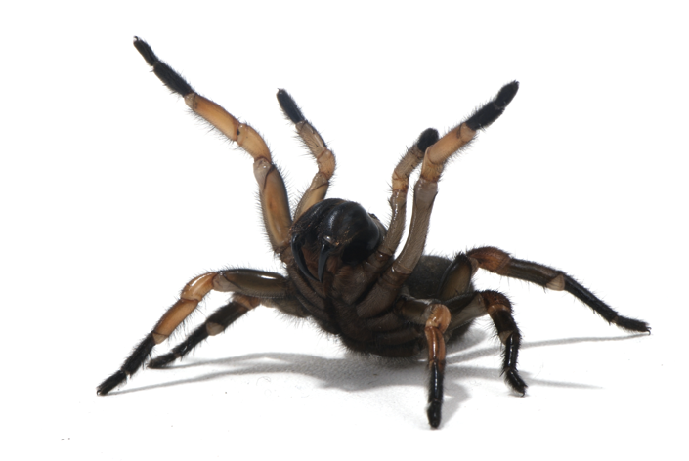
Michael S. Brewer
2024/2025 Scholar Teacher
Department of Biology
Greenville, North Carolina 27858
brewermi14@ecu.edu
Venomics
Research, Teaching, and Mentoring Statement
Evolutionary Genomics
Venoms as key characteristics allowing the diversification of spiders, centipedes, & robber flies
Venom components as sexual signals in tetragnathid spiders
My research focuses on using genomics tools to answer broad evolutionary questions. I include students from K12 through PhD levels in all aspects of my research. In the classroom, I emphasis advancing the research/career goals of students, utilizing their own data and focusing on projects-based experiences.
Color evolution in adaptive radiations
Venoms and Health
Studying highly toxic spider venom evolution to better understand evolutionary biology, ecology, behavior, disease treatment, and pharmaceutical development
Maturity associated color change in Hawaiian Tetragnatha spiders. Transcriptomic analyses revealed 28 loci with signatures of selection potentially involved in the color-switching phenotype.
Population Genomics
Phylogeny of Hawaiian Tetragnatha showing taxa to be sampled. In red boxes from Maui, green Big Island, blue Oahu. Web building clade shown by vertical maroon bar; spiny leg clade (wanderers) by green.
Population genomic analysis of Tetragnatha spiders on Maui Nui and the big island of Hawaii revealed more complex phylogeography than previously known.
High molecular weight (>43 kDa) peptides exclusive to mature male venom. Count data from read mapping to transcriptome contigs shows the extreme bias in male expression. Additionally, four GO terms were overrepresented, and two are involved in hormone processing, indicating potential sexual signaling. Male = blue; female = orange.
Biogeography
Bioinformatics
Figure 3:
Developing new tools to analyze large-scale biodiversity data
How does evolutionary history elucidate contemporary geographic distributions?
Can this be used to predict species behavior, toxicity, and venom composition?
BrewerLab.net

