Slide 1
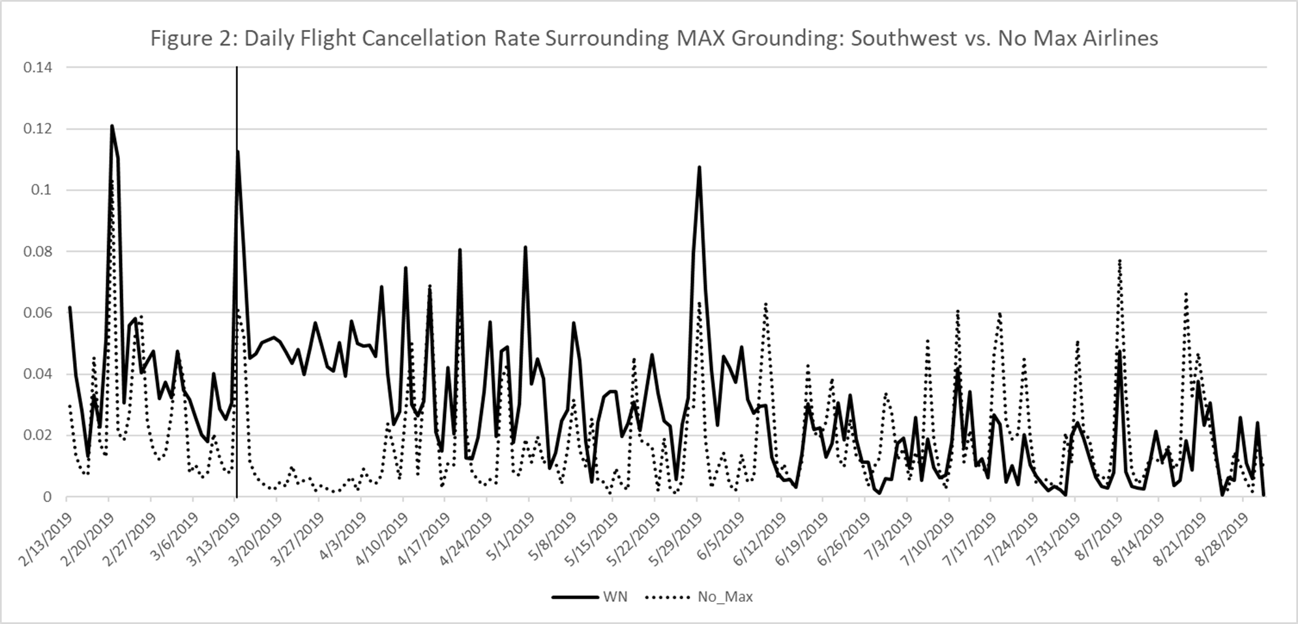
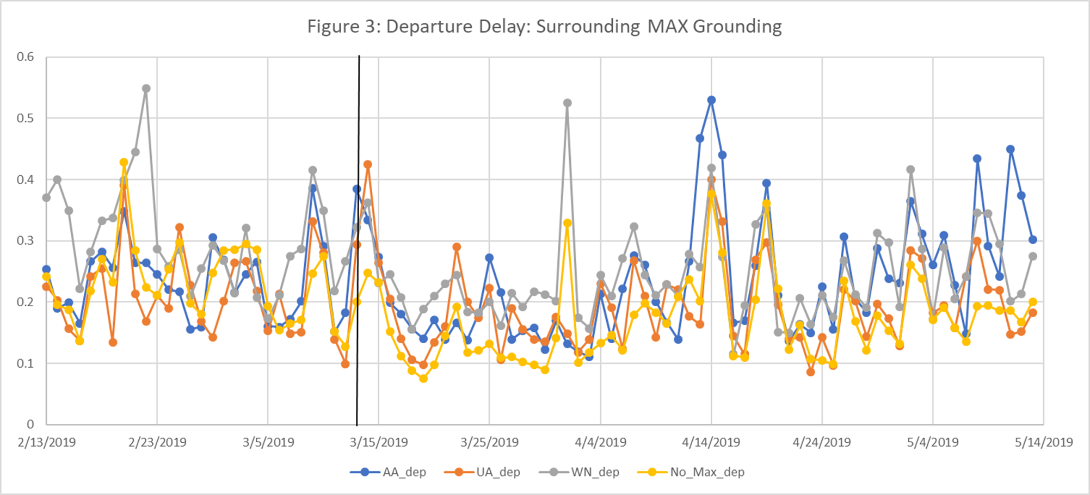
Nicholas G. Rupp
Research and Teaching in Economics
Department of Economics
East Carolina University Greenville, North Carolina 27858
ruppn@ecu.edu
Research Interests
Daily Flight Cancellation Rate Surrounding MAX Grounding: Southwest vs. Non-MAX Airlines
Teaching Strategies
Airline pricing behavior
Airline service quality (flight delays and cancellations)
Airline scheduling following Boeing Max grounding by FAA
Airline use of Artificial Intelligence
Business class fares following entry by new competitor
Keep it simple!
Make it interesting!
Incorporate Learning Assistants into the classroom
Engage students through think-pair-share activities
Split time between lecture and problem solving
Assign homework
Provide lots of resources
Solve lots of problems
Start class with a story, video, joke or performance
Use audience response system (Poll Everywhere)
Offer multiple Learning Assistants Help Sessions before tests
Research Questions Addressed
How do rival airlines respond following an airline merger? (He and Rupp, 2025)
How do business class fares respond following entry by a new competitor? (Rupp and Tan, 2025)
Why do airlines offer lower prices to consumers who purchase bundled tickets? (Escobari, Jindapon, Rupp, 2024)
How valuable is a platform to a seller? (Bilotkach, Pai, and Rupp, 2024)
When do firms offer higher product quality? (He and Rupp, 2025)
How to mergers impact product quality? (Rupp and Tan, 2019)
Why do firms dynamically price discriminate? (Escobari, Rupp, Meskey 2019)
Importance of Assigning Homework in Econ2113
Field experiment in Econ 2113, where half of class was “required” to complete homework (5% of grade)
Half class had “optional” homework (0% of grade)
Homework plays an important role in student learning
Homework required students had higher retention rates (exceeding 95 percent vs. less than 90 percent for optional HW group), higher test scores (5 to 6 percent), more good grades (Bs), and lower failure rates
Among students who failed the first test, those in the homework-required group had between 10 to 14-p;ercent higher test averages compared to students who are not required to submit homework
MAX airlines initially had higher cancellation rates
MAX carriers rapidly responded by finding replacement aircraft after removing MAX from their operating schedule
Quick adjustments prevented competitors from encroaching on MAX routes
Below graph shows initial increase in flight delays in short-run (first 30 days) but little disruption in long-run (30+ days)
References
Bringing Research to the Classroom
“Run-up to a Merger: Pre-Consolidation Pricing by Merging Airlines and Their Rivals” (with Qingxin He), forthcoming Review of Industrial Organization, 2025
“An Evaluation of Legislation Designed to Improve Airline Pilots' Safety and Performance” (with Kerry Tan), forthcoming Journal of Economics and Management Strategy, 2024
•“Bundling in advance sales: Theory and evidence from round-trip vs two one-way tickets” with Escobari, Diego and Jindapon, Paan, Journal of Industrial Economics, 2024 (May 1),
“Value of a Platform to a Seller: Case of American Airlines and Online Travel Agencies” (with Volodymyr Bilotkach and Vivek Pai), Journal of Transport Economics & Policy. October 2024, 58(4), pp. 322-356.,
“When do Firms Offer Higher Product Quality? Evidence from the Allocation of Inflight Amenities” (with Myongjin Kim and Qihong Liu), Review of Industrial Organization, 2023, 62(2), 149-177.
“Mergers and Product Quality: A Silver Lining from De-hubbing in the U.S. Airline Industry” (with Kerry M. Tan) Contemporary Economic Policy, 2019, 37(4), pp. 652-72.
“An Analysis of Dynamic Price Discrimination in Airlines” (with Diego Escobari and Joe Meskey) Southern Economic Journal (lead article), January 2019, 85:3, pp. 639-662.
“JetBlue and Business Fares”, (with Kerry Tan), 2025.
Econ 4020 – students lar about price discrimination (charging different prices to consumers for the same good). My research has shown that airlines dynamically price discriminate by changing prices each day prior to departure
Econ 3323 – Costa Rica Agriculture and Costa Rica Eco-tourism industry – students travel to Costa Rica to see and learn from organic pineapple farmers. Students get to ask questions of the planation owner
HNRS 2013 – Economics of Wine and Craft Beer – student acquire first-hand knowledge of beer industry by brewing 5-gallon beer batch and speaking with people who work in the beer and wine industries

