Slide 1
Data management and Sharing plans Presented by Allison Kaefring and Jamie Bloss
Notes:
Jamie/Allison

Slide 2
Learning Objectives
•Attendees will have a basic understanding of the elements of a data management and sharing plan
•Attendees will be able to log into DMPTool and access different types of plans
•Attendees will be able to list the repository options hosted by or subscribed to by ECU
Notes:
Jamie

Slide 3
Nelson Memo
•Scientific data underlying peer-reviewed scholarly publications resulting from federally funded research should be made freely available and publicly accessible by default at the time of publication.
https://www.whitehouse.gov/wp-content/uploads/2022/08/08-2022-OSTP-Public-access-Memo.pdf
Notes:
Jamie: Funders are starting to recognize that the articles and data produced by the research they fund is most useful to society when it is made freely available to the public. Governments, foundations, charities, and other organizations are starting to require funded authors to make their articles and data available to the public. The Office of Science and Technology Policy (OSTP) updated policy guidance to promote improved public access to federally funded research results.

Slide 4
Who needs to include a DMSP?
All federal research funding agencies, including the National Endowment for the Humanities and National Endowment for the Arts.
All grant proposals submitted to the NIH for submission deadlines on or after January 25th, 2023, where the proposal produces scientific data.
Notes:
Jamie

Slide 5
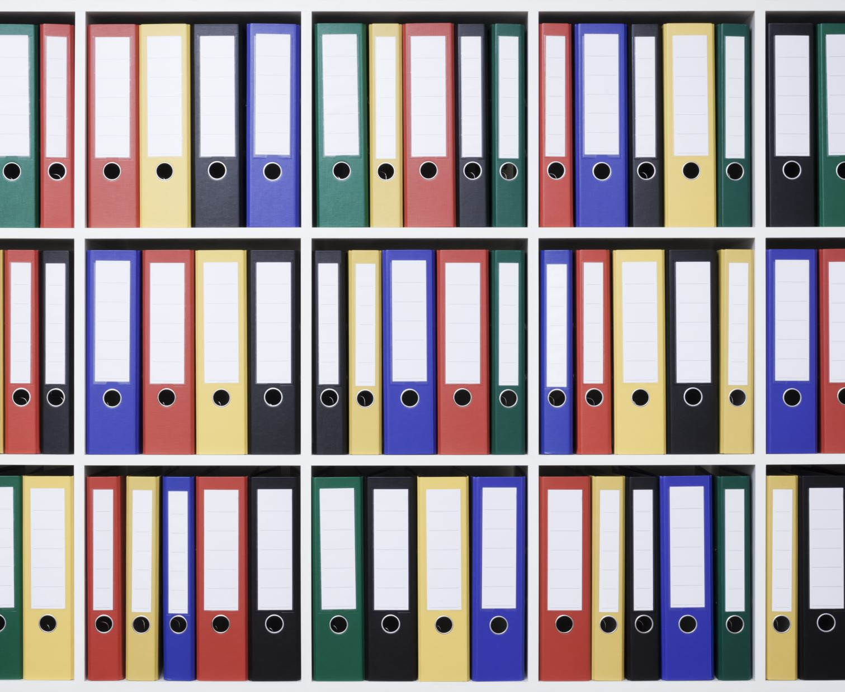
Why is data sharing important?
Replicability of studies/increased transparency
Multiple uses for one data set
Reduces the number of projects that need funding
Reduces strain on community of participants
Supports data education/literacy
Helps track data preservation
Notes:
Allison

Slide 6
Making data legible/reproducible
Data should be understandable by people not a part of your research team
Example: naming conventions
Notes:
Allison

Slide 7
De-identifying data
Legal Requirements
Resources
FERPA (Federal Educational Rights and Privacy Act)
HIPPA (Health Insurance Portability and Accountability Act)
North Carolina Identity Theft Act
https://www.hhs.gov/hipaa/for-professionals/special-topics/de-identification/index.html
https://www.ipc.on.ca/sites/default/files/legacy/2016/08/Deidentification-Guidelines-for-Structured-Data.pdf
https://qdr.syr.edu/guidance/human-participants/deidentification
Notes:
Allison

Slide 8
General Information to de-identify
Personally identifiable information
Indirect Identifiers
Name
SSN
Address/ZIP
phone number
Picture
voice
Varies by research and community being researched
Examples:
Occupation
Region
Outliers
Notes:
Allison

Slide 9
Ethical considerations
Is the community especially vulnerable or stigmatized and might need extra diligence in deidentifying?
Even if data individually cannot identify individuals, can they be identified if taken in the context of the study/other data?
If data can never be responsibly de-identified and how can you write that into your DMP
Is the data still usable to other researchers?
Notes:
Allison

Slide 10
Vulnerable populations/stigmatized subjects
Insider v outsider
Quasi-identifiers
Is the community so small even vague information could identify someone?
Is the data de-identified to outsiders AND insiders
Identity revealing traits that allow linking to other (often external) data sets
ex. Voter registration is public
ex. Course ID unique combinations of courses could be linked to identifying information
Notes:
Allison

Slide 11
How to anonymize
Generalization
Suppression
Create broader categories by combining categories together
Can be less useful/reusable to other researchers
Decrease in overall quality
Distort correlations
Delete/censor data that violates anonymity
Can skew integrity of data and distort it
Decrease in quality of specific censored sections
Distort mean values of de-identified columns
Document what has been changed/anonymized and keep file in secure location separate from data
Notes:
Allison

Slide 12
DMP Tool
https://dmptool.org/plans
Notes:
Allison

Slide 13
examples
DMP tool Dashboard
LibGuide
https://libguides.ecu.edu/DataManagement/datamgtplans
https://library.ecu.edu/ >Research Guides> Faculty Resources> Data Management> Data Management Plans
Notes:
Allison

Slide 14
Bones of the NIH DMSP
1.Data Type: Briefly describe the scientific data to be managed, preserved, and shared, including the data to be collected or used in the study; data to be preserved and shared; and documentation to be collected and shared with the data.
2.Related Tools, Software and/or Code: An indication of whether specialized tools will be needed to access or manipulate the shared scientific data to support replication or reuse, and name(s) of the needed tool(s) and software.
3.Standards: An indication of what standards will be applied to the scientific data and associated metadata (i.e., data formats, data dictionaries, data identifiers, definitions, unique identifiers, and other data documentation). If the discipline of the research does not have a shared approach to data structures, the Plan may indicate that no consensus data standards exist for this scientific data and metadata.
Notes:
Jamie

Slide 15
Bones of the NIH DMSP cont.
4.Data Preservation, Access, and Associated Timelines: Plans and timelines for data preservation and access, including (a) specific repository or repositories where data will be shared (see tab on the left on repositories); what persistent identifier or other indexing tool will be provided to find and access the data; and when data will become available and for how long it will stay available.
5.Access, Distribution, or Reuse Considerations: Any limits that will be placed on access, and why the limits are expected to be placed.
6.Oversight of Data Management and Sharing: Indicate how and on what schedule the DMS Plan will be monitored and managed, and by whom.
Notes:
Jamie

Slide 16
Which element is this?
Data type?
Related tools, software and/or code?
Standards?
Data preservation, access, and associated timelines?
Access, distribution, or reuse considerations?
Oversight of data management and sharing?
Anyone wishing to access, display, process, or reuse the data would need access to a computer and a web browser. They would need to be able to open CSV, TXT, and PDF files. If any survey codebooks are created in a Microsoft word document (.docx), they will be converted to PDF files.
Notes:
Jamie - Answer: related tools, software and/or code

Slide 17
Which element is this?
Data type?
Related tools, software and/or code?
Standards?
Data preservation, access, and associated timelines?
Access, distribution, or reuse considerations?
Oversight of data management and sharing?
The only limitations that could restrict access to data is for privacy and confidentiality protections for patient data recorded by the FHASES system.
Notes:
Jamie - Answer: access, distribution, or reuse conditions

Slide 18
Which element is this?
Data type?
Related tools, software and/or code?
Standards?
Data preservation, access, and associated timelines?
Access, distribution, or reuse considerations?
Oversight of data management and sharing?
Following our IRB and best practices, we will protect participant identities who participate in surveys and qualitative research. We will implement protections to limit any ability to link data with individuals. We will strip identifying information from survey or interview responses as necessary.
Notes:
Jamie - Answer: access, distribution, or reuse conditions

Slide 19
Which element is this?
Data type?
Related tools, software and/or code?
Standards?
Data preservation, access, and associated timelines?
Access, distribution, or reuse considerations?
Oversight of data management and sharing?
Co-Investigator Joseph Lee, ORCID: 0000-0001-9698-649X, will be responsible for the day-to-day oversight of team data management activities and data sharing with input and support from co-investigator Jamie E. Bloss, ORCID: 0000-0002-0706-7684. We plan to review this document every 12 months to update it and make sure that implementation is happening as the research progresses through all years of the award period.
Notes:
Jamie - Answer: oversight of data management and sharing

Slide 20
Which element is this?
Data type?
Related tools, software and/or code?
Standards?
Data preservation, access, and associated timelines?
Access, distribution, or reuse considerations?
Oversight of data management and sharing?
Data will be stored in common and open formats, such as CSV and PDF files for our survey and quantitative data. We will ensure data and other products are stored in a standardized format (e.g., CSV, TXT, HTML, XML, PDF) that are expected to remain compatible with newer versions of software.
Notes:
Jamie - Answer: Standards

Slide 21
Which element is this?
Data type?
Related tools, software and/or code?
Standards?
Data preservation, access, and associated timelines?
Access, distribution, or reuse considerations?
Oversight of data management and sharing?
We will keep all generated data files in two different locations, one of which is ECU's Microsoft OneDrive which the entire grant team has access to, which is approved for storage of research data. Copies will additionally be held locally at ECU on a secured server that is administered by ECU ITCS.
Notes:
Jamie - Answer: Data preservation, access, and associated timelines

Slide 22
Data Repository options
Open Science Framework OSF allows you to have both public and private versions of your study. Once you have de-identified data in an OSF-hosted study, you can register the study and share it for your data sharing compliance. OSF offers DOIs and unique persistent URLs.
ECU ScholarShip: https://thescholarship.ecu.edu/page/deposit Makes a permanent link but not a DOI.
https://libguides.ecu.edu/DataManagement/repositories
Harvard Dataverse:
https://dataverse.harvard.edu/ A dataverse is a container for all your datasets, files, and metadata. Offers DOIs.
4. Data Preservation, Access, and Associated Timelines: Plans and timelines for data preservation and access, including (a) specific repository or repositories where data will be shared (see tab on the left on repositories); what persistent identifier or other indexing tool will be provided to find and access the data; and when data will become available and for how long it will stay available.
Notes:
Jamie

Slide 23
Resources list
DMPTool: https://dmptool.org/
Open Science Framework: https://osf.io/
Updates: https://open.science.gov/
LibGuide: https://libguides.ecu.edu/DataManagement
NIH DMSPs libguide: https://libguides.ecu.edu/nih_dmsp
Notes:
Jamie

Slide 24
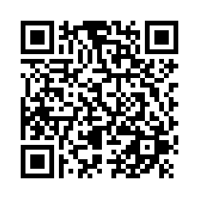
Please fill out this evaluation and assessment
https://ecu.az1.qualtrics.com/jfe/form/SV_ezmz4ZBEENSU2wK
Contact us for more info and assistance:
Jamie Bloss & Xiaolan Qiu - health sciences campus
Blossj19@ecu.edu
Qiux24@ecu.edu
Allison Kaefring - main campus
kaefringa22@ecu.edu
Notes:
Jamie

Slide 25
Questions?

