Slide 1
Systematic Reviews: Data Extraction & Risk of Bias Assessment
Jamie Bloss, MLIS, AHIP
Research Librarian
Laupus Health Sciences Library

Slide 2
SR lifecycle
Notes:
https://www.distillersr.com/resources/systematic-literature-reviews/what-is-a-prisma-flow-diagram

Slide 3
Data Extraction

Slide 4
Objectives
Summarize best practices for evidence synthesis data extraction

Slide 5
Objectives
Identify tips and resources for data extraction in evidence synthesis

Slide 6
Where to start
01

Slide 7
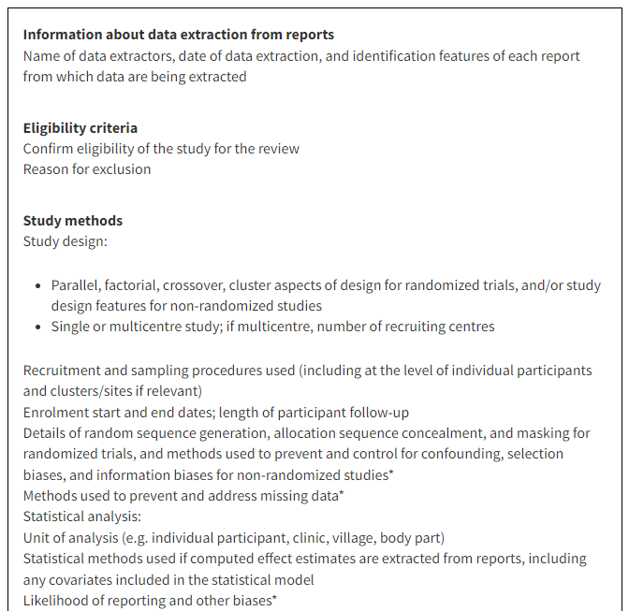
Cochrane Handbook Chapter 5
Notes:
https://training.cochrane.org/handbook/current
https://training.cochrane.org/handbook/current/chapter-05

Slide 8
Cochrane for Qualitative Data Chapter 21
Various Methods of data extraction:
Use a customized, a standardized, or an adapted data extraction template.
Ex. NIH template https://www.ncbi.nlm.nih.gov/books/NBK424005/
Use an a priori theory or predetermined framework to extract the data.
Ex. The SURE Framework https://www.ncbi.nlm.nih.gov/books/NBK344476/
Use a software program to code text in studies.
Ex. NVivo
Notes:
https://training.cochrane.org/handbook/current/chapter-21

Slide 9
Planning Ahead - Protocols
PRISMA for Protocols – It is required to identify what data you plan to gather, how you plan to gather it, and how you plan to present the data.
See Items 11c, 12 and 13
Knowing in detail what data you plan to collect is exceptionally useful for writing the protocol, inclusion/exclusion criteria, and screening.
Hot Tip
Notes:
https://libguides.ecu.edu/c.php?g=57734&p=370926
https://www.prisma-statement.org/protocols

Slide 10
What Data to Extract
02

Slide 11
Start with your question
Use a question framework like PICOT:
Population: The specific population or group that you want to study. This should include characteristics such as age, gender, medical condition/disease, or any other relevant factors.
Intervention: The treatment, exposure, or intervention you are investigating.
Comparison: The comparison group or alternative intervention you are investigating. This can be a placebo, another treatment, standard care, or the absence of the intervention.
Outcomes: The outcomes you are interested in measuring or evaluating. These can be clinical outcomes, patient-reported outcomes, adverse events, or any relevant endpoints. **Consider including outcomes that matter to the end users of the review.
Time Points: Some reviews include time points as part of the PICO(T) framework. You might be interested in collecting data only at specific time points. Other: Includes other essential eligibility criteria for your review such as study design.
Hot Tip
There are other question frameworks if your question doesn’t fit PICOT. Ex. PEO, SPIDER
Notes:
The PEO framework, or population exposure outcome framework
SPIDER is a search strategy for finding research to answer a mixed-method qualitative research question. https://researchguides.gonzaga.edu/qualitative/spider

Slide 12
Creating your DE form
Data extraction forms should be designed and developed with both the review question and subsequent analysis in mind. For every data point, ask if it serves to answer the question or help with the analysis.
Examine multiple articles that definitely belong in the review: What data elements would you want to capture from it?
If you plan to analyze the results for each outcome, think about how you will group the data for the later stages of your review process.
Look for an existing extraction form or template to help guide you. Use existing systematic reviews on your topic to identify what information to collect if you are not sure what to include.
Hot Tip
Templates
Qualitative Data Template
Cochrane Data Extraction Template
Notes:
Take time to look through examples

Slide 13
Creating your DE form
Step 1. Develop outlines of tables and figures expected to appear in the systematic review.
Step 2. Assemble and group data elements to facilitate form development.
Step 3. Identify the best way to structure each question on the form.
Ask closed-ended questions (i.e. questions that define a list of permissible responses).
Avoid asking a question where the response may be left blank. Instead use ‘not applicable’, ‘not reported.’
Remember that the form should focus on what is reported in the article rather what assume has been done. No guessing!
Where a judgement is required, record the raw data. Incorporate flexibility to allow for variation in how data are reported.
Step 4. Design and pilot-test data collection forms.

Slide 14
Pilot & Edit the Extraction Form
Forms should be piloted to ensure that all the relevant information is captured and that time and effort is not wasted on extracting unnecessary data.
Piloting will reduce the risk that you need to:
Edit the template during extraction.
Go back to studies after extraction to extract more data.
Spend a lot of time cleaning data or making sense of the data after data extraction.
Ideally done before registering your protocol, but more practically for some teams, before abstract screening.
Remember, protocol registration has to be done before you start data extraction.
Pilot on “paper” first, not within the software.
Do this for every type of study you plan to include – RCT, cohort, cross-sectional, etc. – because the data will look different.
Done by everyone involved in data extraction so the team can train itself.
Notes:
Can use Qualtrics, redcap, Covidence form

Slide 15
Pilot & Edit the Extraction Form
What to look for:
The template’s layout and sequence are logically organized.
Any missed data points or irrelevant data points.
The guidance and/or instructions for extractors are as comprehensive as possible.
Extractors have had enough training to perform independent extraction effectively.
The anticipated output will enable you to compare and group studies so you can analyze results for your review.
As a minimum, one researcher should extract the data with a second researcher independently checking the data extraction forms for accuracy and detail.
However: “Evidence in support of duplicate data extraction comes from several indirect sources. One study observed that independent data extraction by two authors resulted in fewer errors than data extraction by a single author followed by verification by a second (Buscemi et al 2006).”
Hot Tip
Notes:
Can calculate agreement - https://www.k-alpha.org/

Slide 16
Training your data extractors
Train the review team on the extraction categories and what type of data should be expected.
A manual or coding guide may help your team establish standards and avoid errors and subjective decisions.
During the pilot, ensure data extractors are recording similar data. Revise the extraction form if needed.
Discuss any discrepancies or questions in coding throughout the pilot process with the team.
Document any changes to the extraction process or the form.
Keep track of the decisions the team makes and the reasoning behind them.
Notes:
Example: https://ecu.az1.qualtrics.com/jfe/form/SV_2azvlHeBVygypQa

Slide 17
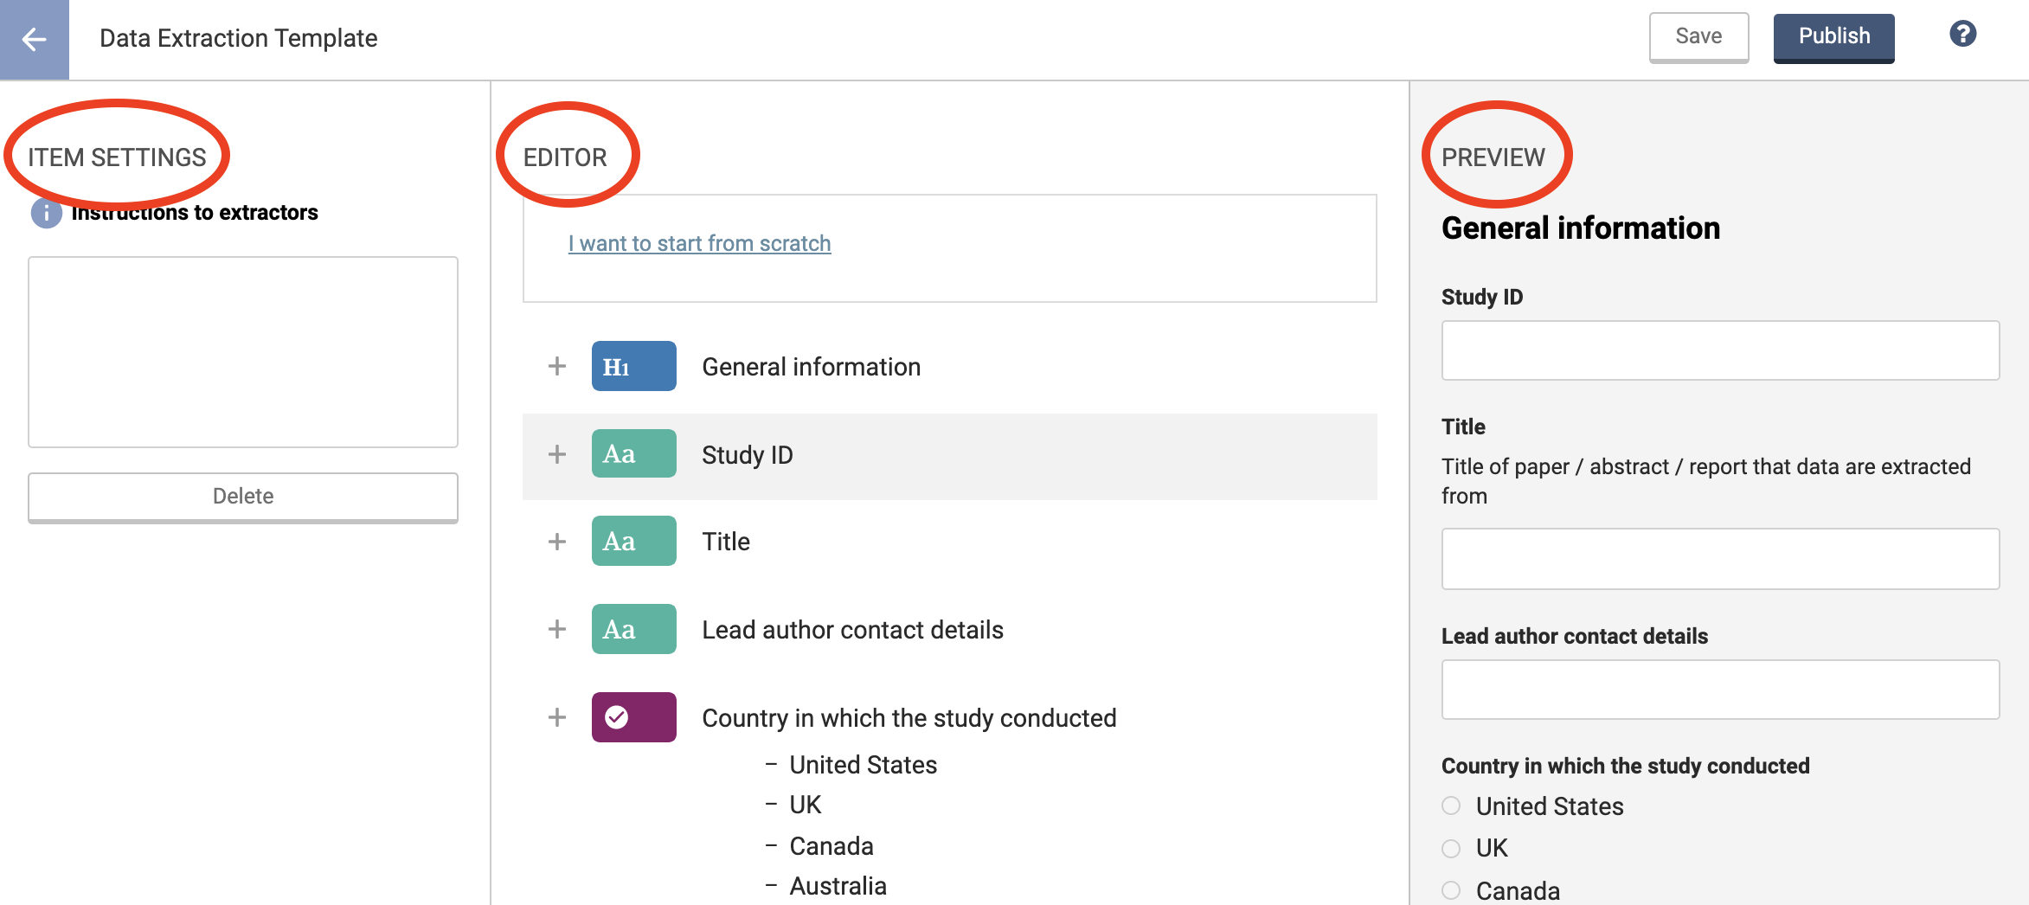
Covidence

Slide 18
Covidence
Covidence’s New In-Depth Data Extraction Guide
&
Planning checklist for data extraction
Data collection process
Data items
Study risk of bias
assessment
Which outcomes, time points and measures do you intend to collect?
What data items will you collect?
What should the structure of the extraction form (often called a template) be?
What are the processes for handling and reporting missing or unclear data?
What are the processes for handling a study which doesn’t neatly fit into a form?
Which tool(s) will you use?
Who will be involved in extracting?
What’s the process for contacting authors?
How often will you discuss progress and raise questions as a team?
Which tool(s) will be used?
Who will be involved in assessing the risk of bias?
Effect measures
Which effect measures will be collected and/or calculated?

Slide 19
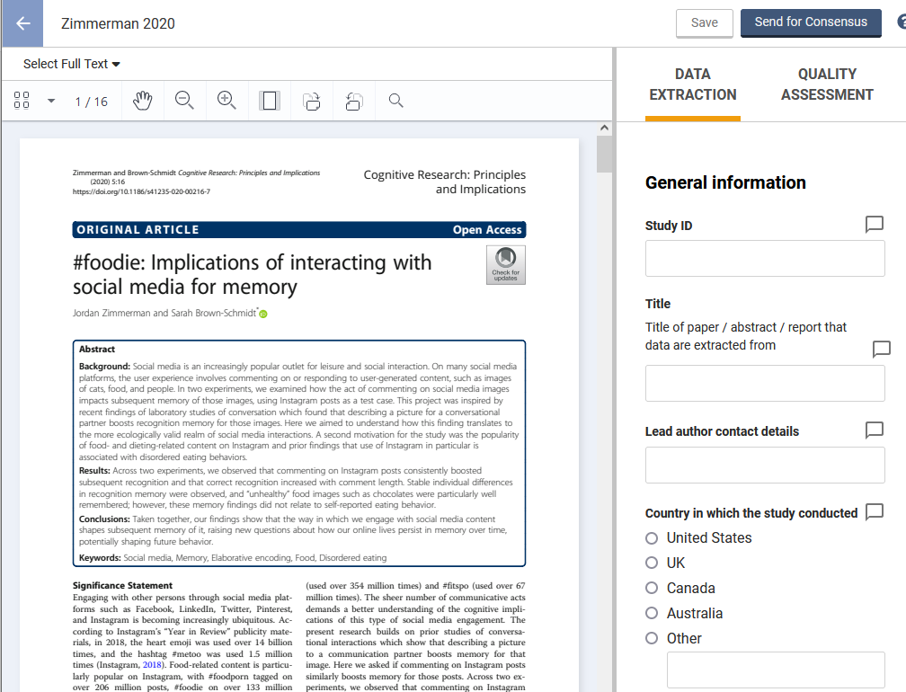
Hot Tip
Have your extractors do both quality assessment and data extraction at the same time.

Slide 20
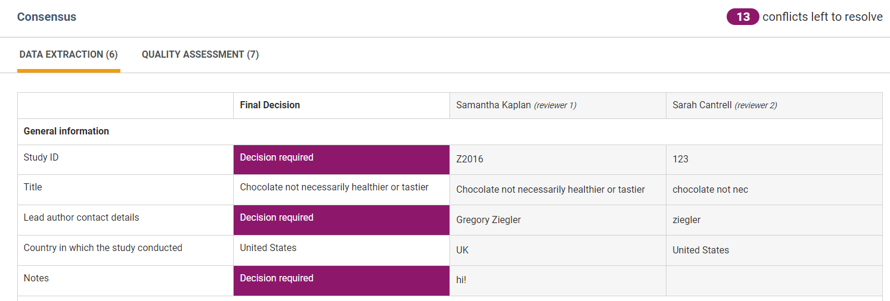
Covidence - Consensus

Slide 21
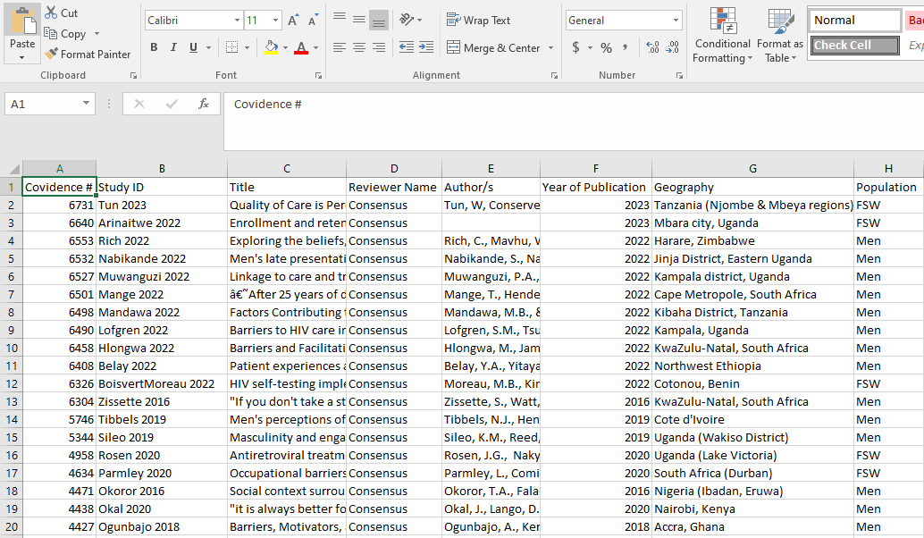
Covidence – Exporting Data
Hot Tip
Covidence does not analyze the data for you! It exports it into a spreadsheet.

Slide 22
Resources
Summarising good practice guidelines for data extraction for systematic reviews and meta-analysis
AHRQ Data Extraction Training
A Framework for Developing a Coding Scheme for Meta-Analysis
A Guide for Reading Qualitative Studies: Data extraction and QA
Interesting example qualitative data extraction form
Data extraction for complex meta-analysis (DECiMAL) guide

Slide 23
Risk of Bias assessment

Slide 24
Objectives
Describe the differences between risk of bias (RoB) and critical appraisal

Slide 25
Objectives
Summarize the methodology for risk of bias in systematic reviews

Slide 26
03
Terminology
Why Risk of Bias? Not critical appraisal?

Slide 27
Risk of bias refers to the potential – for it is impossible to measure
with certainty – that the conducted study contains a methodological flaw that forces the results to deviate from the truth (Boutron et al., 2022).
Risk of Bias
Notes:
RoB 2 is structured into a fixed set of domains of bias, focusing on different aspects of trial design, conduct, and reporting.
https://methods.cochrane.org/bias/resources/rob-2-revised-cochrane-risk-bias-tool-randomized-trials

Slide 28
“The process of carefully and systematically examining research to judge its trustworthiness, and its value and relevance in a particular context.”
Critical Appraisal
-- https://casp-uk.net/what-is-critical-appraisal/
Notes:
This allows the reader to judge its trustworthiness and applicability to their area of work or research. Below are general steps for critically appraising a paper:
Decide how trustworthy a piece of research is (Validity)
Determine what the research is telling us (Results)
Weigh up how useful the research will be in your context (Relevance)

Slide 29
“Can the results be applied to your local population the people in your care?” (CASP)
Examples
Notes:
https://casp-uk.net/casp-tools-checklists/ - Critical Appraisal Skills Programme

Slide 30
Examples
“Will these results help me care for my patient?” (CEBM)
Notes:
https://www.cebm.net/ - Centre for Evidence Based Medicine

Slide 31
JBI Critical Appraisal Tools
Risk of Bias
GRADE
Outcome RoB
Reporting Guideline
STROBE
Notes:
We advise that the outcomes listed in your Summary of Findings table(s) should have RoB 2 assessments as you will use these to inform your GRADE judgements.
The Grading of Recommendations, Assessment, Development and Evaluation (GRADE) framework considers risk of bias when evaluating the quality of evidence for clinical practice recommendations. However, GRADE assesses risk of bias at the outcome level, not the study level. This means that a risk of bias tool is still needed when conducting a systematic review.
https://www.strobe-statement.org/checklists/

Slide 32
04
Conducting Risk of Bias

Slide 33
1. Select a tool to use
2. Two people blindly assess all articles
3. Summarize process in the manuscript methods; summarize all RoB scores in a table for manuscript
No article should ever be excluded solely because of a poor RoB score
Hot Tip

Slide 34
How to Select a Tool?
Version and Instructions
Scoring System
Validation/IRR
Pilot test above all else

Slide 35
Pieces of a Risk of Bias Tool:
Instructions, study type identified
Source: https://methods.cochrane.org/risk-bias-2
Notes:
https://methods.cochrane.org/bias/resources/rob-2-revised-cochrane-risk-bias-tool-randomized-trials

Slide 36
Pieces of a Risk of Bias Tool:
Information on the domains to be assessed
Source: https://methods.cochrane.org/risk-bias-2

Slide 37
Pieces of a Risk of Bias Tool:
The Scoring Methods
Source: https://methods.cochrane.org/risk-bias-2

Slide 38
What to do when there are multiple study design types?

Slide 39
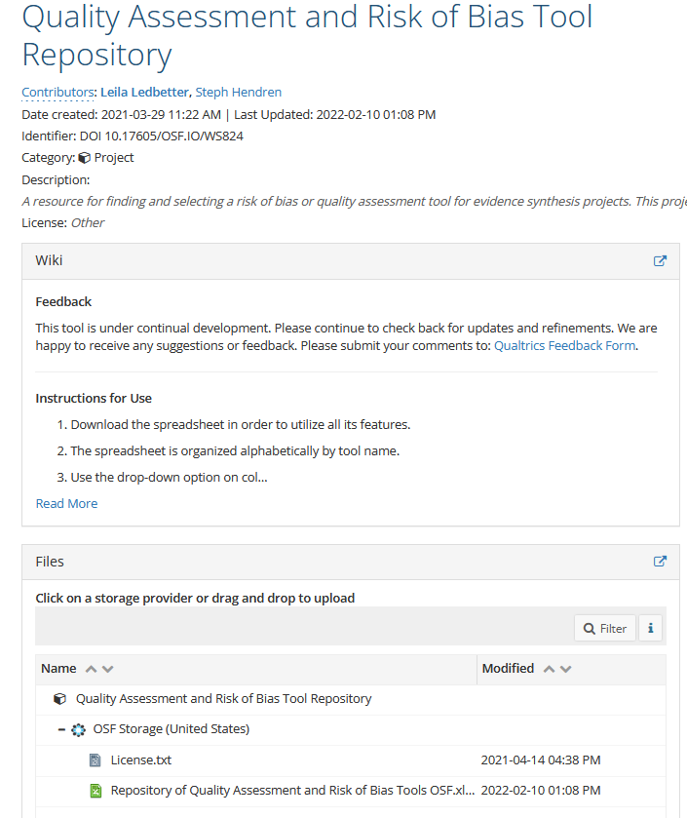
osf.io/ws824/
Please download the excel sheet

Slide 40
Summarizing the process for paper’s methods -From PRISMA 2020
1. Specify tool name and version
2. Specify any modifications made to a tool
3. Specify the methodological domains the tool uses for RoB assessment. Report whether an overall risk of bias score was summarized across all domains

Slide 41
Summarizing the process for paper’s methods -From PRISMA 2020
4. Report the logistical process: how many reviewers, using what software, how disagreements were resolved
5. Report if an automation tool was used to assess risk of bias
6. Report any processes to obtain additional information from authors

Slide 42
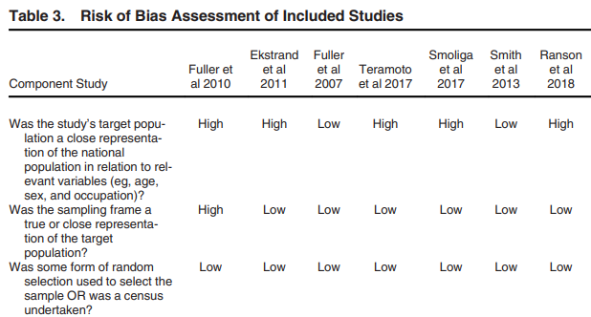
From PRISMA 2020

Slide 43
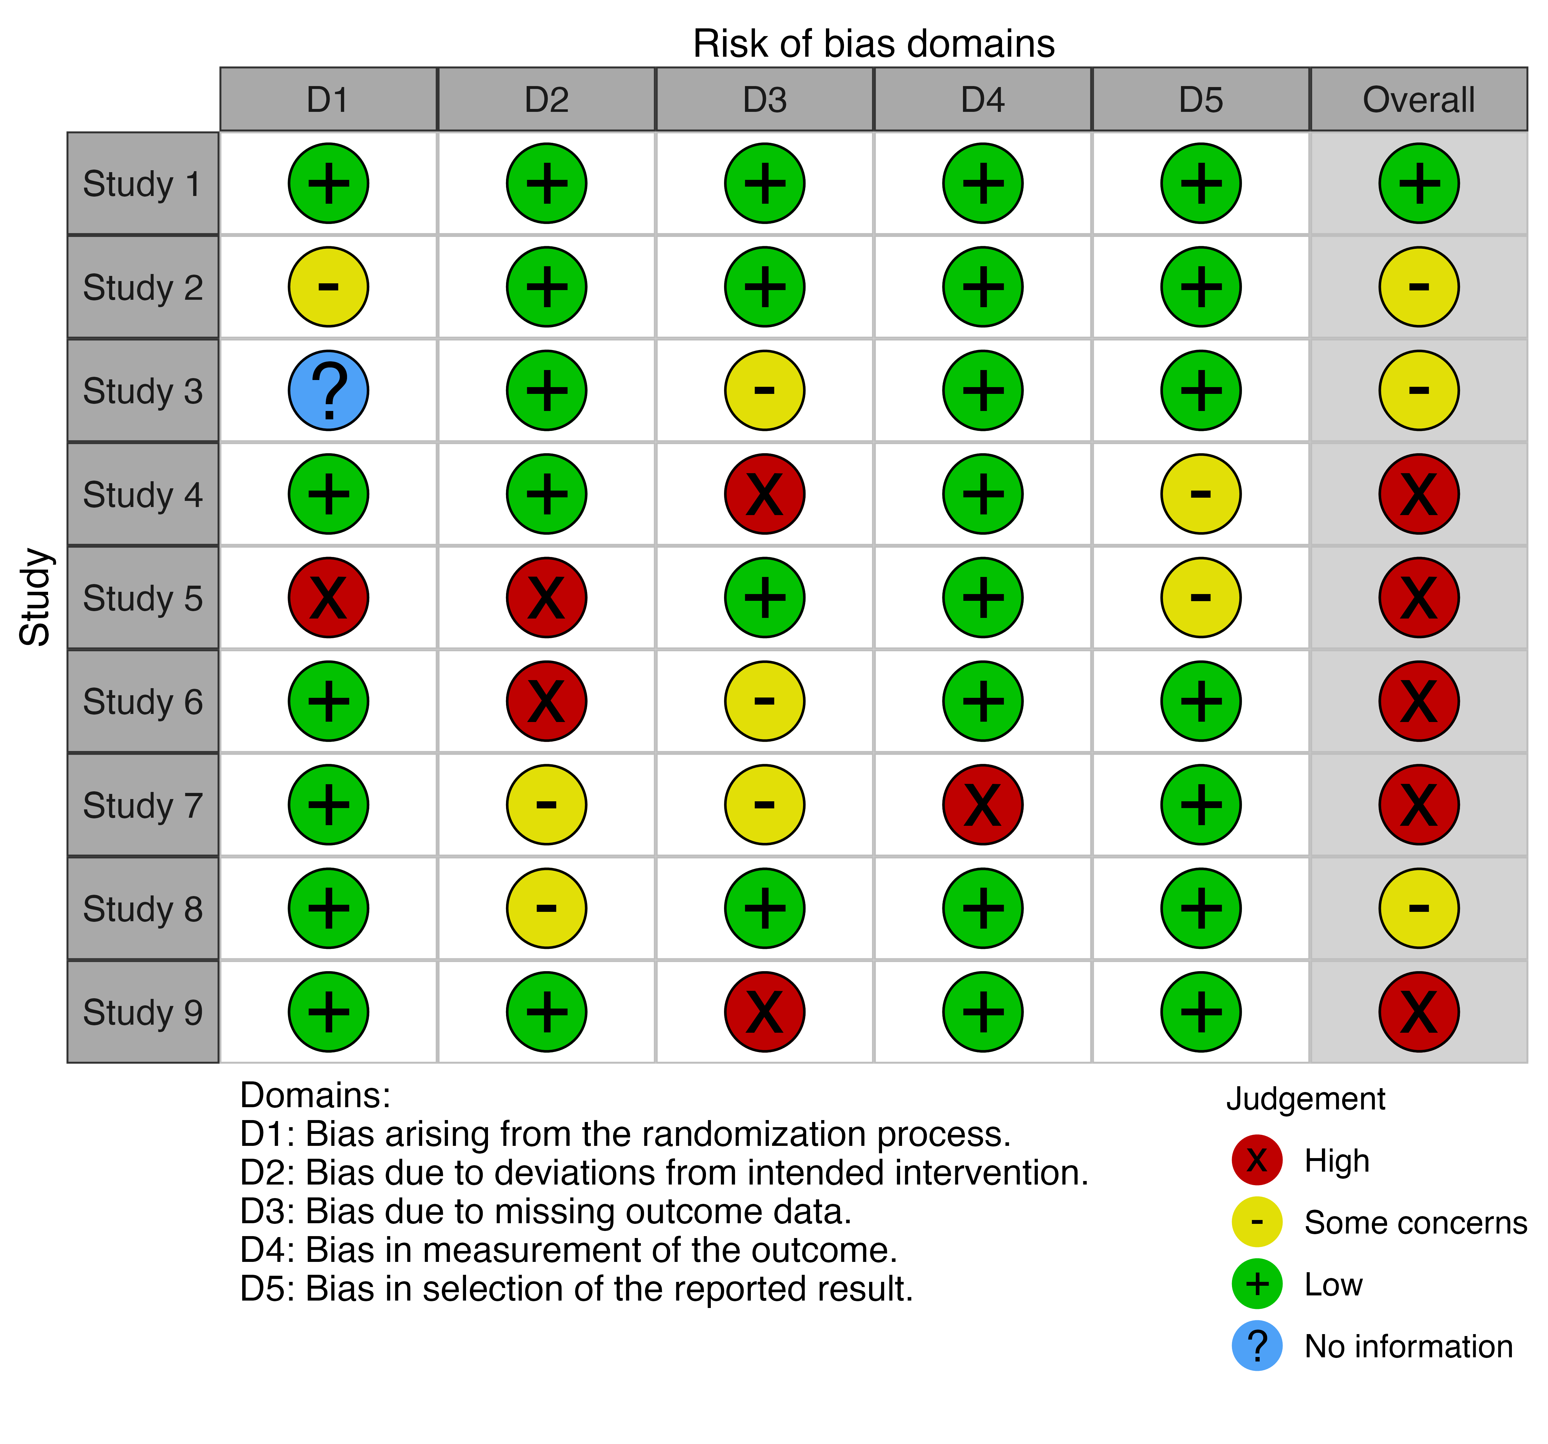
Traffic Lights vs Numbers
Numbers are vague and introduce bias

Slide 44
Resources
Osf.io/ws824/
https://training.cochrane.org/handbook/current/chapter-08
https://nap.nationalacademies.org/catalog/13059/finding-what-works-in-health-care-standards-for-systematic-reviews
Chapter 3: Standards for Finding and Assessing Individual Studies

Slide 45
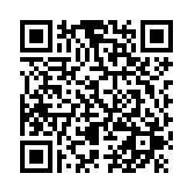
Questions Acknowledgements assessment
Reach out – blossj19@ecu.edu
252-744-3055
Thank you to Steph Hendren and Leila Ledbetter at Duke University Medical Center Library for sharing their presentation materials with me.
https://ecu.az1.qualtrics.com/jfe/form/SV_ezmz4ZBEENSU2wK
Notes:
https://ecu.az1.qualtrics.com/jfe/form/SV_ezmz4ZBEENSU2wK

