Slide 1
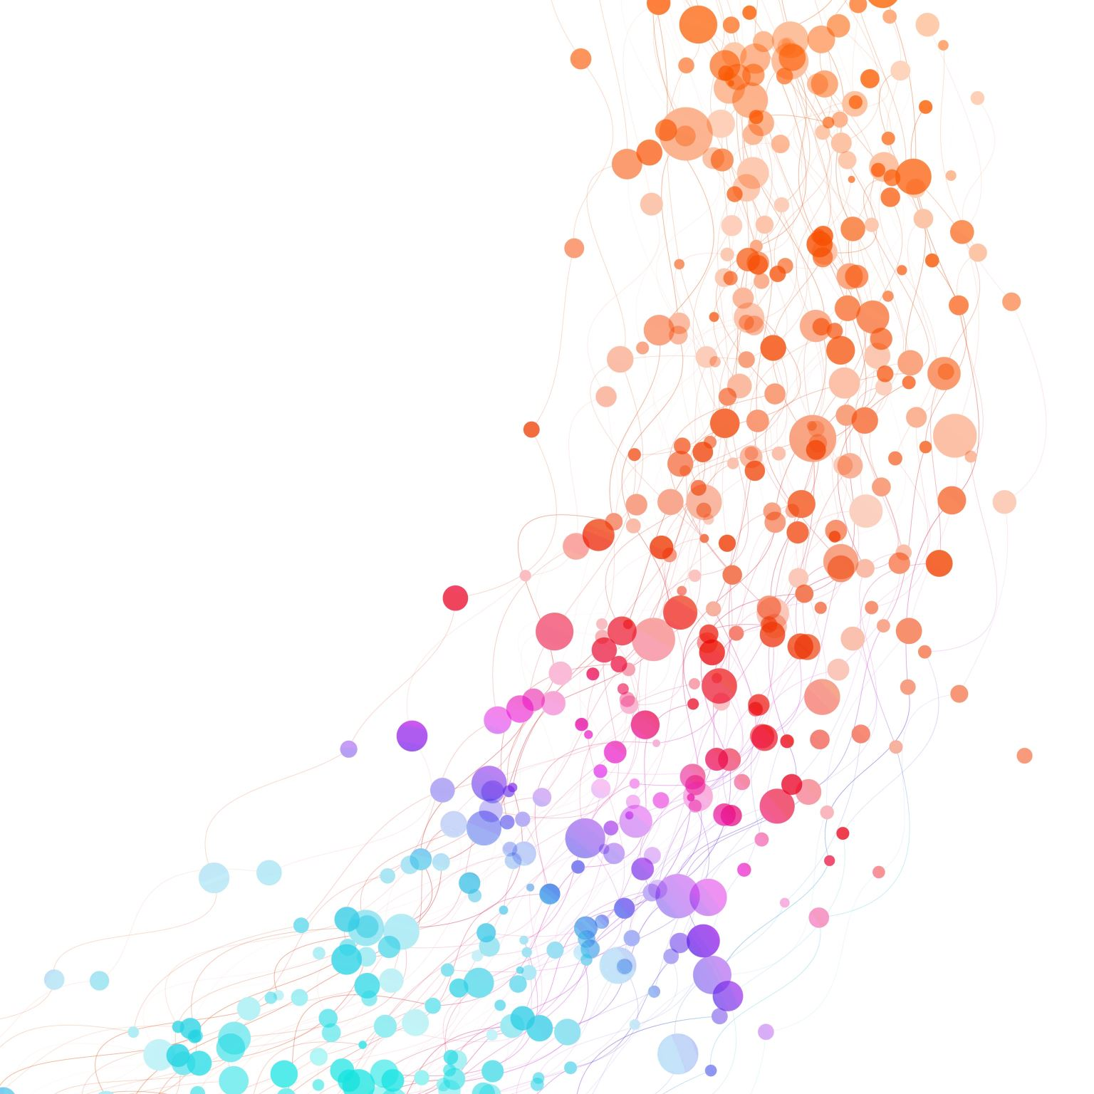
My Proposal was Declined, now what?
Heather Harris Wright, PhD
Associate Dean for Research
College of Allied Health Sciences &
College of Nursing

Slide 2
Developing Resilience
Constructive way forward during challenging times
Can be learned and practiced
Internally –
Awareness of own negative self-talk; develop ways to manage
Externally –
Building relationships with peers & mentors
Using available resources
Based on presentation, “Becoming a Resilient Scientist” Sharon Milgram, NIH Office of Intramural Training & Education

Slide 3
Dream
Reality

Slide 4
Everyone has setbacks
Grant proposal “not discussed” or “not funded”
Manuscript rejection
Harsh teaching evaluations
Difficult students
Conference presentation Q&A implodes

Slide 5
Use it to advance your science and grow as researchers
AND
Cultivate a more supportive research culture

Slide 6
Resilience
Attitude
Action
Tracy Love, “Responding to Challenges with Resilience”, ASHA Pathways 2018

Slide 7
Attitude: follow the 5:1 Rule
Ability to resubmit
Identify what they liked in the proposal
A good idea that we hadn’t thought about
You may disagree but have a good rationale for your position
Will encourage to develop an argument; construct; etc…
“They hated it”

Slide 8
Action
Carefully look at feedback
Get out your highlighter –
What did they like?
What did they hate?
What did they think you needed/could do to fix?
Share, share, share
Read through feedback with Co-Is, mentor, other folks you trust

Slide 9
What else can you get from it?
Think Products -
Guest lecture
Invited presentation
Conference presentation
Review paper
Data-based paper with preliminary data

Slide 10
Able to resubmit? Get a Proposal Review
Why?
Eliminates “generalization”
Improve overall content
Your role in the proposal review process
Listen
Accept
Ask
Clarify

Slide 11
Proposal Review
Some options:
Peer review
Grant Advisory Panel
External review

Slide 12
Thank you!
Heather Harris Wright wrighth@ecu.edu

