Slide 1
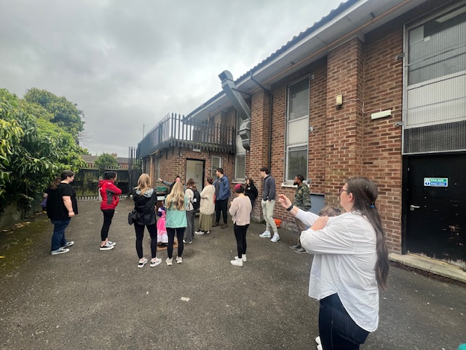
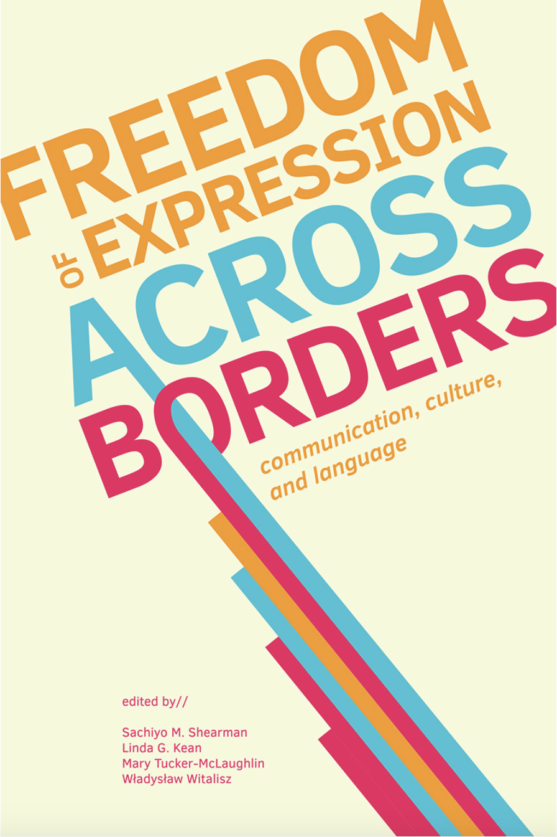
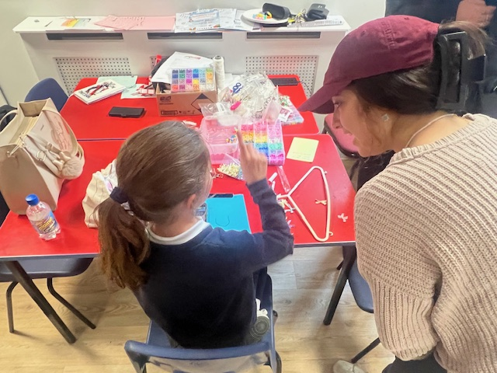
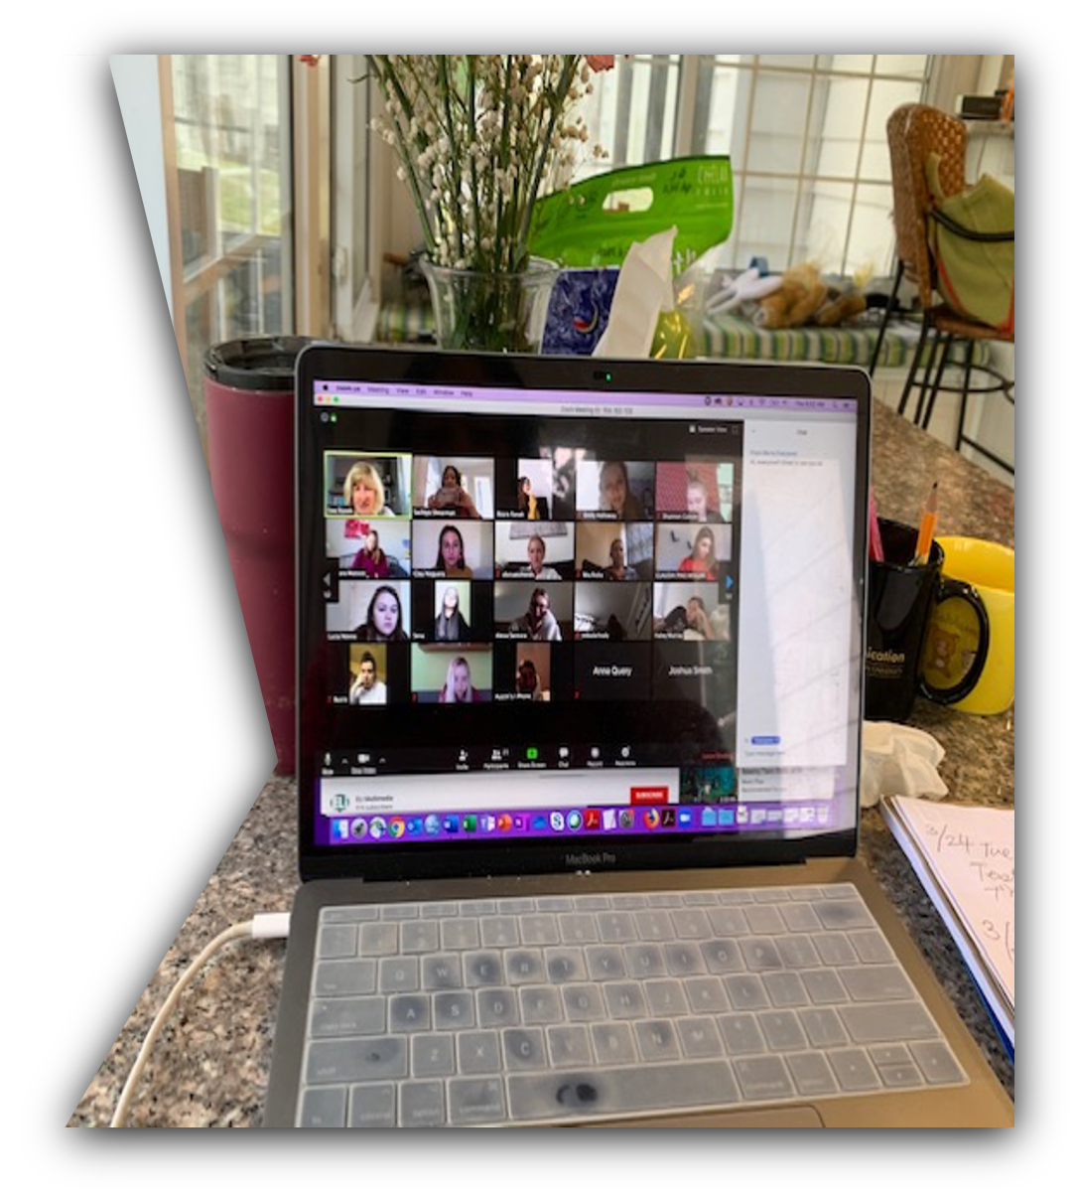
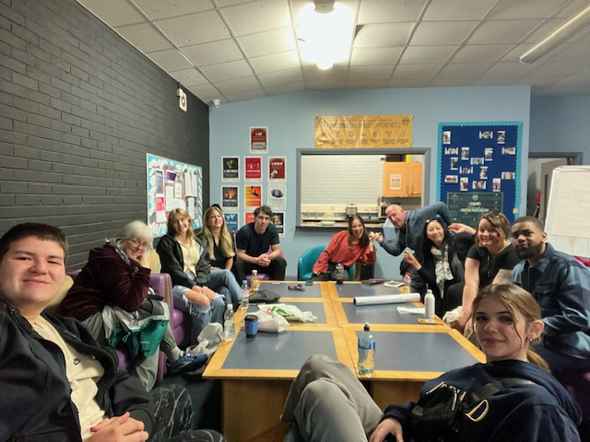
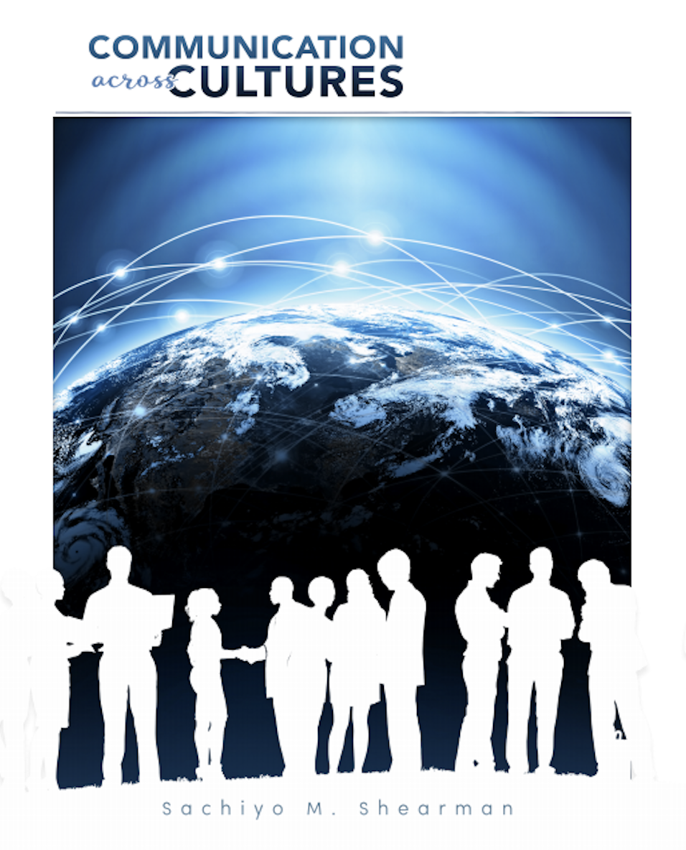
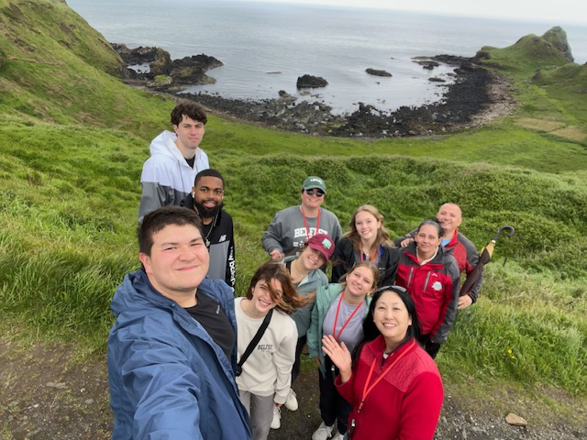
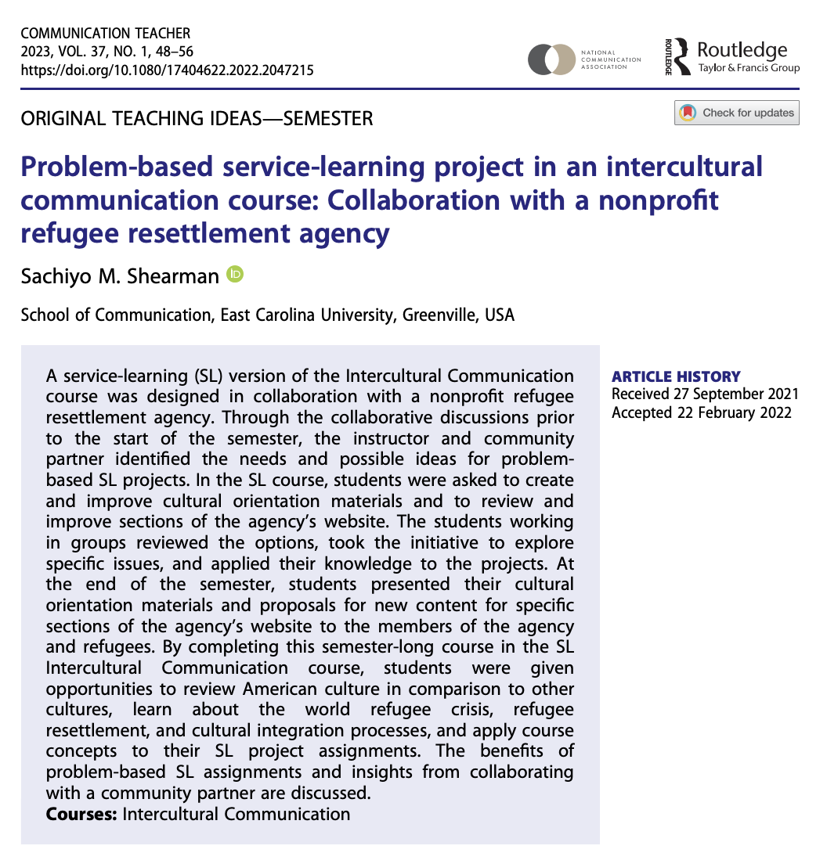
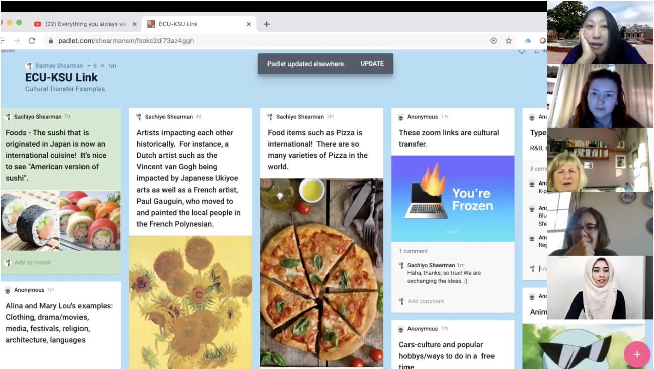
Experiential Learning: Incorporating research and service in teaching
2024/2025 Scholar-Teacher
Sachiyo M. Shearman
School of Communication
College of Fine Arts and Communication
Greenville, North Carolina 27858
shearmans@ecu.edu
Introduction
Experiential Learning: Local and Global Service Learning
Edited Book
Sachiyo Shearman is a professor in the School of Communication at East Carolina University. She has taught undergraduate and graduate courses in the School of Communication and the International Studies Master's Program, both face-to-face and online teaching delivery formats.
She has conducted cross-cultural comparative research studies examining communication behaviors in families, organizations, and health contexts. Her research studies have been published in journals such as Communication Quarterly, Health Communication, Howard Journal of Communication, Human Communication Journal, Journal of Family Communication, PLOS ONE, and PLOS Global Public Health.
In this poster, I have listed some of the examples of where my research and service activities are integrated into teaching, especially using experiential learning.
Global Service-Learning - Study Abroad in Northern Ireland in the Summer of 2024
This study abroad program offered two courses - COMM4040 Media, Culture, and Society, and COMM4130 Conflict and Communication.
Students participated in global service learning, as we worked with a partner non-profit organization, Amizade, a leader in global service learning.
We stayed in Belfast, Northern Ireland, for twelve days. We visited and worked in various youth centers such as St. Peter’s Youth Center, Townsend Youth Center, Holy Trinity Youth Center, and Forth Springs Youth Center.
Students listened to a variety of guest speakers from both sides of the conflict (Republican, Irish, and Catholic as well as Loyalist, British, and Protestant) who survived the 1969-1998 Troubles.
More details about this study abroad trip can be found on the CFAC website - https://artscomm.ecu.edu/iat/programs-soc/.
Shearman, S. M., Kean, L. G., McLaughlin, M., & Władysław, W. (2023). Freedom of expression across borders: communication, culture, and language. East Carolina University Academic Library Services/North Carolina University Press. https://thescholarship.ecu.edu/items/03691060-23cf-47aa-91cc-47241177dce6
This was an edited book that came out of collaboration with my colleagues here at ECU and colleagues at Jagiellonian University and Carpathian State University. This book emphasizes on understanding phenomena where culture, language, and communication intersect. Whenever possible, I try to incorporate my recent research effort in my teaching.
International Virtual Exchange
In collaboration with multiple professors in countries such as Japan, Peru, and Poland, we have provided International Virtual Exchange (IVE) modules to students.
In IVE modules, students discussed a variety of topics on Zoom with international classmates. At times, they are grouped up and worked on collaborative assignments as an international team.
My colleagues and I have conducted survey and interview studies to examine the impact of IVE based on students’ experiences (Shearman & Eguchi, 2018; Shearman & Rusek, 2023).
Interactive Electronic Textbook
Shearman, S. M. (2019). Communication Across Cultures (First Edition). Dubuque, IA:
Great River Learning. ISBN#9781680757071
https://www.greatriverlearning.com/
For my Intercultural Communication course, I have worked and published the electronic textbook titled “Communication Across Cultures” (Shearman, 2019).
In this electronic textbook, students can respond to the questions posed in the book chapters.
Instead of in-class chapter-reading pop quizzes, students complete “Interactive exercises” on this and chapter reading quiz on this e-book. Students can be interactive by typing into e-book chapters, while I can check to see if they are reading the textbook.
After participating in the alternative textbook program in 2024, I am trying to use other accessible open educational resources as supplementary materials in my courses.
Local Service-Learning Course
COMM3180 Intercultural Communication
In my COMM3180 Intercultural Communication course, students worked with a local non-profit refugee processing agency so they could work on problem-based service-learning projects to help assist refugees who are resettled in Eastern North Carolina.
In a past semester, I have set up occasions where students took a bus to a former-refugee-owned business in New Bern, NC. We had a joint class session with ECU students and local/former refugees who are now residents of the City of New Bern.
More details can be found on the article (https://dx.doi.org/10.1080/17404622.2022.2047215 ) published in Communication Teacher titled “Problem-Based Service-Learning project in intercultural communication courses” (Shearman, 2022).
I have also collaborated on a research project with this non-profit refugee agency (Shearman, Husson, & Fleishman, 2022). As I serve as a board member of non-profit refugee processing agency called Interfaith Refugee Ministry (www.helpingrefugees.org) and I hope continue to combine teaching, research, and service.
Mentoring & Lifelong Learning
Mentoring is at the core of what I do as a professor. I truly enjoy this experience of mentoring students with their individual projects, besides mentoring in the classroom.
In the past, I served on over 60+ comprehensive examination committees, one dissertation,14 theses, an honor’s thesis, and professional papers. My colleagues and I assisted in the publication of previous students’ papers in journal articles such as in GEP journal (Sharma & Sherman, 2021), PLoS Global Health (Bertges et al., 2024; Carvajal et al., 2022), and in conference presentations (Juarez et al., 2024; Pun et al., 2023).
She believes in life-long learning. She continues to learn along with her students and colleagues by researching, teaching, doing service, and incorporating these three elements.

