Slide 1
SciENcv: How to create your NIH biosketch
01/15/2025
Mary Lisa Pories, PhD, CRA
ECU Sponsored Programs Officer

Slide 2
Learning objectives:
Understand the reason for the changes in biosketch setup
Understand how to set up SciENcv and use the biosketch template in SciENcv to build and download your biosketch
Navigate the process of adding research products to your bibliography
Learn how to link an existing ORCID to your NCBI account and add delegates

Slide 3
Why?
And why now?

Slide 4
  NATIONAL RESEARCH SECURITY CONCERNS
National Security Presidential Memorandum 33 (NSPM-33) requires all federal research funding agencies to strengthen and standardize disclosure requirements for federally funded awards
https://www.whitehouse.gov/wp-content/uploads/2022/01/010422-NSPM-33-Implementation-Guidance.pdf

Slide 5
  NSPM-33
The purpose of NSPM-33 is to strengthen protections of U.S. Government-supported R&D against foreign government interference and misappropriation, while maintaining an open environment to foster research discoveries and innovation that benefit the United States and the world.
https://www.whitehouse.gov/wp-content/uploads/2022/01/010422-NSPM-33-Implementation-Guidance.pdf

Slide 6
  NSPM-33
Five key areas addressed in NSPM-33:
1. Disclosure Requirements and Standardization
2. Digital Persistent Identifiers
3. Consequences for Violation of Disclosure Requirements
4. Information Sharing
5. Research Security Programs
https://www.whitehouse.gov/wp-content/uploads/2022/01/010422-NSPM-33-Implementation-Guidance.pdf

Slide 7
  Science Experts Network Curriculum Vitae
SciENcv
  Cooperative project requested by the Federal Demonstration Partnership (FDP) of which ECU is a member
  Electronic system that helps researchers assemble the professional information needed for participation in federally funded research
  https://www.ncbi.nlm.nih.gov/sciencv/background/

Slide 8
The value of SciENcv:
Formats it correctly for you for either NIH or NSF biosketch
Eliminates the need to repeatedly enter your biosketch information
  Reduces the administrative burden associated with federal grant submission and reporting requirements
Provides access to a researcher-claimed data repository with information on expertise, employment, education, and professional accomplishments
https://www.ncbi.nlm.nih.gov/sciencv/background/

Slide 9
Required
Currently required for National Science Foundation (NSF) applications
https://www.ncbi.nlm.nih.gov/sciencv/background/
Will be required for National Institutes of Health (NIH) applications starting May 25, 2025 (was January 25, 2025)
We do not expect anymore delays in this rollout
https://grants.nih.gov/grants/guide/notice-files/NOT-OD-24-163.html
https://grants.nih.gov/grants/guide/notice-files/NOT-OD-24-084.html

Slide 10
Before we begin
We recommend you register with ORCID

Slide 11
ORCID
Open Research and Contributor ID

Slide 12
ORCID
ORCID is a free, unique, persistent identifier (PID) for individuals to use as they engage in research, scholarship, and innovation activities and meets the requirements of the NSPM-33.
https://orcid.org/

Slide 13
ORCID
Anyone who participates in research, scholarship, or innovation can register an ORCID ID for themselves, free of charge, and can use the same ID throughout their whole career‚ even if your name changes or you move to a different organization, discipline, or country.
https://info.orcid.org/researcher-faq/

Slide 14
ORCID
Federal grant applicants can link their ORCID accounts with SciENcv to simplify the creation of biosketches for grant applications.
https://grants.nih.gov/grants/guide/notice-files/NOT-OD-19-109.html

Slide 15
ORCID
If you do not have one, please get one!
NIH, AHRQ and CDC already require ORCID for research training, fellowship, research education, and career development awards
Required by NIH starting January 25, 2025
https://grants.nih.gov/grants/guide/notice-files/NOT-OD-19-109.html
https://grants.nih.gov/grants/guide/notice-files/NOT-OD-24-163.html

Slide 16
ORCID
To register:
https://orcid.org/signin

Slide 17
Links to helpful videos
What is an ORCID ID? - https://www.youtube.com/watch?v=vB4GjGFs1LM
SciENcv – Integrating with ORCID https://www.youtube.com/watch?v=G_cKSRr7TJ4

Slide 18
One last thing…
NCBI

Slide 19
My NCBI
National Library of Medicine
https://www.ncbi.nlm.nih.gov/

Slide 20
My NCBI
My NCBI includes other features that help you save PubMed citations to your articles and manage peer review article compliance with the NIH Public Access Policy (My Bibliography), create online professional profiles (SciENcv), highlight search terms, and set up Outside Tool preferences for PubMed.
https://www.ncbi.nlm.nih.gov/books/NBK3842/

Slide 21
My NCBI
My Bibliography is a reference tool that helps you save your citations from PubMed or, if not found there, to manually upload a citations file, or to enter citation information using My Bibliography templates. My Bibliography provides a centralized place for your publications where citations are easily accessed, exported as a file, and made public to share with others.
https://www.ncbi.nlm.nih.gov/books/NBK3842/

Slide 22
My NCBI
When a My Bibliography collection is set as public to share with others, a URL is provided to a public view of your bibliography. The public view page displays all the citations stored in your My Bibliography collection.
https://www.ncbi.nlm.nih.gov/books/NBK3842/

Slide 23
My NCBI
Create your account:
https://account.ncbi.nlm.nih.gov/signup or https://www.ncbi.nlm.nih.gov/sciencv/.
If you already have an eRA Commons or NSF account, please use it to create your NCBI account.
https://www.nlm.nih.gov/ncbi/workshops/2023-02_SciENcv/SciENcv_what2know.html#creating

Slide 24
Linking to Sciencv
Log in to your NCBI account.
Click your username which is located on the top right of the browser page.
Click Change in the Linked Account portlet.
Locate eRA Commons, enter your eRA Commons credentials or locate National Science Foundation, enter your NSF credentials.
Follow the onscreen prompts.
https://www.nlm.nih.gov/ncbi/workshops/2023-02_SciENcv/SciENcv_what2know.html#creating

Slide 25
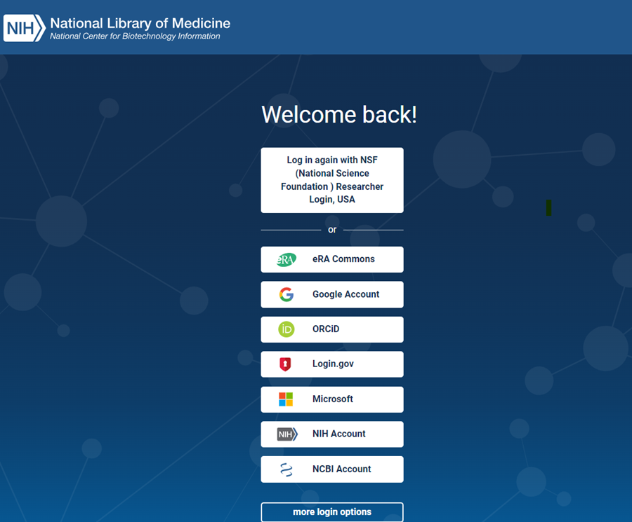
Select eRA commons

Slide 26
The Main Event
SciENcv

Slide 27
Getting started
Log into SciENcv:
https://www.ncbi.nlm.nih.gov/sciencv/

Slide 28
Getting started
Click the link to sign in with your eRA Commons ID.

Slide 29
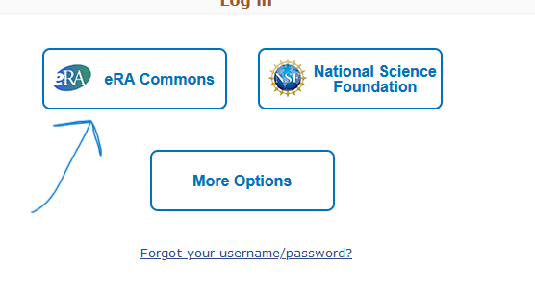
eRA commons

Slide 30
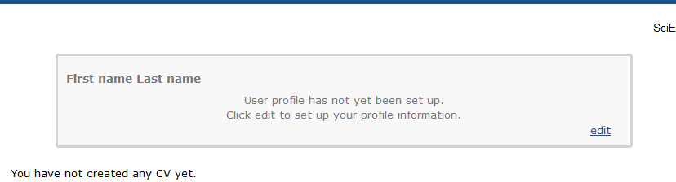
If you have not set up your user Profile….

Slide 31
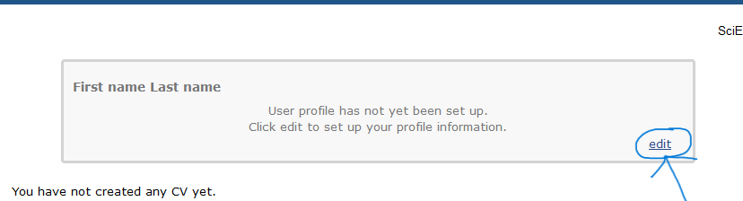
Click edit

Slide 32
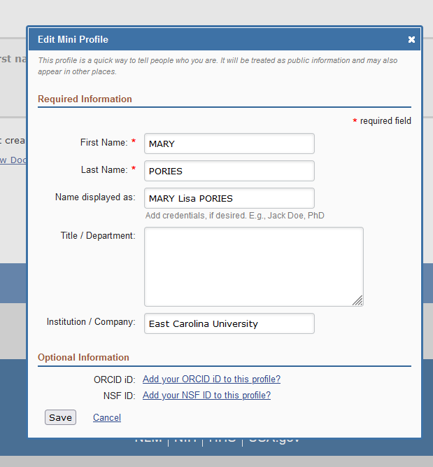
and….

Slide 33

After you save, Add ORCID Id

Slide 34
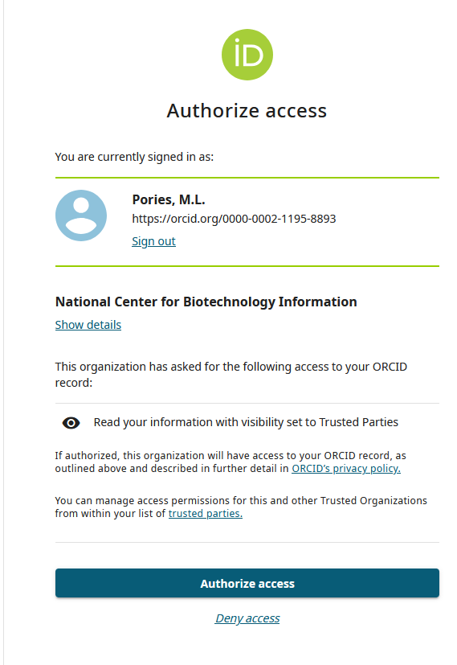
Authorize access

Slide 35
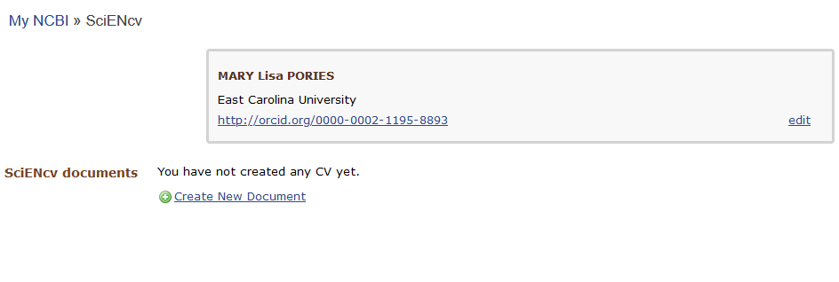
And now….

Slide 36
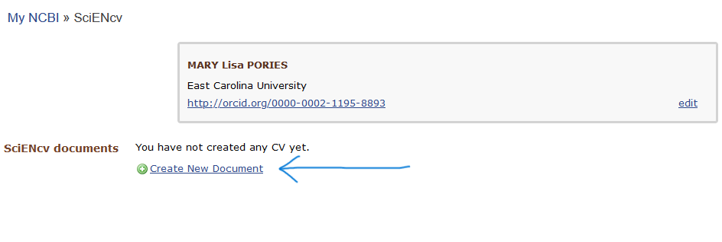
Create new Document

Slide 37
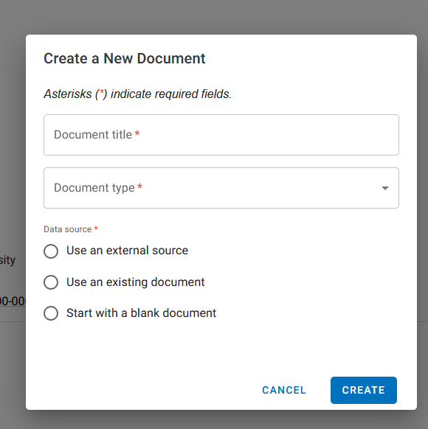
Create new Document

Slide 38
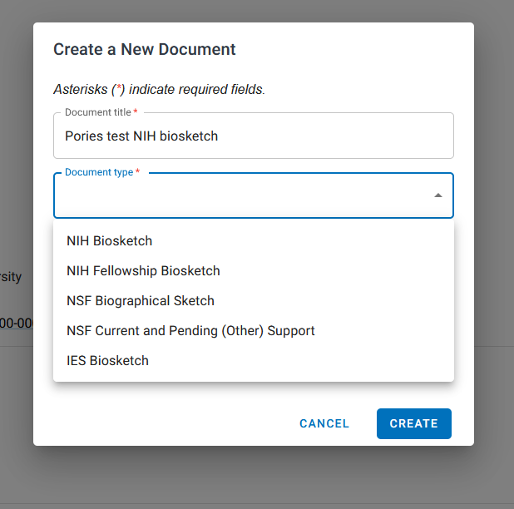
Name and Select

Slide 39
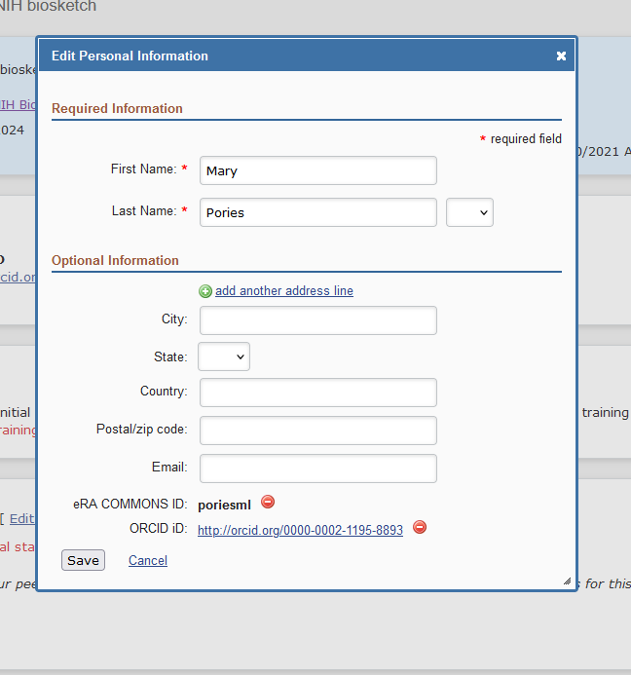
Edit Personal information

Slide 40
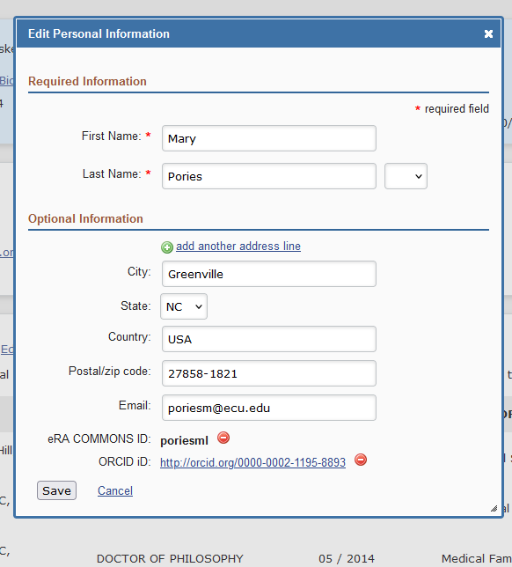
Added

Slide 41
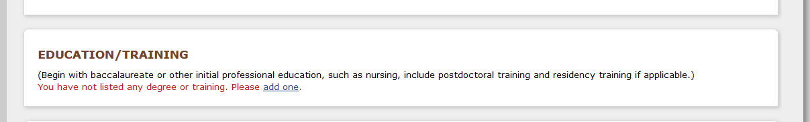
Add your education/training

Slide 42
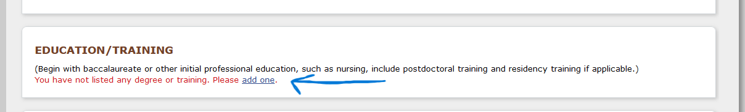
Add your education/training

Slide 43
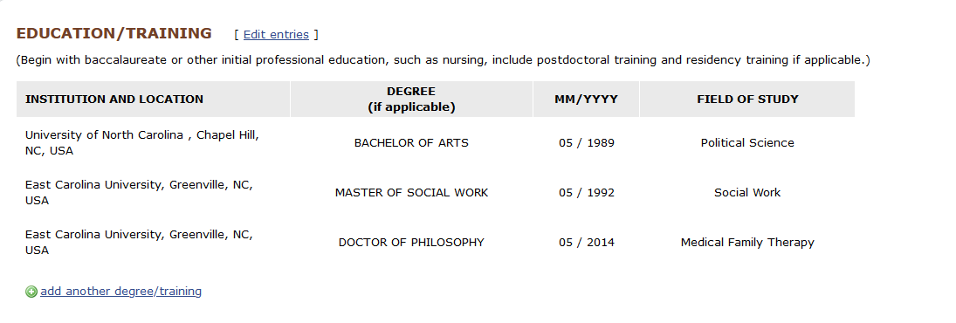
Added

Slide 44
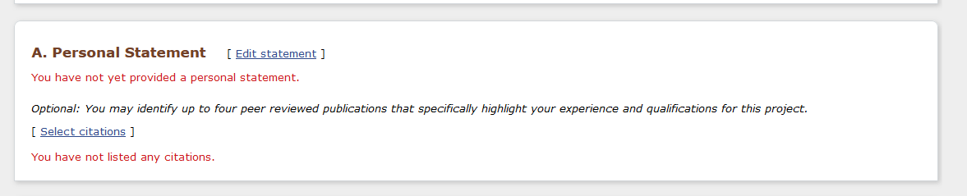
Add your Personal statement

Slide 45
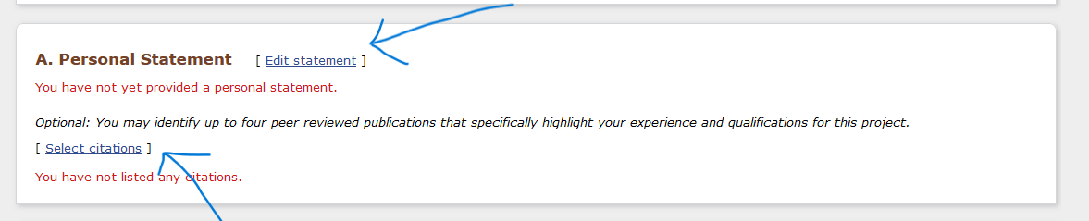
Add your Personal statement

Slide 46
Personalize Your Personal statement
Personalize to the project you are submitting for. Check the RFP to ensure you cover any items they require in this section (based on the mechanism).

Slide 47
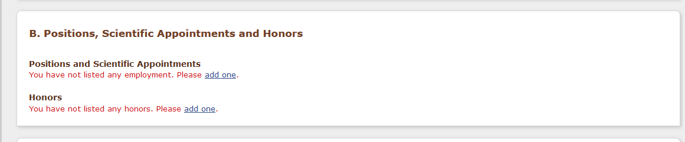
Add your positions, appointments and Honors

Slide 48
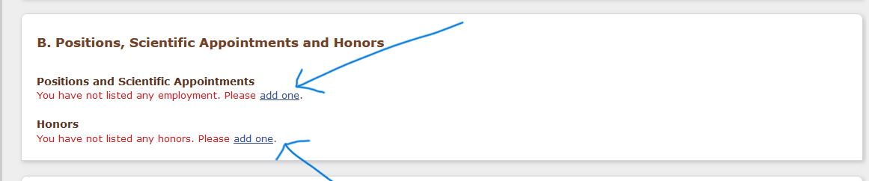
Add your positions, appointments and Honors

Slide 49
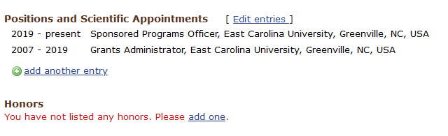
Added

Slide 50
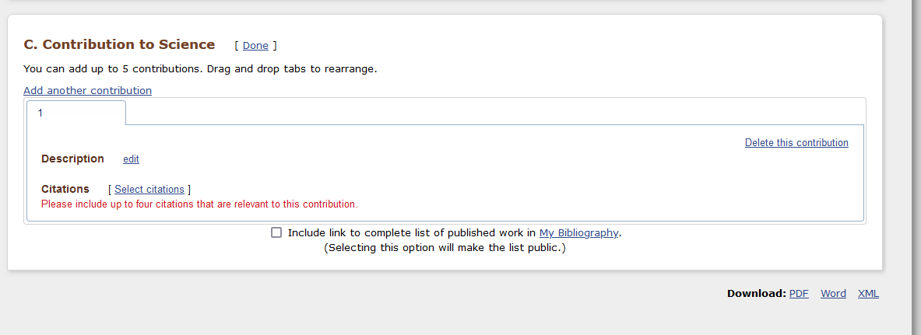
Add Contribution to Science

Slide 51
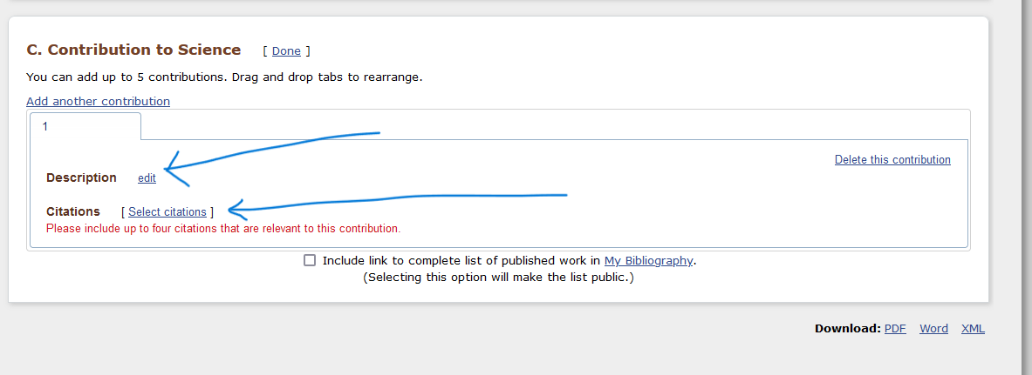
Add Contribution to Science

Slide 52
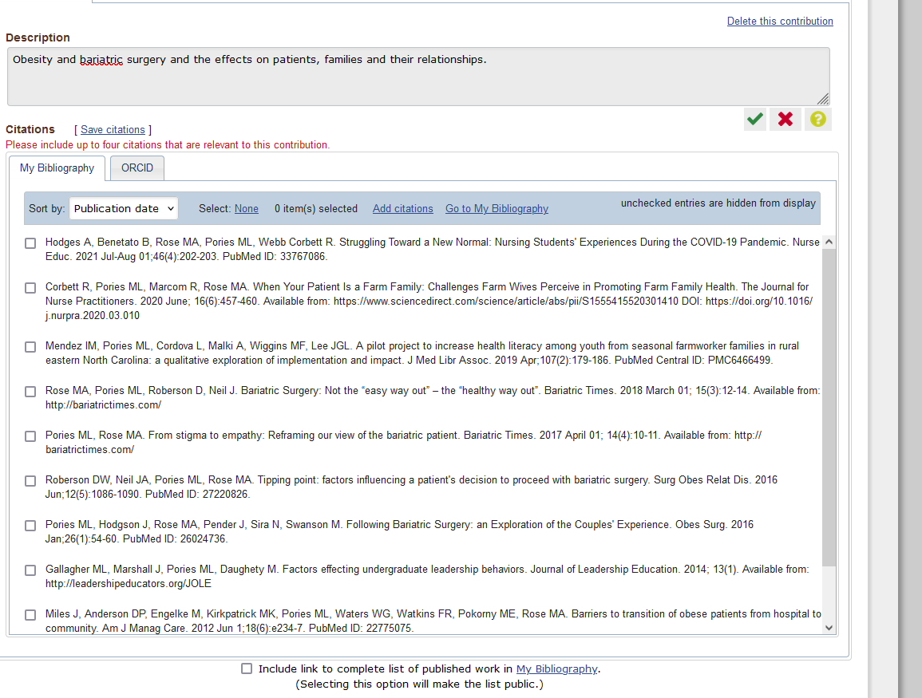
Add Contribution to Science

Slide 53
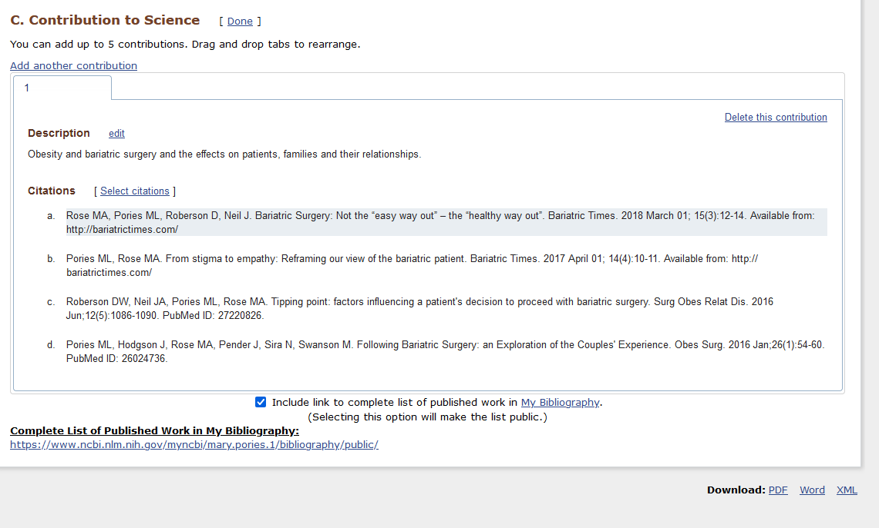
Added

Slide 54
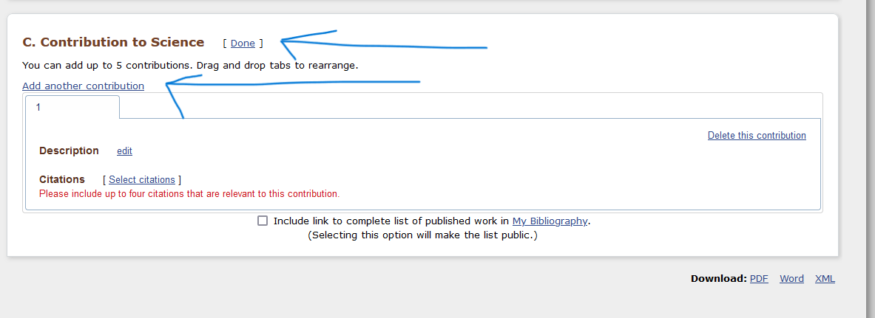
Add Contribution to Science

Slide 55
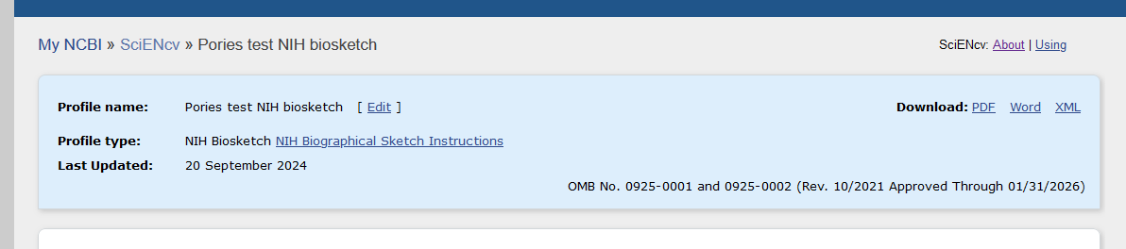
Download your Biosketch

Slide 56
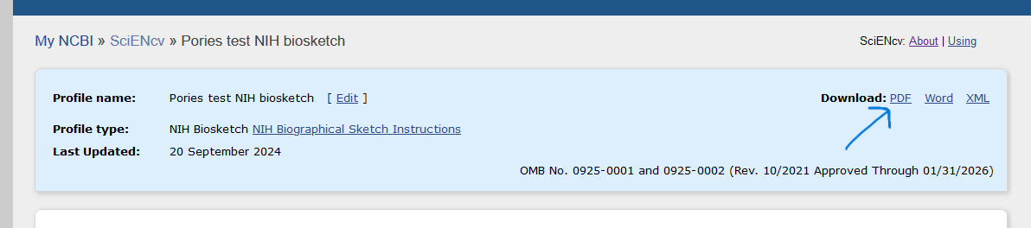
Download your Biosketch

Slide 57
BIosketch
Downloaded biosketch will be correctly formatted for the type of document you selected when you created a new document and selected the type:
NIH biosketch
NIH Fellowship Biosketch
NSF Biographical Sketch
NSF Current and Pending (Other) Support
IES biosketch

Slide 58
Delegates
As a My NCBI account holder, you can invite other individuals to act as your delegate and grant them the ability to view and edit your My Bibliography collection (including Other Citations), as well as the ability to view, edit, and create profiles in your SciENcv.
https://ncbiinsights.ncbi.nlm.nih.gov/2015/02/19/my-bibliography-and-sciencv-how-to-delegate-authority-to-others-to-editcreate-your-profile-and-collections/

Slide 59
Invite a Delegate
After you’ve logged in to your NCBI account, click on your username in the top right corner of the screen to access your Account Settings. Then, under the “Delegates” section, click “Add a delegate” and enter the email address for your intended recipient. The Delegates section of the Account Settings page displays a list of all the delegates granted access to either your My Bibliography collection or your SciENcv, or both.
https://ncbiinsights.ncbi.nlm.nih.gov/2015/02/19/my-bibliography-and-sciencv-how-to-delegate-authority-to-others-to-editcreate-your-profile-and-collections/
https://www.ncbi.nlm.nih.gov/books/NBK154494/#sciencv.Adding_Delegates_to_SciENcv

Slide 60
Invite a Delegate
In the Delegates section you may add or remove delegates as well as modify the access granted, see ‘Adding and Removing Delegates.’ You can have multiple delegates and can control what each delegate has access to.
https://ncbiinsights.ncbi.nlm.nih.gov/2015/02/19/my-bibliography-and-sciencv-how-to-delegate-authority-to-others-to-editcreate-your-profile-and-collections/

Slide 61
Links to helpful Information
National Library of Medicine video: Creating an NIH or NSF biosketch with SciENcv:
https://www.nlm.nih.gov/ncbi/workshops/2023-02_SciENcv/workshop-video.html

Slide 62
Links to helpful Information
https://www.youtube.com/watch?v=KD381vU7HD0
https://www.youtube.com/watch?v=oUHQnkOocUc
https://www.ncbi.nlm.nih.gov/books/NBK154494/

Slide 63
Links to helpful Information
My NCBI Help
https://www.ncbi.nlm.nih.gov/books/NBK154494/
Tutorial
https://www.youtube.com/watch?v=eGyHX85DIcE

Slide 64
Common forms - January 25, 2025
NIH will implement the use of the Common Forms – Biosketch created in SciENcv and ORCID number will also be required!
Current & Pending form also in SciENcv
https://grants.nih.gov/grants/guide/notice-files/NOT-OD-24-163.html

Slide 65
NIH required documents update
Form I application packages go into effect for applications due on or after January 25, 2025.
https://grants.nih.gov/policy-and-compliance/changes-coming-2025/updated-forms-I-instructions

Slide 66
Questions?

Slide 67
  NSPM-33
1. Standardization of disclosure requirements:
Disclosure requirements will be standardized across research agencies to the greatest extent practicable. Variations among research agencies should be limited to cases (a) where required by statute or regulation; (b) where more stringent protections are necessary for protection of R&D that is classified, export-controlled, or otherwise legally protected; or (c) for other compelling reasons consistent with individual agency authorities and as coordinated through the NSTC.
https://www.whitehouse.gov/wp-content/uploads/2022/01/010422-NSPM-33-Implementation-Guidance.pdf

Slide 68
  NSPM-33
2. Standardization of disclosure forms and formats:
Disclosure forms and formats will be standardized across research agencies to the greatest extent practicable. Research agencies that adopt the standard requirements and processes should collect identical data elements.
https://www.whitehouse.gov/wp-content/uploads/2022/01/010422-NSPM-33-Implementation-Guidance.pdf

