Slide 1
Teaching Writing in the Age of AI
Michelle F. Eble
eblem@ecu.edu

Slide 2
Agenda
Introductions Workshop Goals
Part 1: Writing & Learning Landscape and Generative AI Technologies (GAI)
Part 2: GAI Tool Demonstrations
Part 3: Writing Assignment Considerations Part 4: Discussion and Q & A

Slide 3
Introductions
Who Am I?
Who Are You?
What are your current experiences with AI in the classroom? What is your biggest concern about AI in writing instruction?
What this workshop isn’t?

Slide 4
What are your current experiences with AI in the classroom?
I haven't incorporated AI into my teaching yet I've revised my assignments to account for AI use I explicitly allow students to use specific AI tools I demonstrate AI tools in class I'm actively teaching AI literacy I've created an AI policy for my courses I'm exploring AI but haven't implemented anything yet

Slide 5
What is your biggest concern about AI in writing instruction?
Student overreliance on AI Academic integrity issues Loss of writing skills Keeping up with rapid changes Assessment challenges Maintaining assignment effectiveness Understanding the technology

Slide 6
What this workshop isn’t?
AI technologies are tools that have material and potentially harmful consequences.
Environmental Concerns
Human Resources Concerns
Copyright/Intellectual Property/Authorship
Essential to Critical AI Literacy but not part of today’s workshop.

Slide 7
Workshop Goals
Discuss strategies to navigate this current technology landscape.
Encourage opportunities for teaching critical AI literacy.
Explore the intersection of generative AI technologies and writing instruction.
Understand how current AI tools can enhance (and impede) writing instruction.
Design writing assignments that incorporate AI literacy objectives and have students to critically engage with AI tools.

Slide 8
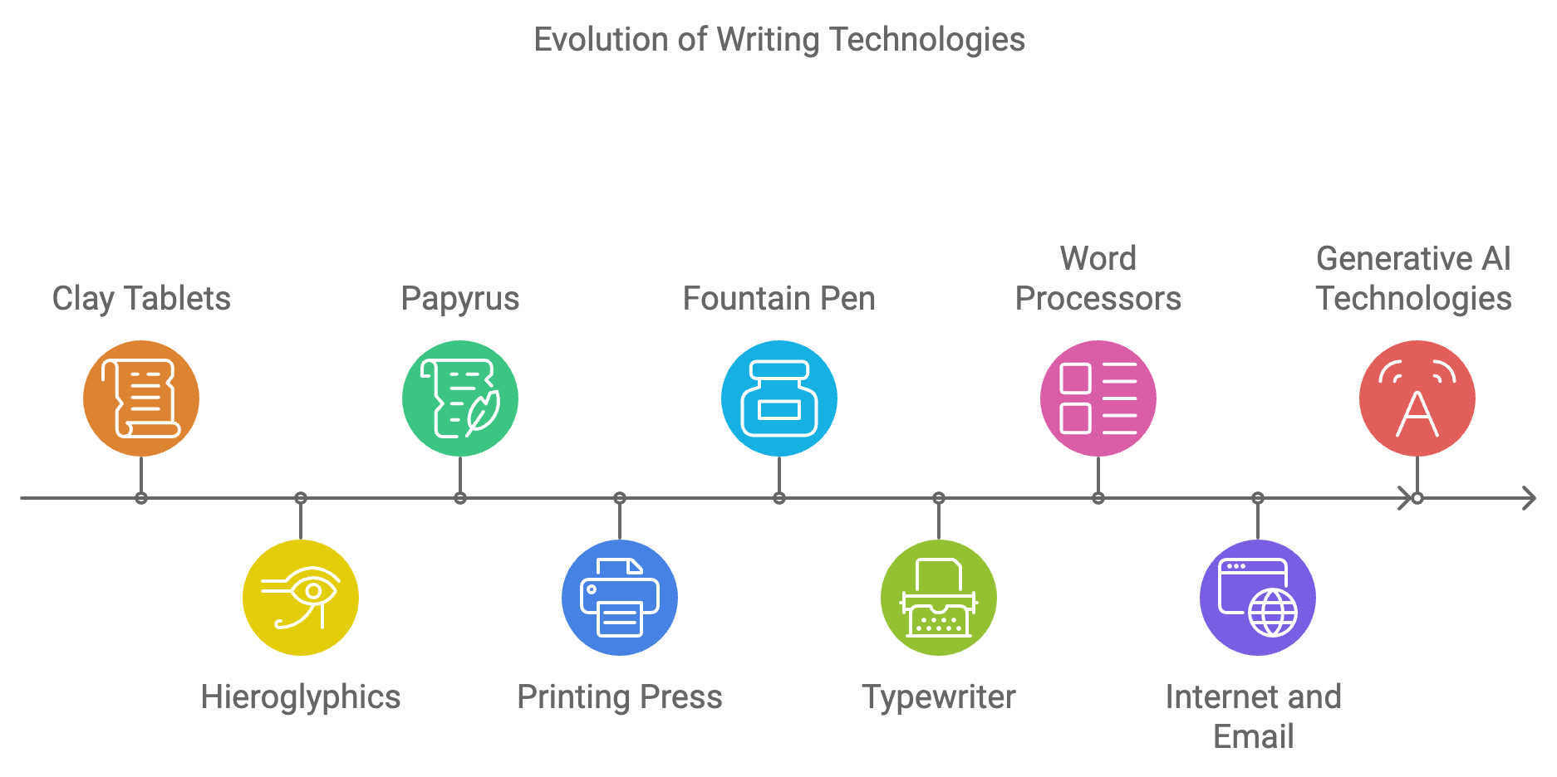
Part 1: Writing & Learning Landscape and Generative AI Technologies (GAI)

Slide 9
Part 1: Writing & Learning Landscape and Generative AI Technologies (GAI)
Invention→ Drafting → Reviewing → Revising → Editing → Delivery→ Writing is never done, only due!
What are the affordances of using these technologies?
What are the constraints?

Slide 10
Part 2: GAI Tool Demonstrations
Microsoft Copilot https://copilot.microsoft.com/
Perplexity AI https://www.perplexity.ai/
NotebookLM
https://notebooklm.google/

Slide 11
Part 2: GAI Tool Demonstrations
Microsoft Copilot https://copilot.microsoft.com/
Microsoft CoPilot is an “AI-powered assistant … designed for users to interact through natural language, making it easy to search for information, generate text….”

Slide 12
Part 2: GAI Tool Demonstrations
Perplexity AI https://www.perplexity.ai/
Perplexity AI is an “AI-powered search engine and research tool launched in 2022, designed to provide accurate answers to user queries using natural language processing. It synthesizes information from various web sources and includes citations for verification.”

Slide 13
Part 2: GAI Tool Demonstrations
NotebookLM
https://notebooklm.google/ NotebookLM “facilitates efficient note taking by allowing users to save both AI-generated responses with citations and direct quotations from source materials as notes. These notes can then be used to create outlines, study guides, or other synthesized formats using NotebookLM's suggested actions.”

Slide 14
Part 3: Writing Assignment Considerations
Teaching Writing vs. Assigning Writing
Key Distinction: Process vs. Product
Assigning writing—usually focuses on the final product
Teaching writing—usually guides decision-making throughout the process

Slide 15
Part 3: Writing Assignment Considerations
Examining Your Assignments/Projects
What skills are you assessing?
What parts of your assignment could be completed without any learning taking place?
Where in your assignment do students make meaningful decisions about their writing?
At what points do students need your guidance most?

Slide 16
Part 3: Writing Assignment Considerations
Reflecting on Assignments/Projects
In your current assignment, where do students practice making writing choices?
What invisible steps in the writing process do you assume students know?
When do you intervene in student writing processes? Only at the end?
How much of your writing instruction happens before the first draft?

Slide 17
Part 3: Writing Assignment Considerations
Reimagining Assignments/Projects
Could this assignment be broken into smaller decision points?
Where could you add opportunities for structured experimentation?
What if the final product was not the main focus?
How might AI tools change your role in the writing process?

Slide 18
Resources
Link to Handout

Slide 19
Th

