Slide 1
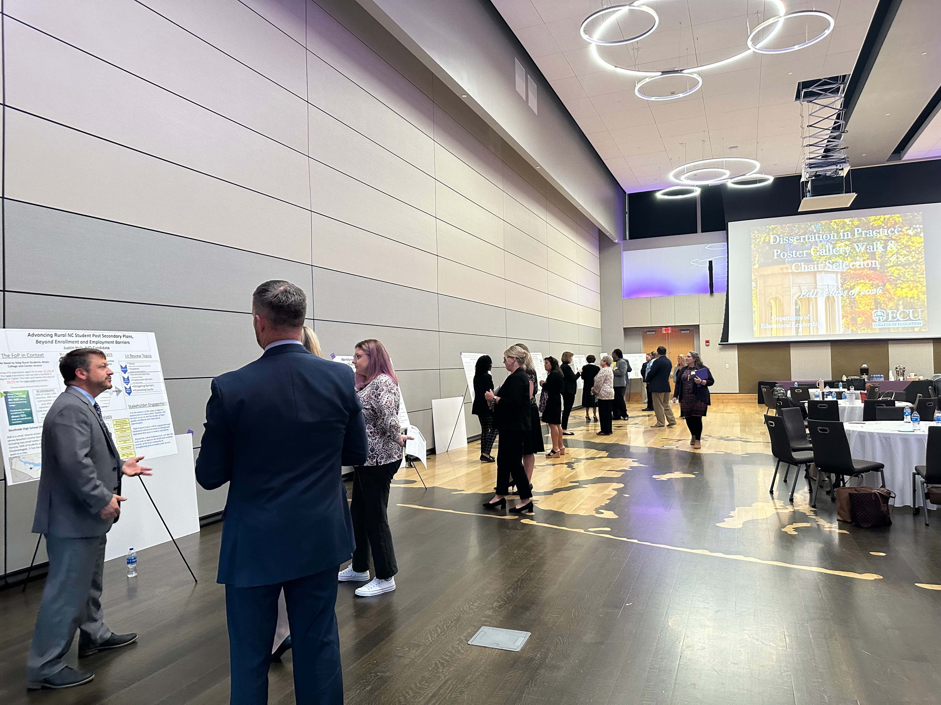
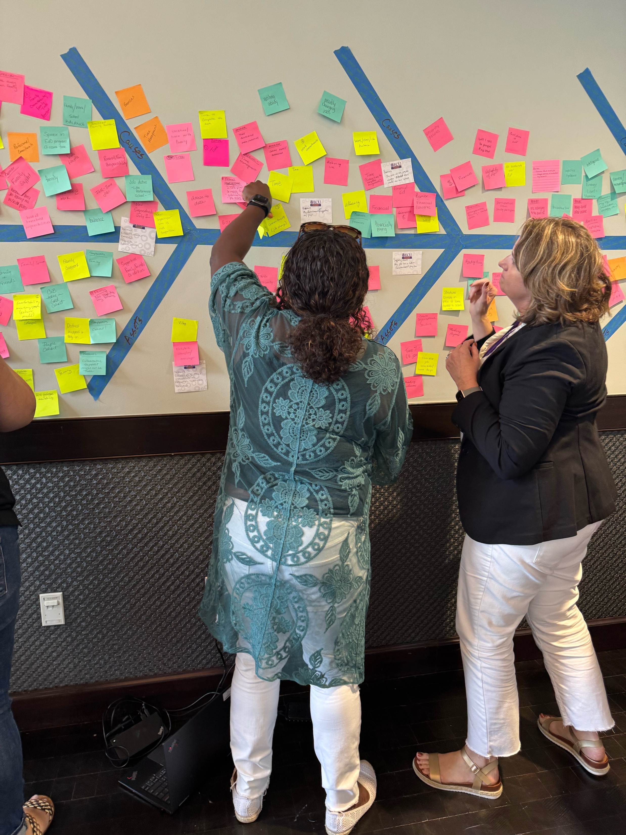
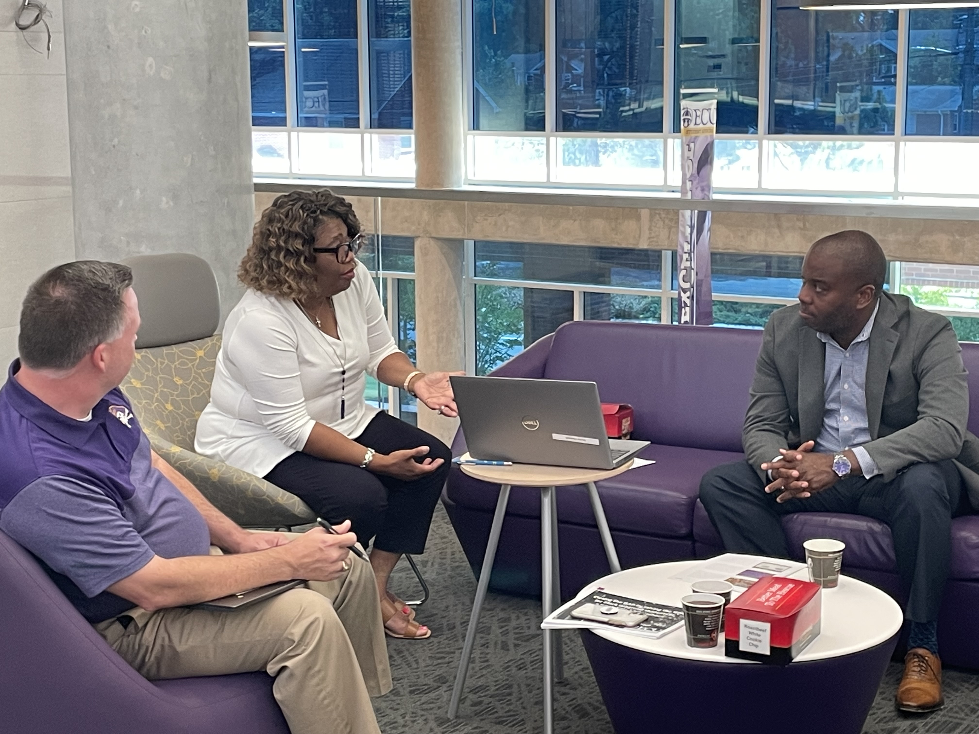
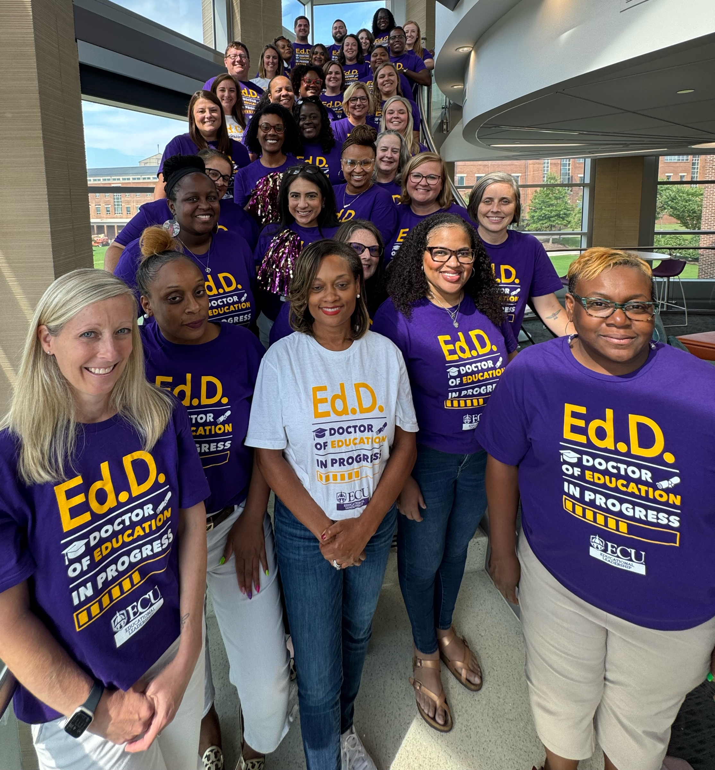
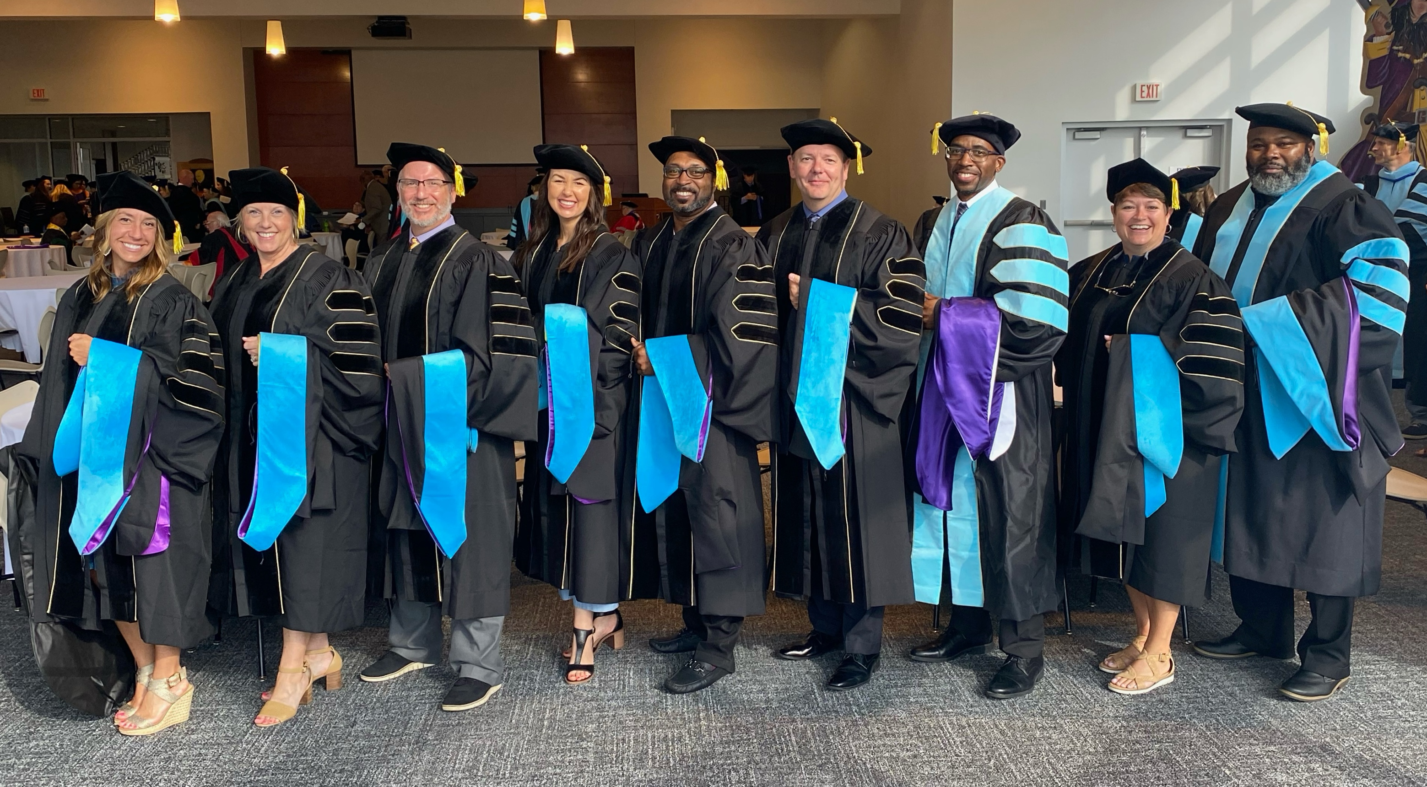
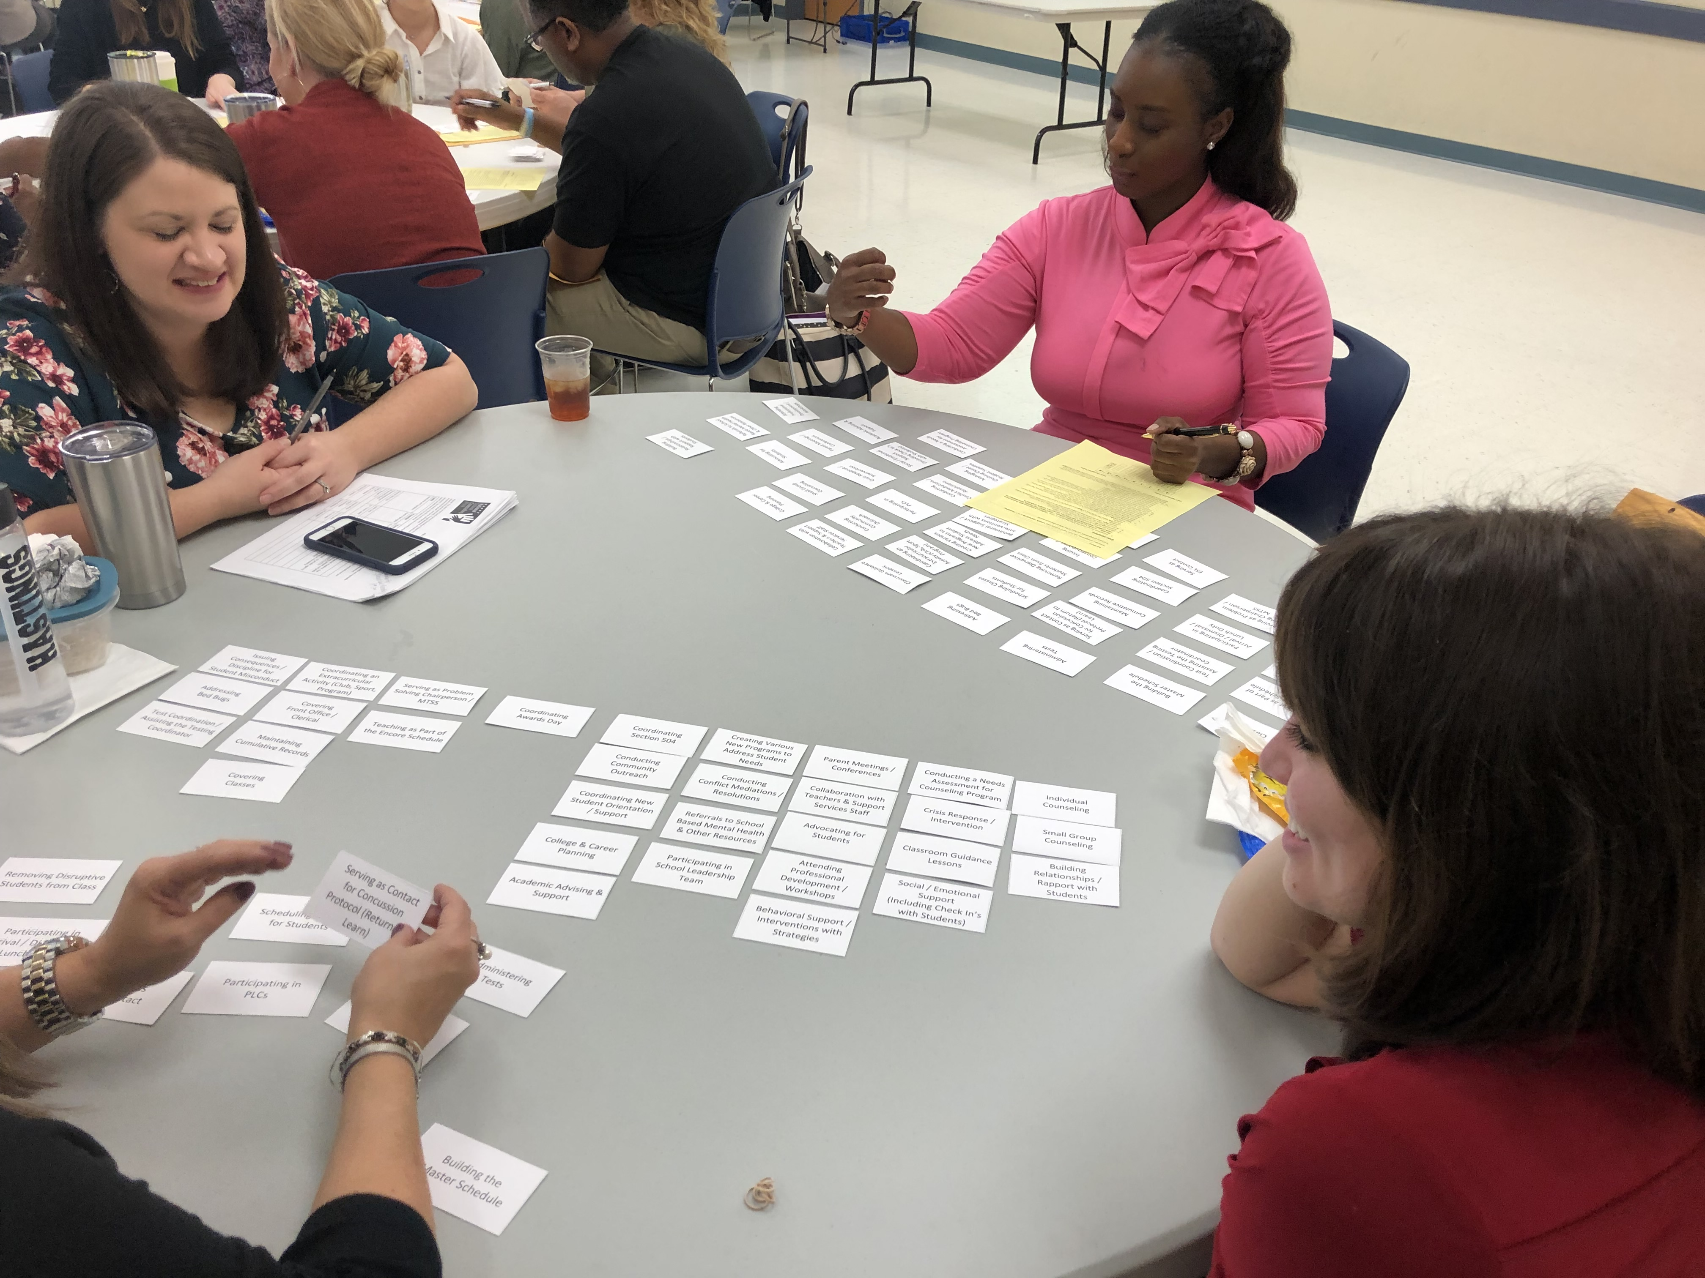
Travis Lewis, EdD
2024-2025 Scholar Teacher
Educational Leadership
College of Education
lewistr16@ecu.edu
Improvement Science in Educational Leadership
Developing K-12 School Administrators & District Superintendents
Related Research Publications & Presentations
In the EdD program at ECU, K-12 education leaders learn and apply improvement science methodology through carefully-designed courses aligned with an identified problem of practice in the respective school or district where they currently serve as an administrator.
My research includes examining effective pedagogical practices surrounding this approach to developing school administrators who can thoughtfully lead continuous school and district improvement.
Findings from this research indicate that doctoral students become more reflective leaders through the methods taught and applied in the ECU EdD program, including:
Cause & Effect (Fishbone) Analysis
Driver Diagramming
Pitch Presentations with Supervisors
Plan-Do-Study-Act (PDSA) Improvement Cycles
Community Learning Exchanges (CLEs)
Problem of Practice Poster Gallery Walks
Jones, K. D., & Lewis, T. E. (2024, November). Utilizing improvement
science for advancing school and district change. Presented at the 2024
Northeast Regional Education Service Alliance (NERESA) Fall
Leadership Conference. Kitty Hawk, NC.
Lewis, T. E., & Hodgkins, L, Maness, K., & Casey, M. (2024, March).
Effective principal practices in support of beginning teachers. Presented
at the 2024 North Carolina Association of School Administrators
(NCASA) Conference on Educational Leadership. Wilmington, NC.
Jones, K. D., & Lewis, T. E. (2023). Connecting the dots: Program coordinator as school district-university partnership facilitator. In N. A. Paufler & E. H. Reames (Eds.) Navigating the Ubiquitous, Misunderstood, and Evolving Role of the Educational Leadership Program Coordinator in Higher Education, Information Age Publishing.
Lewis, T. E., Jones, K. D., Ringler, M. (2023, October). Master’s to
specialist to the EdD: Developing & sustaining scholarly practitioners
across degree programs. Presented at the 2023 Carnegie Project for
Education Doctorate (CPED) Virtual Convening.
Lewis, T. E., Puckett, H., & Novey, D. (2022). Leading the leaders: The
redesign of an EdD program to prepare superintendents to serve North
Carolina schools. Journal of Organizational & Educational Leadership,
7(2), Article 3. https://digitalcommons.gardner-webb.edu/joel/vol7/iss2/3
Puckett, H., & Lewis, T. E. (2022). Do I really belong here? EdD student perceptions of a poster gallery walk to mitigate imposter syndrome and match with a dissertation chair. International Journal of Educational Leadership Preparation, 17(1), 101-116. https://www.icpel.org/uploads/ 1/5/6/2/15622000/ijelp_volume_1_spring_2022.pdf
Lewis, T. E., Puckett, H., & Siegel, D. J. (2021) Making our pitch: Engaging practitioner supervisors in the development of the dissertation in practice. Journal of Research on Leadership Education, 18(2), 159-180.doi: 10.1177/194227751211055087
Problem of practice poster gallery walk with EdD doctoral candidates and ECU College of Education Faculty.
Cause & effect analysis of feelings of imposter syndrome among EdD doctoral candidates themselves.
Pitch presentations with doctoral students’ workplace supervisors regarding their dissertation in practice topic.
Q methodology data collection on the perceptions of school administrators on the appropriate role of school counselors.
EdD Class of 2027

