Slide 1



Understanding Ethics and Policies of Using AI for Research

Slide 2


Agenda
What is AI?
Copyright
Journal Policies
General Ethics

Slide 3
This is the worst ai will ever be
And what’s true today might not be tomorrow

Slide 4
What is Generative ai
Finds words roughly 80% most likely to come next; cannot evaluate what is True
Literally runs on bias- the more a word or concept appears in training data the more likely it is to appear in the generated response
Relies on large amounts of training data scraped from web
Views all data equally (scholarly journals, Reddit threads, and joke websites are viewed as equal sources); or if there are weights, we don’t know them
We don’t know where all the data is coming from

Slide 5
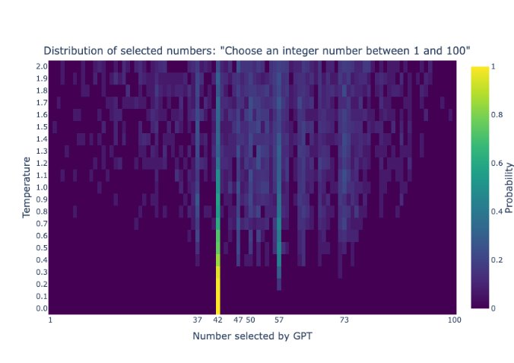
More than one type of bias
Specht (2023) "42: GPT's answer to life, the universe, and everything" Lenio Labs

Slide 6
What scholarly research do Ai companies have
Taylor and Francis/Routledge and Wiley announced that they sold content to ai companies

Slide 7
A note on Copyright
I am not a lawyer

Slide 8
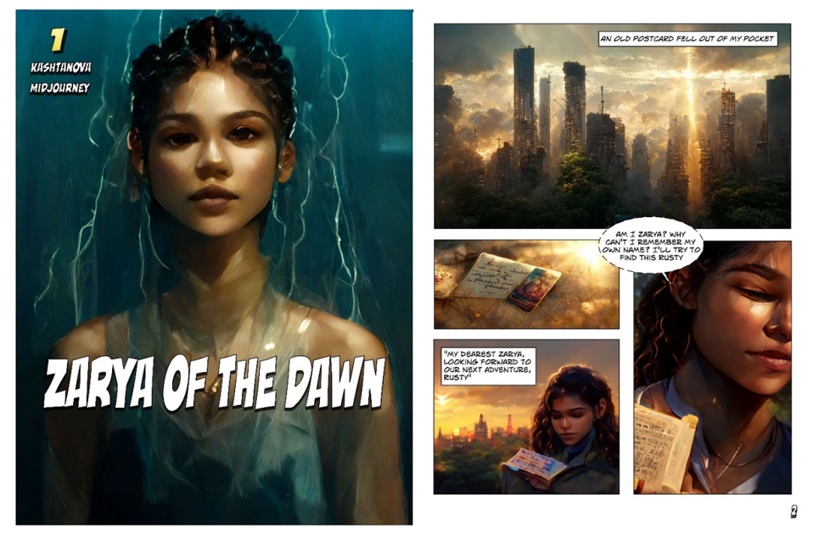
Input vs output
Input/training data
Fair use (for now)
  Several lawsuits may change this
Publishers contracts override copyright
‘Distilling’ or creating an AI model from the data/outputs of other AI models may be copyright infringement
Output/text and image generation
Not copyrightable as is
  Works where you share tasks with AI could still be, but AI components will not
If you had copyright of the input, you still have copyright of that portion of the output
Prompts are currently not copyrightable

Slide 9
IP vs copyright
Intellectual property
copyright
Any intellectual creation
Can cover things that are in multiple instances, trademarks, patent, and copyright (Mickey Mouse)
A type of IP
Covers the specific instance of tangible expression (Steamboat Willie, Mickey Mouse Clubhouse, Disneyland mascot)
AI outputs might not be a violation of copyright, but still be a violation of IP

Slide 10

Why should you care?
“There’s a chance that scientists using [Deepseek] R1 could be forced to retract papers, if using the model was considered a violation of the journal's ethical standards, says Ana Catarina De Alencar, a lawyer at EIT Manufacturing in Paris who specializes in AI law. A similar situation could apply to the use of models by OpenAI and other firms accused of intellectual-property violations, says De Alencar.” –What Are the Best Tools for Research? Nature’s Guide

Slide 11
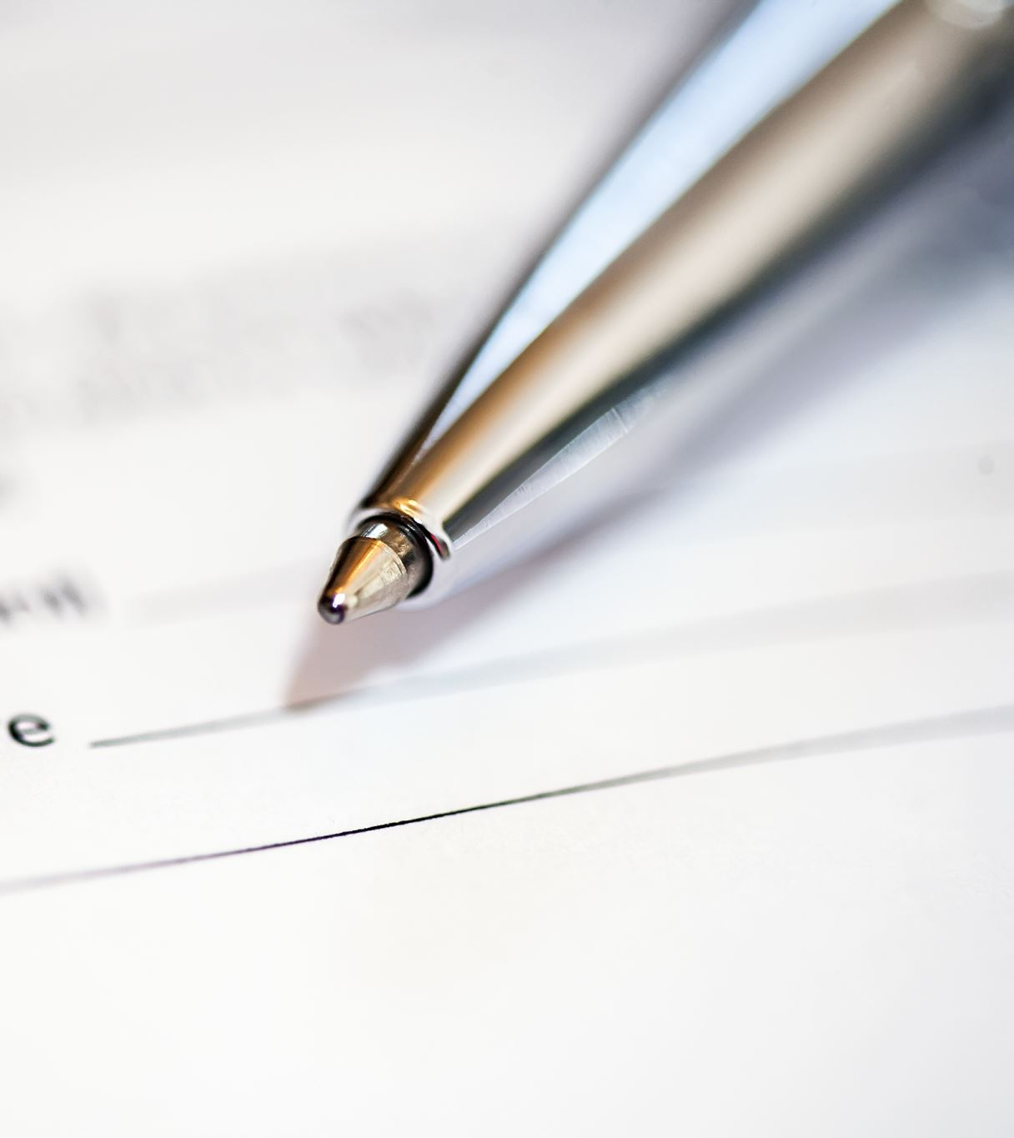
policies

Slide 12
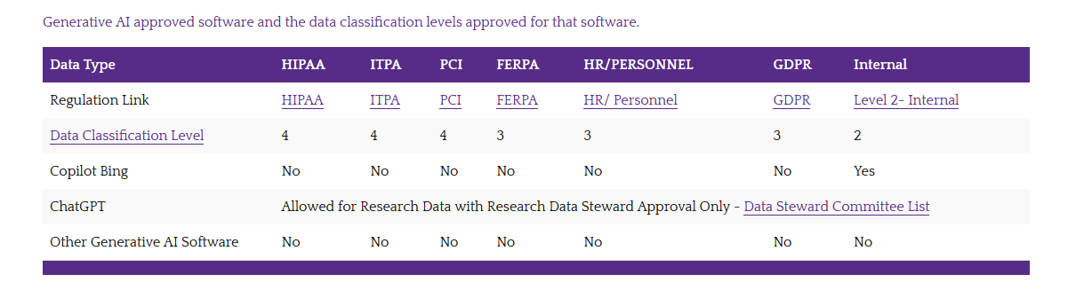
ECU AI and Data policy

Slide 13
Note on Deepseek
No guidance from UNC, but NC department of IT has declared it high risk and urges researchers to use caution

Slide 14
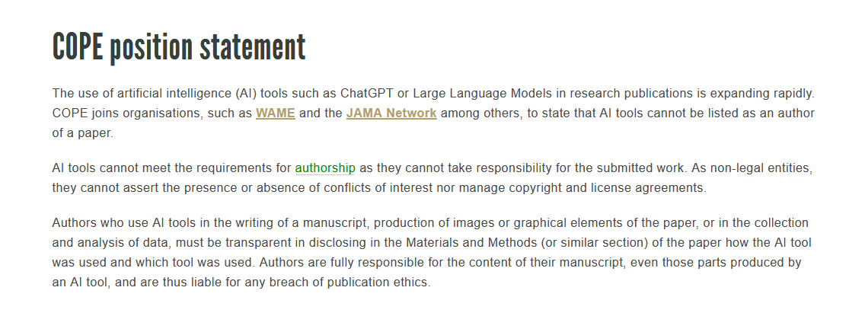
Ai and research articles
Check journal requirements
Disclosure is always required (methods or acknowledgements section)
AI not usually allowed for creating whole code for analyzing data or filling gaps for core research data
Some not allowed for figures, images, etc
AI is allowed for brainstorming, grammar, and structure: no disclosure needed

Slide 15
What to disclose
What model (and version number)
What aspects were affected/generated
How you checked it for accuracy

Slide 16
Other AI Policies
Taylor and Francis https://taylorandfrancis.com/our-policies/ai-policy/
Wiley https://www.wiley.com/en-us/terms-of-use/ai-principles; https://authorservices.wiley.com/ethics-guidelines/index.html#22
Elsevier Books https://www.elsevier.com/about/policies-and-standards/the-use-of-generative-ai-and-ai-assisted-technologies-in-writing-for-Elsevier; Elsevier Journals https://www.elsevier.com/about/policies-and-standards/generative-ai-policies-for-journals
Springer https://www.springer.com/gp/editorial-policies/artificial-intelligence--ai-/25428500?srsltid=AfmBOoq4zp1-UhBbxF1bsJFzrwtoI6jOxIvU2csNEBFXksbaTd0VZgFl
SAGE https://us.sagepub.com/en-us/nam/artificial-intelligence-policy
PLOS https://journals.plos.org/plosone/s/ethical-publishing-practice#loc-artificial-intelligence-tools-and-technologies

Slide 17
AI Assisted v AI Generated
Assisted- no disclosure needed
Generated- disclosure needed
Grammar
Outlining
Searching (except systemic reviews)
Translation
Figure generation
Text generation

Slide 18
To cite or not to cite
AI should NOT be listed as an author, most publishers don’t want it cited as an author
APA has citation guidelines and examples
AI cited as software
different requirements/ideas about whether the prompt or whole chat conversation should be included
Perplexity and other AIs that give you the citation- you should cite (and use) the original source
Read more here

Slide 19

Ai is not an author and cannot be held liable for mistakes

Slide 20
IS disclosure needed?
You ask copilot to create an outline for your conference presentation

Slide 21
IS disclosure needed?
You give chatgpt your written article and ask it to generate an abstract

Slide 22
IS disclosure needed?
You give an ai your survey data and ask for a sentiment analysis (analyzing if comments were positive or negative)

Slide 23
IS disclosure needed?
You use an ai search engine to find and create summaries of articles before choosing and reading ones to use for your literature review

Slide 24
IS disclosure needed?
You ask Claude.ai how to code specific things- ex. what libraries to import, change line height in your tables, etc

Slide 25
Peer review
Data privacy issues
Bias
White Text and Jailbreaking
Journals are mixed
COPE lays out requirements
AI alone should not do peer review- one stage in the process
Check with the editors before putting a paper you are peer reviewing into any AI

Slide 26
Ethics considerations

Slide 27
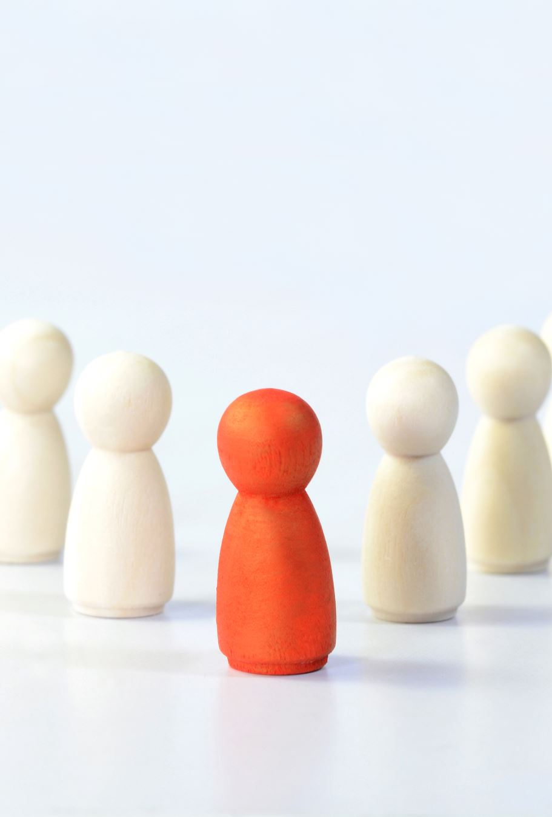
Hallucinations
Human (with subject expertise) intervention always needed to ensure that information is accurate

Slide 28
Data privacy
Black box with no info on what is being done with the information
01
Putting student work in violates ferpa/patient data violates hippa etc
02
Currently need Data Stewardship Committee approval for any information above level two and only ChatGPT approved
03

Slide 29

Bias
Generated text reflects the commonalities of the English speaking internet, not necessarily the most accurate or up to date information

Slide 30
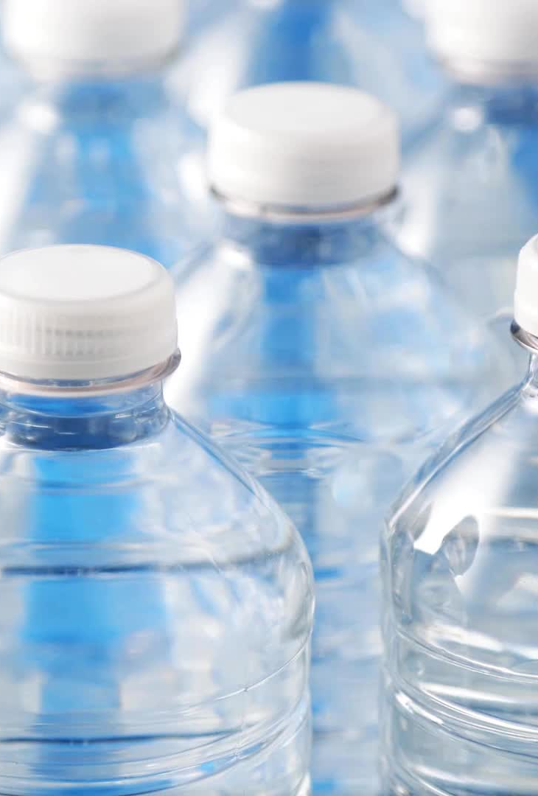
Water usage
AI servers run on water based cooling systems
1-5 prompts takes a full bottle of water- Making AI Less Thirsty
Most data server warehouses are in drought areas

Slide 31
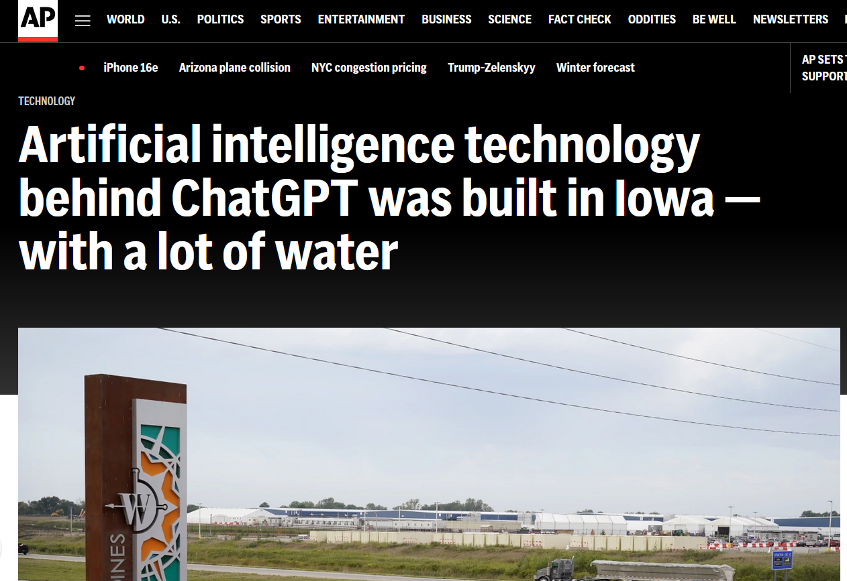
https://apnews.com/article/chatgpt-gpt4-iowa-ai-water-consumption-microsoft-f551fde98083d17a7e8d904f8be822c4

Slide 32
Energy Consumption
New Gen3 reasoning models like Grok 3 (xAI) and Claude 3.7
“These models use over 10^26 FLOPS of computing power in training…equivalent to running a modern smartphone for 634,000 years or the Apollo Guidance Computer that took humans to the moon for 79 trillion years.” –Ethan Molluck one useful thing

Slide 33
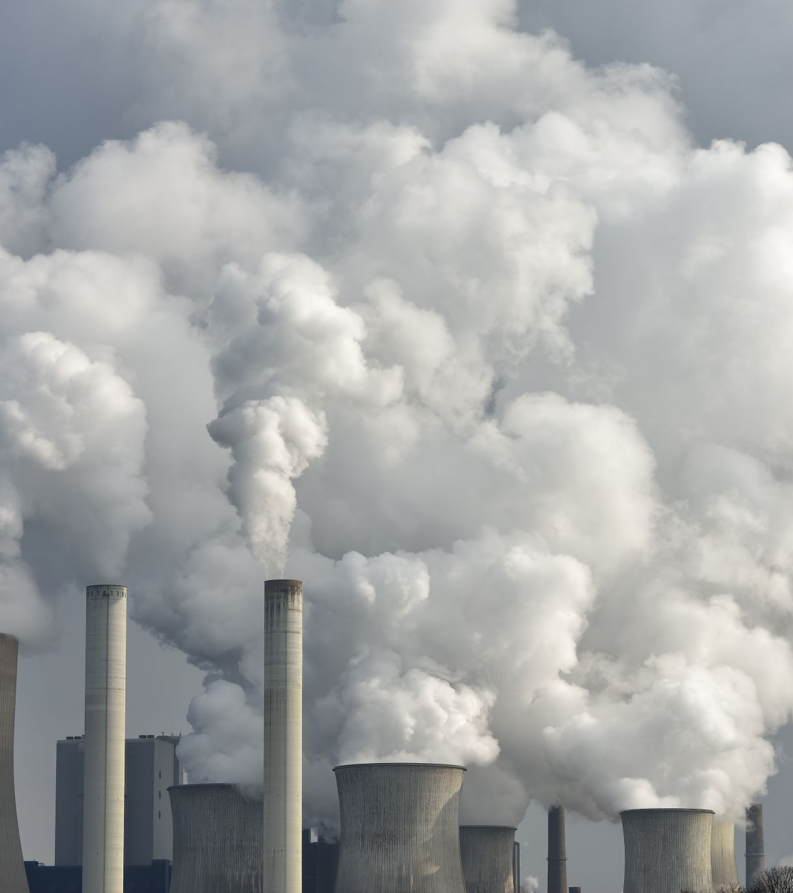
Carbon Emissions
“A report from Morgan Stanley suggests the datacenter industry is on track to emit 2.5 billion tons by 2030, which is three times higher than the predictions if generative AI had not come into play” source
Google reported 48% increase in emissions over last 5 years, Microsoft reported 30% increase source

Slide 34
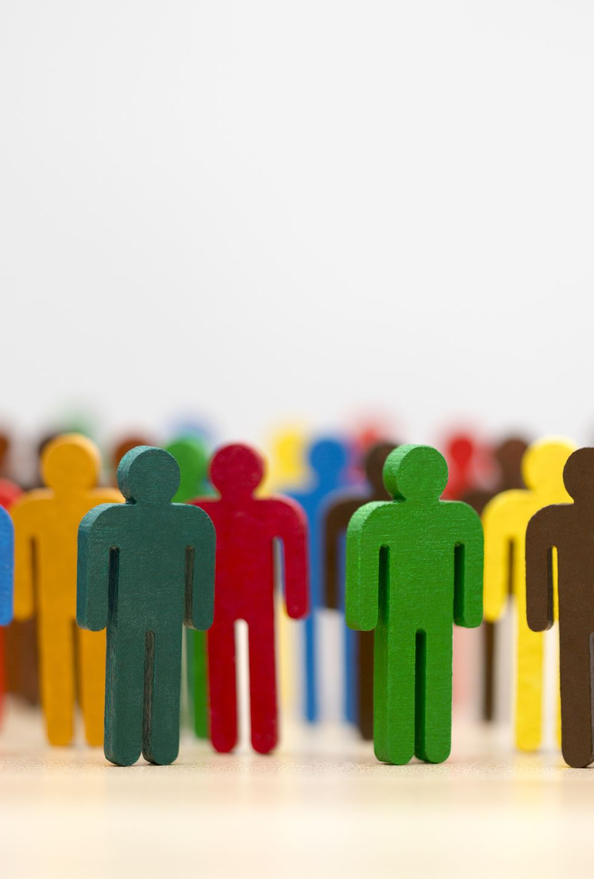
Labor issues
Training AI out of harmful habits takes human labor
Most workers in 3rd world countries paid very little for distressing work

Slide 35

Output is public domain *for now* but ip is still a consideration
Even if the creation is non-copyrightable because there is no human author, If you are using a character, image, or slogan etc. from a corporation they still own the intellectual property

Slide 36
Resources/further reading
Co-intelligence by Ethan Mollick (or Mollick’s newsletter OneUsefulThing https://substack.com/@oneusefulthing)
Affordable Learning Georgia ‘Guidelines for Using Generative AI Tools in Open Educational Resources’
https://www.leniolabs.com/artificial-intelligence/2023/10/04/42-GPTs-answer-to-Life-the-Universe-and-Everything/
https://www.chronicle.com/article/two-major-academic-publishers-signed-deals-with-ai-companies-some-professors-are-outraged
Texas A&M AI for research guide https://guides.library.tamucc.edu/ai
Joyner’s guide to AI for students https://libguides.ecu.edu/artificialintelligence
What is ChatGPT doing… and why does it work? https://writings.stephenwolfram.com/2023/02/what-is-chatgpt-doing-and-why-does-it-work/

Slide 37
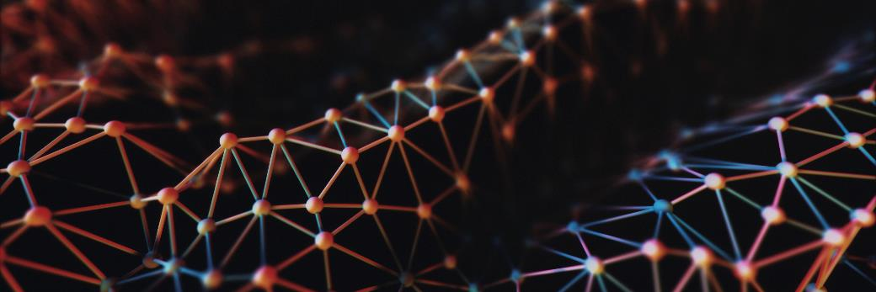
Contact me
kaefringa22@ecu.edu

