Slide 1
You’ve Written Your Article: Now What?
An Introduction to Scholarly Publishing for Early Career Faculty and Grad Students

Slide 2
Agenda
Finding a Journal
Peer Review
Navigating Journal Requirements
Open Access
Post Publication

Slide 3
Finding a Journal
Libguide: https://libguides.ecu.edu/journalpub
https://library.ecu.edu/ > Research Guides > Faculty Resources > Journal Selection and Evaluation
Ask your department if they have a list of preferred journals/look at where your mentors have published
Look at the journals that publish the papers you are citing

Slide 4
Things to consider for journals
Publishing Timeline: one issue a year, special issues only, one issue a month, etc.
What Article Types they Accept: Original research only? Reviews? Case studies? Etc.
Audience: is it a professional/trade or scholarly journal (especially for education journals and other professions)- who do you want to read it/who do you want to influence?
Value/'Prestige': what is the acceptance rate? The citation rate? What does your department/field value?

Slide 5
Avoiding Predatory Publishers
Think check submit
OFE workshop recording
You can always reach out to Scholarycomm@ecu.edu with your journal title if you are unsure

Slide 6
Navigating Journal Requirements
Pre-prints/Dissertations
Contributor Roles Taxonomy (CRediT)- listing authors
Data sharing
OSF
Harvard Dataverse
OFE workshop recording

Slide 7
Journal style requirements
Check section headings such as: about the journal, publish with us, author information, instructions for authors, etc.
Example journals:
Scientific Reports
Communication Studies

Slide 8
Generative Ai
Disclosure required for all journals
which software, for what, how you verified validity of information
Most allow AI for brainstorming and grammar, but journals vary for content creation
check author guidelines or publishing ethics
OFE Workshop recording

Slide 9
Orcid https://orcid.org/
Links your work to YOU (name changes, institution changes, too many John Smiths in Physics, etc.)
Can autofill information for publishers
Can autofill information into Faculty 180
If you would like help, you can email your CV to scholarlycomm@ecu.edu and we can do it for you

Slide 10
ORCId and faculty 180

Slide 11
Funding requirements
Nelson Memo, Gates policy, NIH etc- Open Access Requirements
Gates now requiring preprints and not funding APCs
Data sharing- OSF, Harvard Dataverse, etc
Some grants require funding ID to be submitted as part of article to journal or repository to track compliance

Slide 12
Peer review type
Double blind: author doesn’t know reviewers, reviews don’t know authors
Single blind: reviewers know who the author is, but author doesn’t know reviewers
Open peer review: both authors and reviews are known to each other
Post Publication: used in pre-prints and some books; reviewers post their reviews as public comments on the publication

Slide 13
What you might hear after peer review
Exact language and options varies by publisher, some possibilities include:
Accepted
Accepted with Minimal Revisions
Revise and Resubmit
Out of Journal Scope
some publishers might recommend a different journal in their company that might fit better
Rejected
It can take weeks to months to hear back after submitting your article, exact timelines vary by journal

Slide 14
Be suspicious of email invitations from journals you don’t know

Slide 15
Open Access
Taking research out from behind the paywalls

Slide 16
Types of open access
Diamond:
fully open journal with no fees for authors
Gold:
fully open journal with APCs
Hybrid:
authors can chose to pay APC to have their article open or article will be behind paywall
Green (self archiving):
after embargo author can place article in IR, or personal website

Slide 17
APC (Article Processing Charge/fee)
Publishing costs money (software, formatting, storage, etc)
Even diamond oa has a cost- ECU hosted journals are free to publish in, but Joyner pays some costs and the journal pays a fee (department or society foots the bill)
Fee varies by journal and by discipline
OAPSF- Open Access Publishing Support Fund
Reimburses your department part of the APC

Slide 18
Publishers with waived/reduced fees for ecu authors
Cambridge University Press
PLOS
The Company of Biologists
Frontiers (covers 50%)
IOP Publishing
Sage (10% discount)
Springer Nature
Wiley
IGI
Elsevier (hybrid only)
Mary Ann Libert
See Sustainable Scholarship for more info

Slide 19
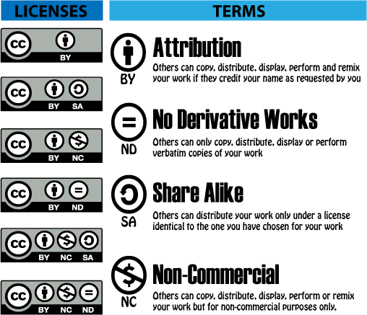
CC licenses

Slide 20
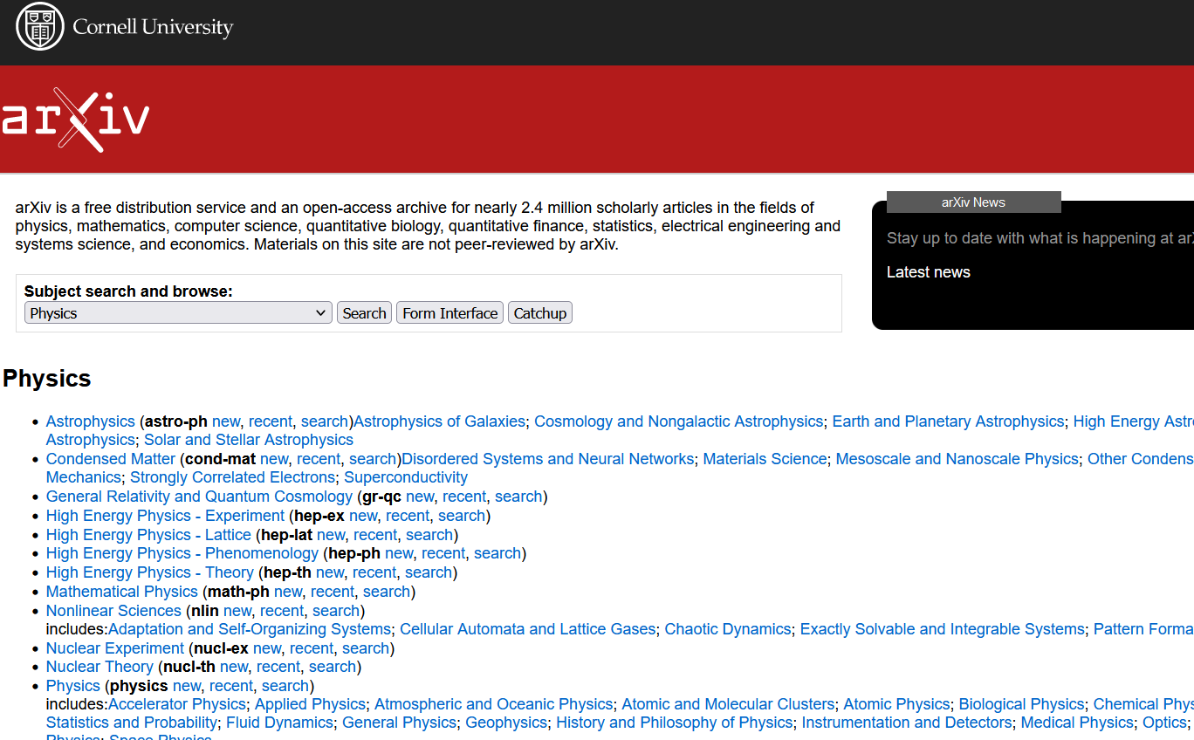
Pre-prints
Common in math, physics, and computer science
Gained popularity during covid when researchers couldn’t wait for peer review to get new research on covid vaccine and medications
Puts article in world before submitting to journal- hinges on open peer review where other researchers comment on the article and the authors adapt/update as they get feedback
Examples: arXiv; ASAPbio preprint directory

Slide 21
Post-Publication
Metrics and Repositories

Slide 22
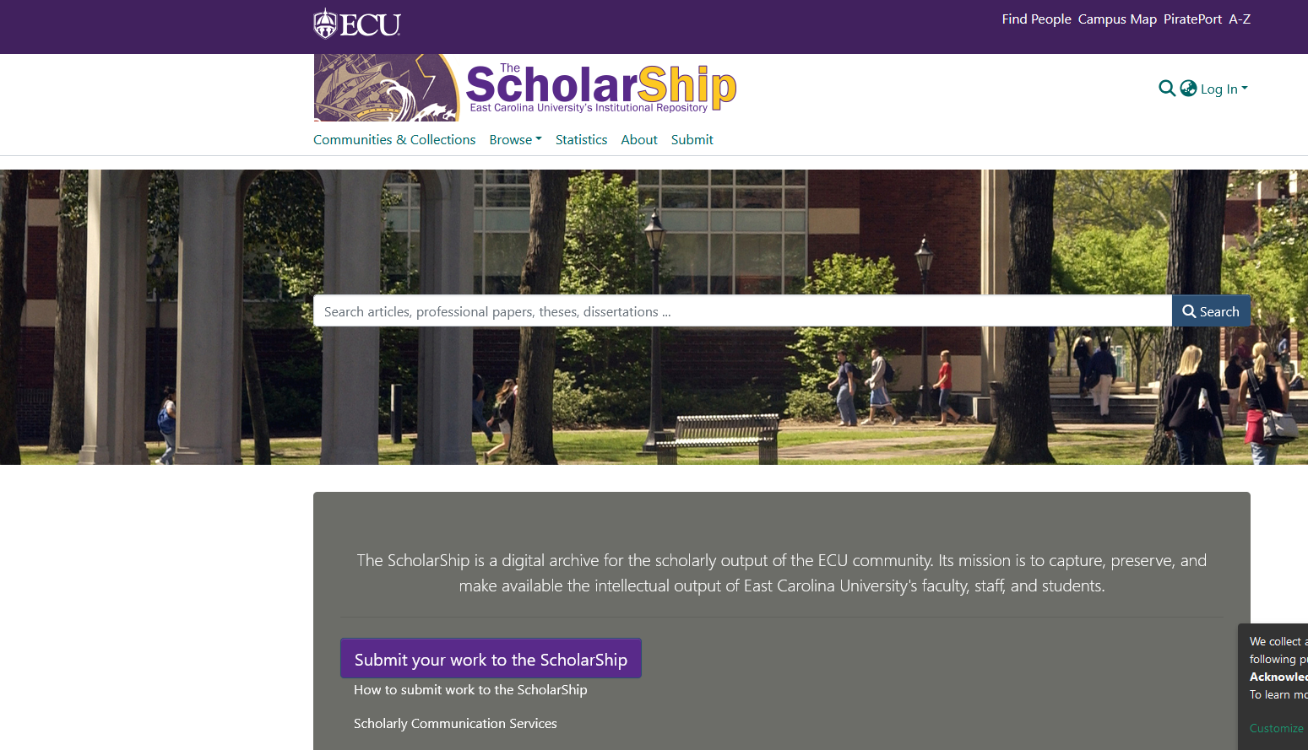
Green Open Access
Repositories
ScholarShip- Institutional Repository https://thescholarship.ecu.edu/home
Research gate https://www.researchgate.net/
Scholars@ECU https://faculty180.ecu.edu/scholars/
Field specific repositories
After an embargo, you can usually put paywalled articles free online in repositories

Slide 23
Metrics
Journal Level
Journal Citation Report- # of citations to articles published 2 years before/ total # of articles published during a 2 year span
SCImago Journal Rank- based on number of journals in database, number of papers from journal in database, number of citations https://www.scimagojr.com/
Article Level
Citation counts- google scholar, proquest database, medline, or publisher platform
Altmetrics- media citations (tweets, blog posts, news mentions, etc.)
OFE Workshop Recording

Slide 24
Thank you!
kaefringa22@ecu.edu
scholarlycomm@ecu.edu

